Slide 1
Arthur H. Compton Lecture Series: An Intro to Climate Systems Engineering
Lecturer: Professor David Keith
22nd November 2025

Slide 2
 | Speakers | Topics
Oct 4 | Keith | Introductions. Climate in 4 Dimensions. Emissions are peaking. Adaptation. Climate in Context.
Oct 11 | Archer | Carbon cycle and natural geochemical processes as basis to understand carbon removal.
Oct 18 | Shaw | Scientific basis for predicting climate changes in response to emissions of greenhouse gases and aerosol pollution.
Oct 25 | Cael | Carbon removal, including ocean alkalinity enhancement, land-based methods, bioenergy with carbon capture, and direct air capture with storage.
Nov 1 | Keith | Sunlight Reflection Methods (SRM) Part 1: How to Reflect Sunlight, the history of SRM, and why stratospheric sulfur aerosols are most plausible now.
Nov 8 | MacAyeal & Keith | MacAyeal on science of glaciers and interventions to prevent glacial melt. Keith on developing DAC technologies at Carbon Engineering, and lessons for cleantech.
Nov 15 | Shaw & Keith | The climate responses to SRM, potential side effects, and what can be learned from past aerosol pollution, highlighting the limits and uncertainties of experiments.
Nov 22 | Keith | The future of climate systems engineering, and climate engineering in context.

Slide 3
Outline
Concerns about reflecting sunlight
Navigating in 4D
Politics

Slide 4
fascism
Sir David Attenborough
"....it’s batshit crazy and a powder-keg for priming a global explosion of the law of unintended consequences."
Anthony Watts of What’s Up With That?
a rogue proposition
Naomi Klein
insane, utterly mad and delusional in the extreme
Al Gore
Notes:
https://slate.com/technology/2015/02/nrc-geoengineering-report-climate-hacking-is-dangerous-and-barking-mad.html
title: "Climate Hacking Is Barking Mad"
Here's another from some climate deniers / skeptics: What's up with that - a climate denial website described it as batshit crazy
https://wattsupwiththat.com/2011/06/17/leaked-smoke-and-mirror-geoengineering-ideas-from-the-ipcc/
"....it’s batshit crazy and a powder-keg for priming a global explosion of the law of unintended consequences."

Slide 5
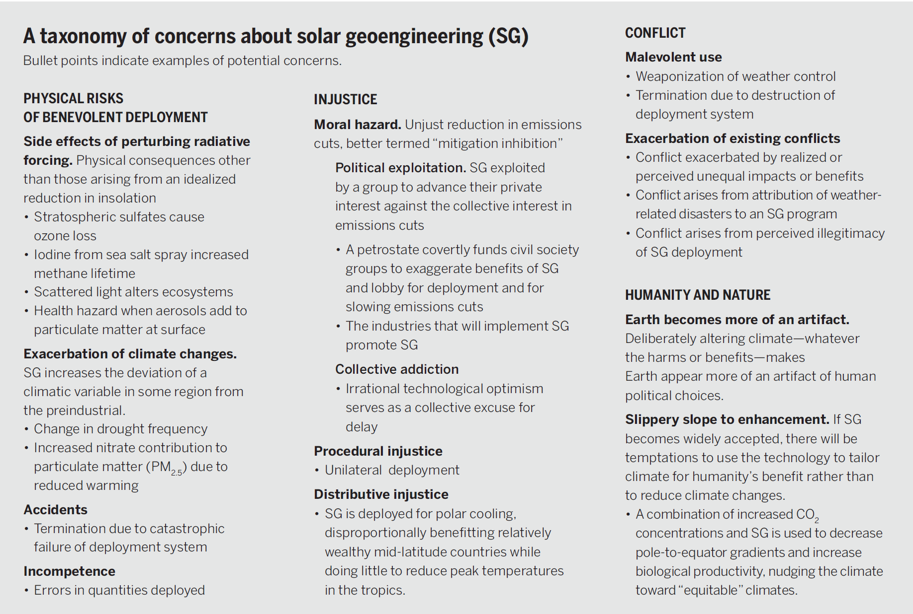
Towards constructive disagreement about geoengineering, David Keith. Science, 2021.

Slide 6
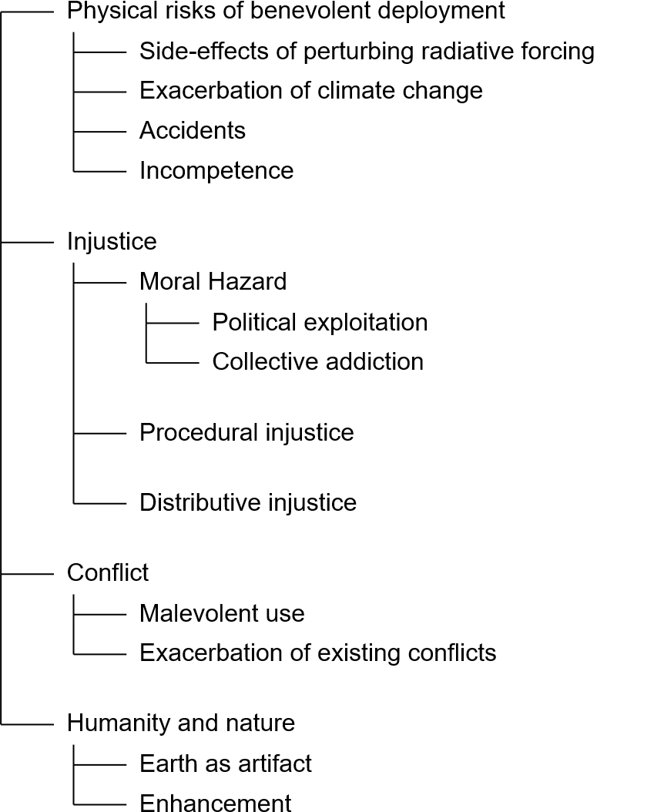
Toward constructive disagreement about geoengineering,
David W. Keith, Science, 2021.

Slide 7
How to navigate in four dimensions?
Economy
Emissions
Concentrations
Climatic change
Impacts
Decarbonization
Carbon removal
Sunlight reflection
Adaptation
Notes:
Each has many sub types, much complexity but more-or-less every physical thing that humans can to do to reduce climate risk fits into one, and only one of these.
And, collapsing any two of these into one, removes an essential part of the problem.

Slide 8

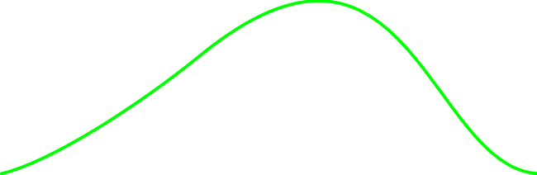
Fossil fuels forever
Emissions cut to zero
Climate risks
SRM
Emissions cuts &
Carbon removal &
Sunlight reflection
Emissions cuts & Carbon removal
Time
Notes:
Fall 2019 version

Slide 9
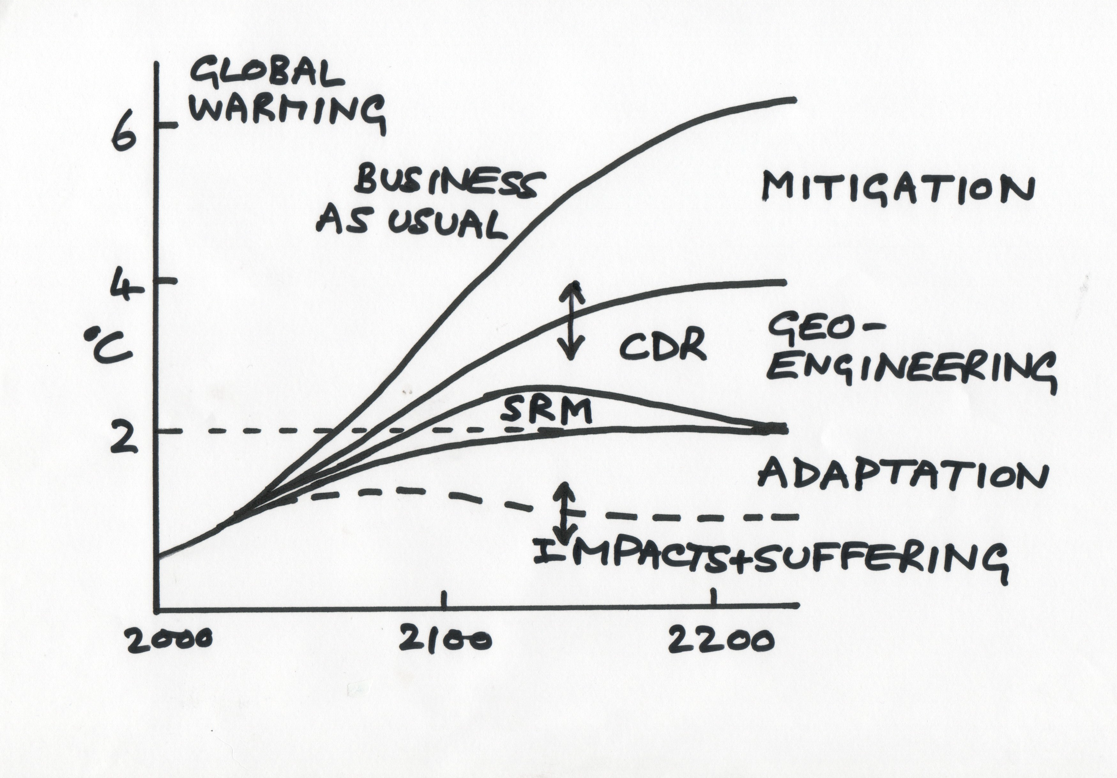
John Shepherd, 2010

Slide 10
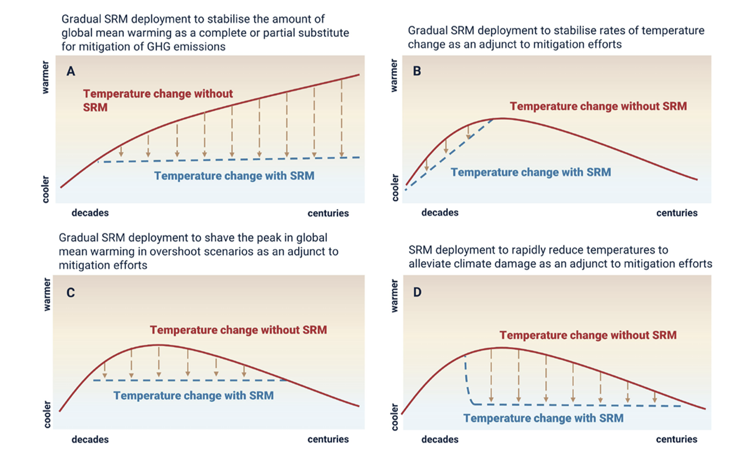

Slide 11
How fast should we cut emissions?

Slide 12
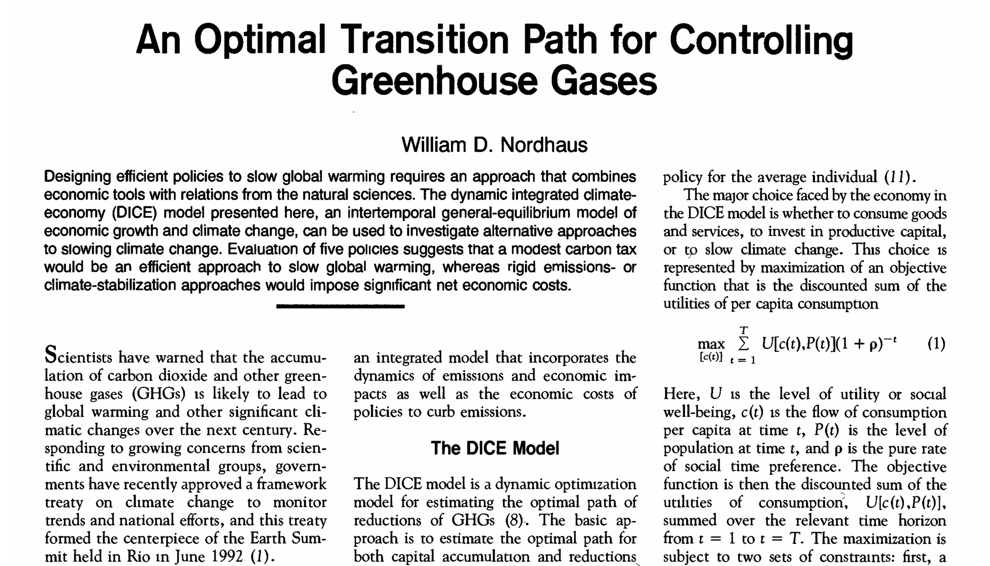

Slide 13
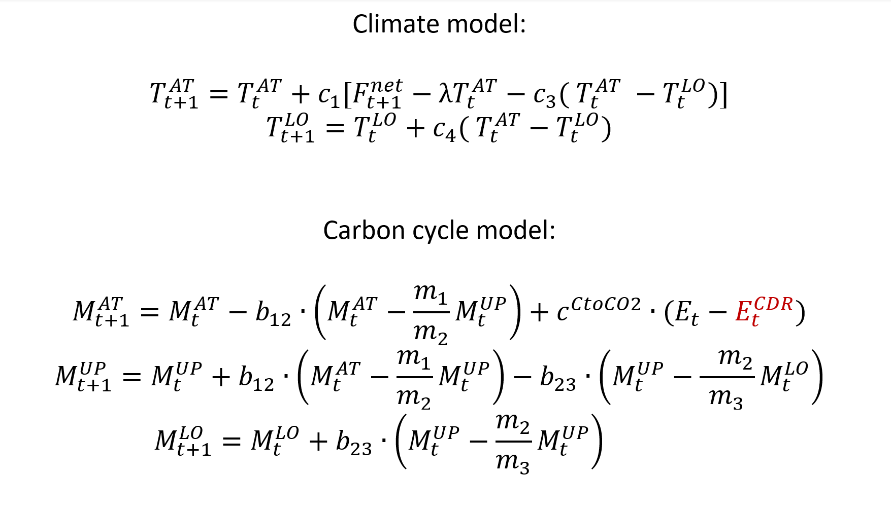
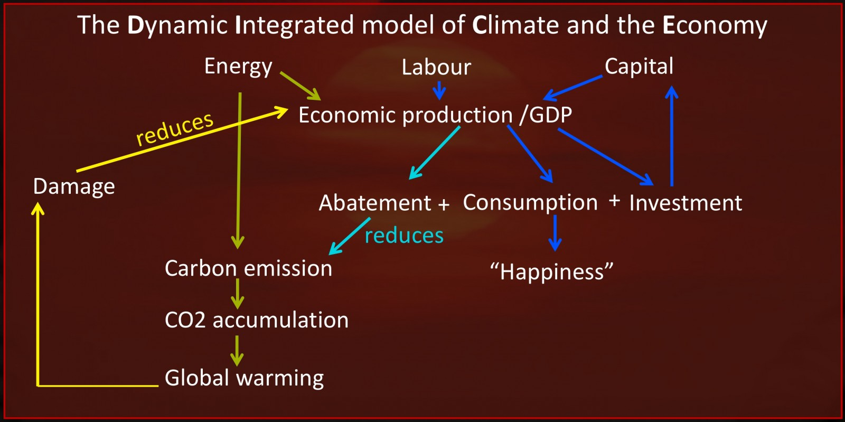
Figure credit: Claudia Wieners, 2018 God does not play DICE – but Bill Nordhaus does! What can models tell us about the economics of climate change?
Notes:
https://blogs.egu.eu/divisions/cl/2018/12/03/god-does-not-play-dice-but-bill-nordhaus-does-what-can-models-tell-us-about-the-economics-of-climate-change/
Claudia Wieners, 2018 God does not play DICE – but Bill Nordhaus does! What can models tell us about the economics of climate change?

Slide 14
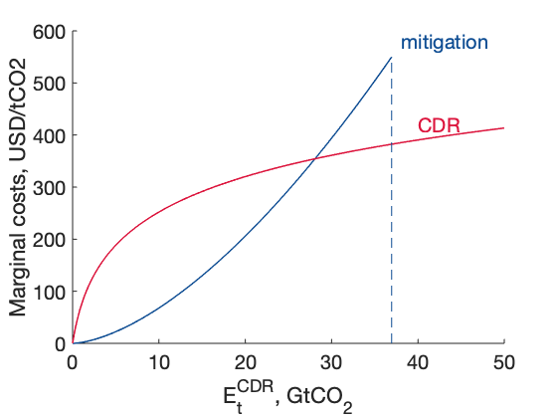
Parametrization of CDR in DICE
Logarithmic function for marginal cost
One free parameter: the fraction of emissions that for which mitigation is cheaper than CDR. We are using 75%
We assume the decline in cost with time is same for CDR and mitigation.

Slide 15
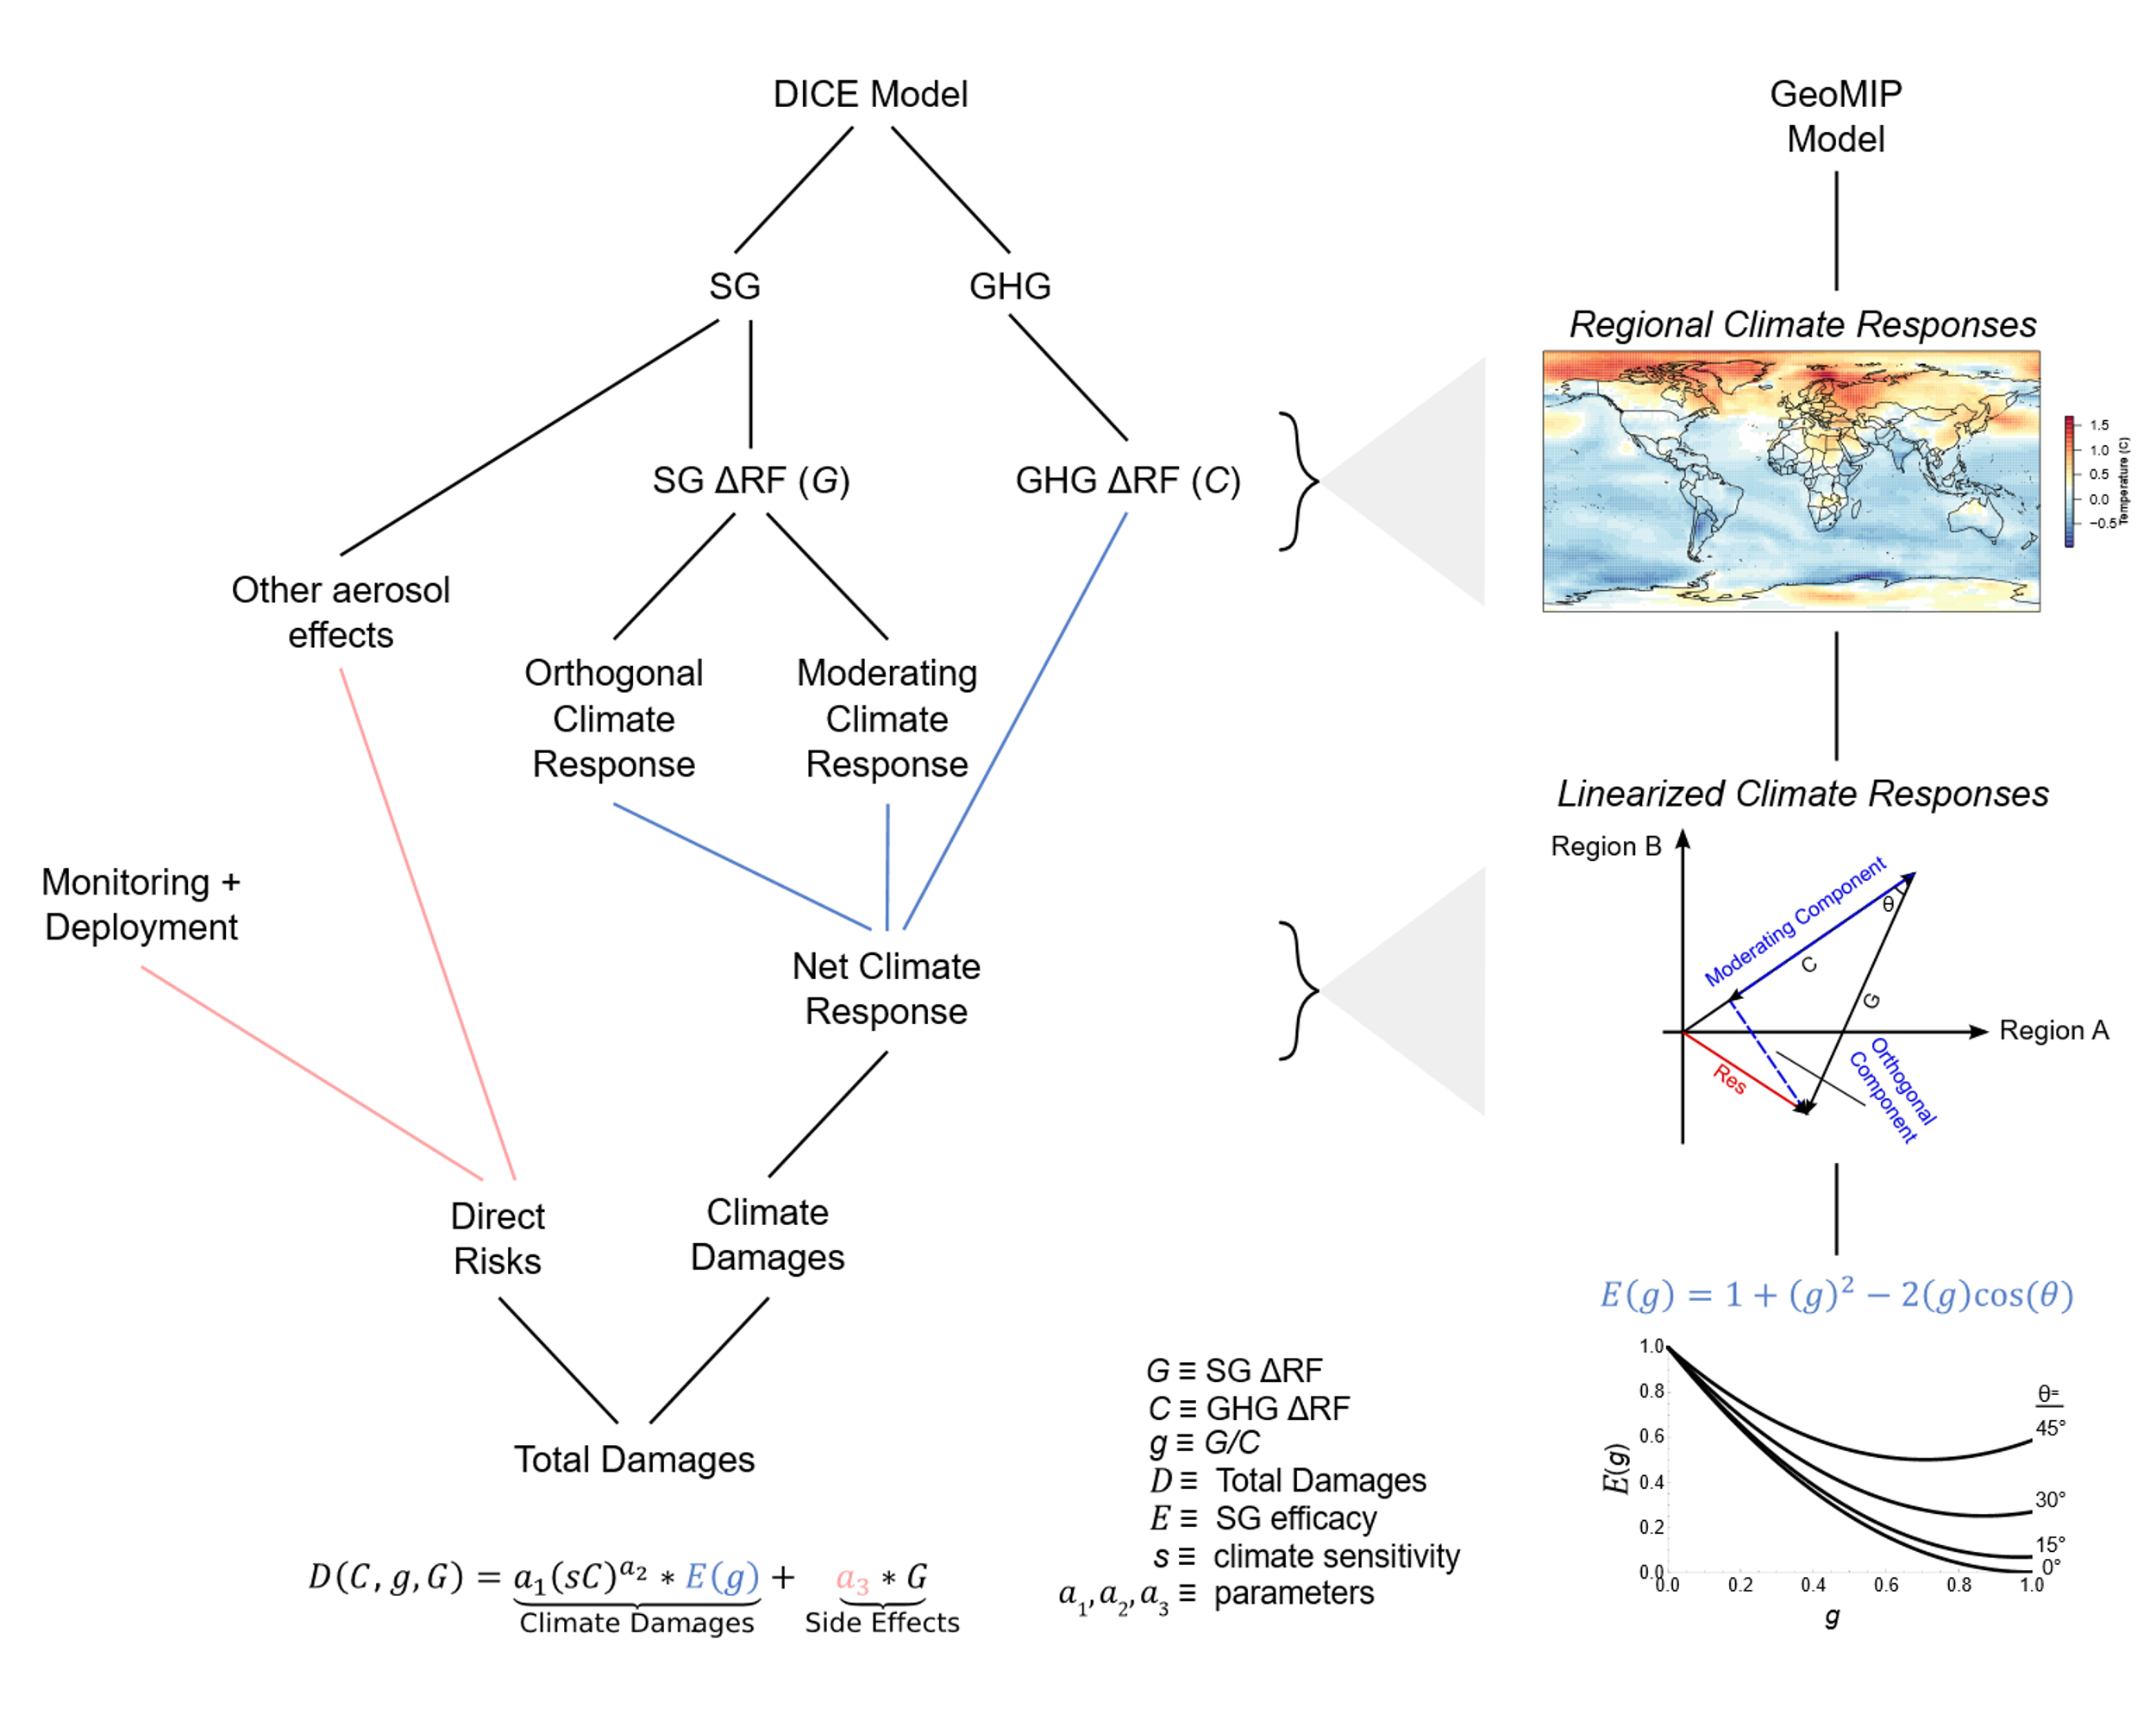

Slide 16
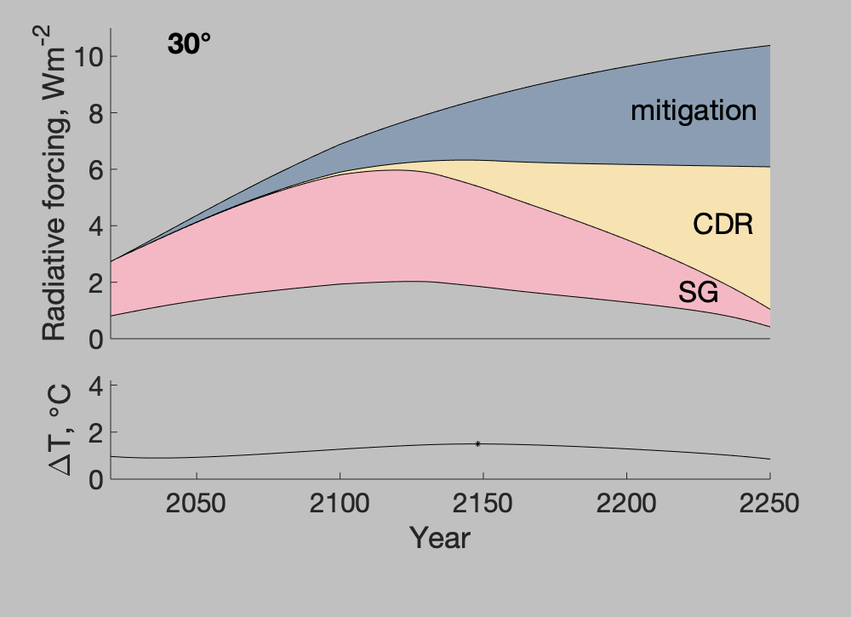
Policy costs: 0.17%
Damage costs: 1.2%
Peak temperature: 1.5°C
Costs and GDP are computed as Net Present Value over 2020-2120, discounted at 3% per year
Optimal climate policy in 3D: mitigation, carbon removal, and solar geoengineering.
Mariia Belaia, Juan Moreno-Cruz, and David Keith. Climate Change Economics, 2021
Notes:
Costs and GDP: NPV over 2020-2120, discounted at 3% per year
Optimal climate policy in three dimensions, Mariia Belaia, Juan Moreno-Cruz, and David Keith

Slide 17
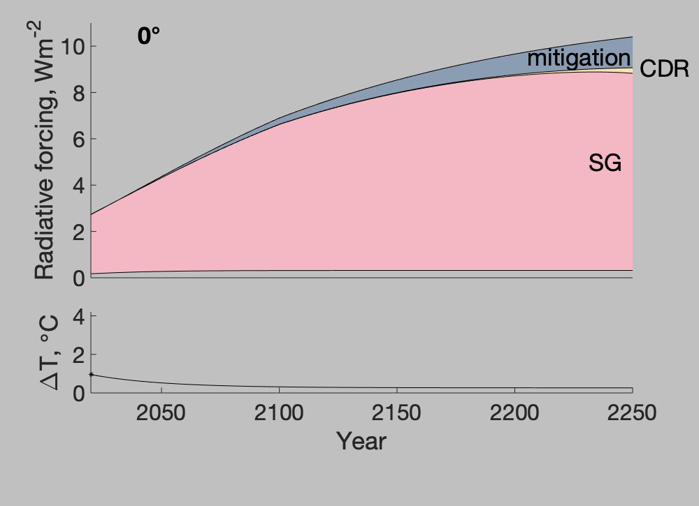
Policy costs: 0.009%
Damage costs: 0.48%
Peak temperature: 1.0°C
Notes:
Costs and GDP: NPV over 2020-2120, discounted at 3% per year

Slide 18
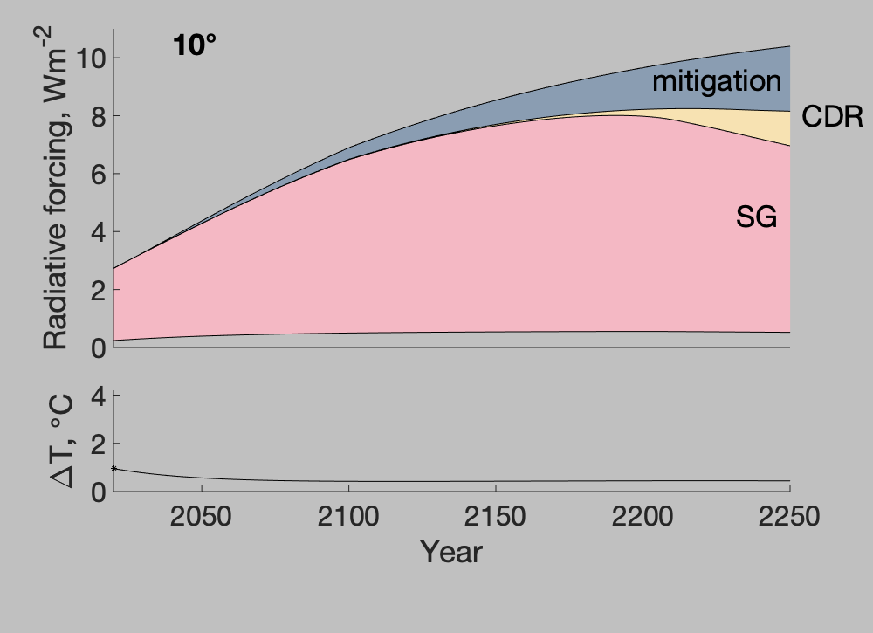
Policy costs: 0.02%
Damage costs: 0.6%.
Peak temperature: 1.0°C

Slide 19
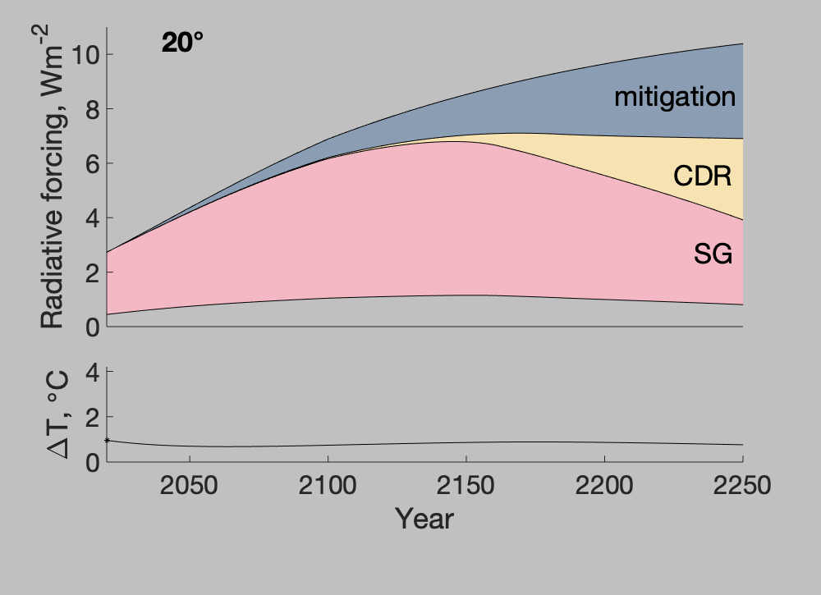
Policy costs: 0.07%
Damage costs: 0.9%
Peak temperature: 1.0°C

Slide 20
Policy costs: 0.17%
Damage costs: 1.2%
Peak temperature: 1.5°C

Slide 21
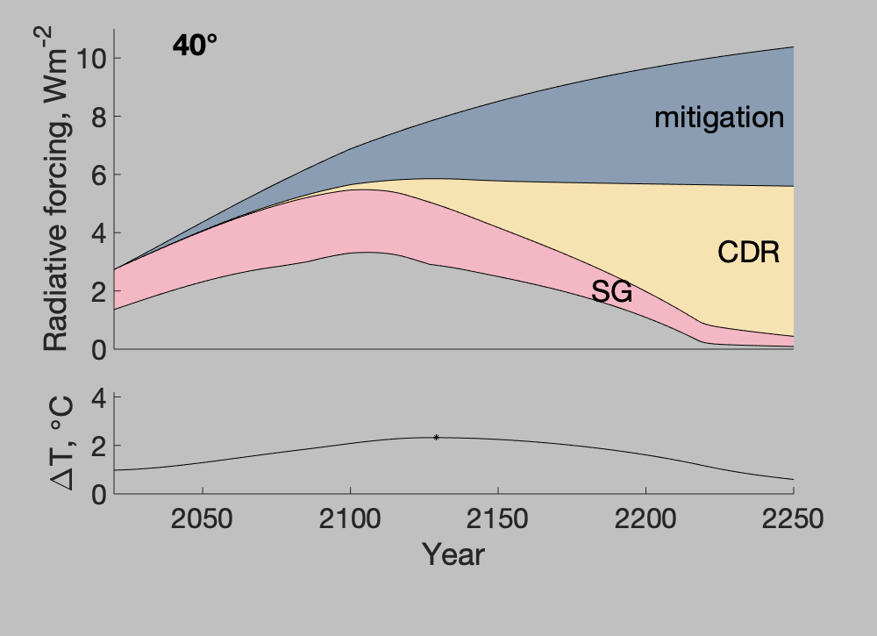
Policy costs: 0.3%
Damage costs: 1.39%
Peak temperature: 2.3°C

Slide 22
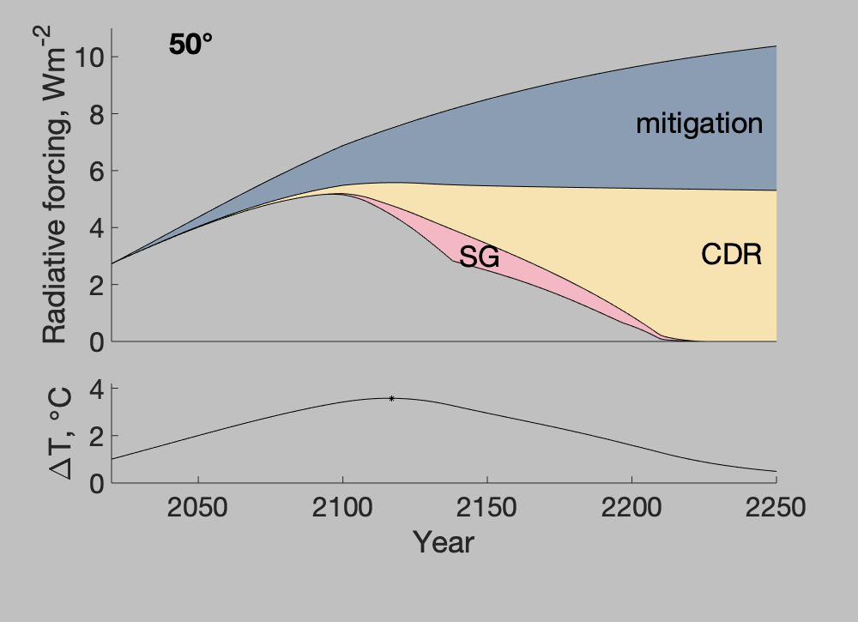
Policy costs: 0.46%
Damage costs: 1.4%
Peak temperature: 3.6°C

Slide 23
Policy costs: 0.17%
Damage costs: 1.2%
Peak temperature: 1.5°C
Costs and GDP are computed as Net Present Value over 2020-2120, discounted at 3% per year
Optimal climate policy in 3D: mitigation, carbon removal, and solar geoengineering.
Mariia Belaia, Juan Moreno-Cruz, and David Keith. Climate Change Economics, 2021
Notes:
Costs and GDP: NPV over 2020-2120, discounted at 3% per year
Optimal climate policy in three dimensions, Mariia Belaia, Juan Moreno-Cruz, and David Keith

Slide 24
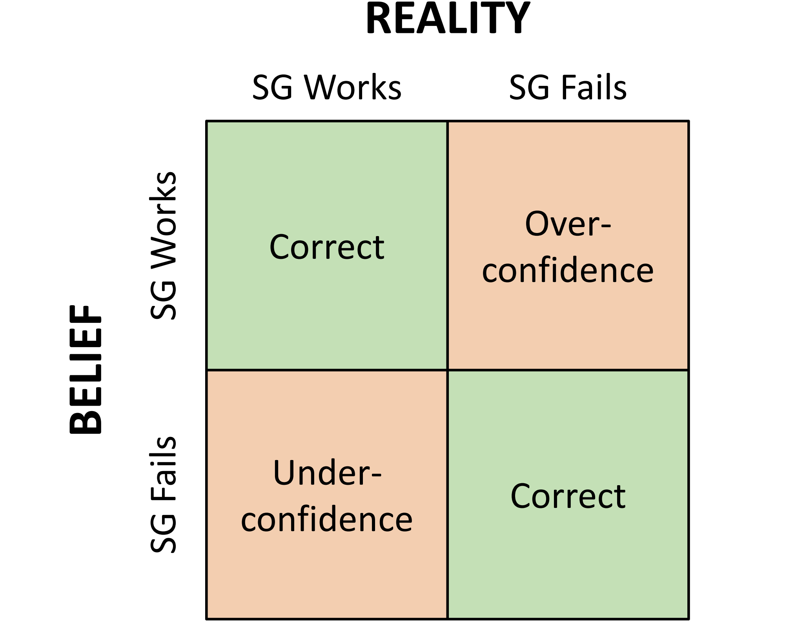
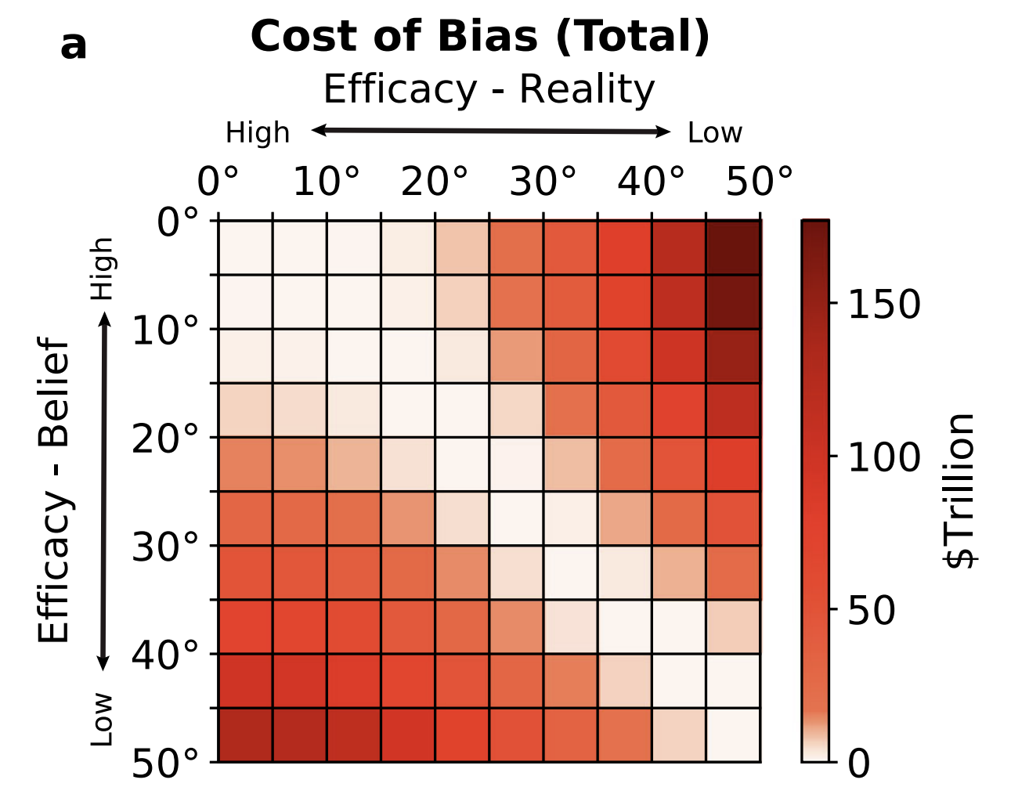
What’s the value of knowing more about SRM?
Reducing uncertainty about performance of SRM by a third in 2030 is worth roughly 4.5 $trillion
Big model full of approximations
Fine print: we compute net present value of optimal policy using a modified version of the Nordhaus DICE model with uncertainty in SRM and in climate sensitivity. Answer depends on many assumptions, but $trillion is right order of magnitude.
The value of information about solar geoengineering and the two-sided cost of bias. Tony Harding, Mariia Belaia, and David Keith. Climate Policy, 2022

Slide 25
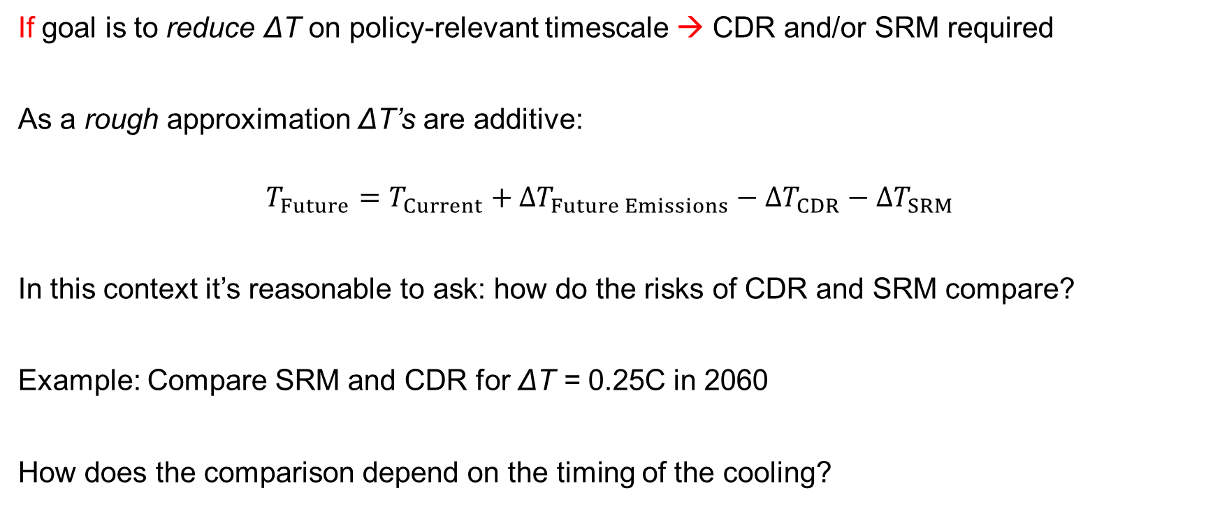
Comparing risks SRM and CDR
If goal is to reduce ΔT on policy-relevant timescale → CDR and/or SRM required
As a rough approximation ΔT’s are additive:
$$T_{Future}=T_{Current}+{∆T}_{Future Emissions}−{∆T}_{CDR}−{∆T}_{SRM}$$
In this context it’s reasonable to ask: how do the risks of CDR and SRM compare?
Example: Compare SRM and CDR for ΔT = 0.25C in 2060
How does the comparison depend on the timing of the cooling?

Slide 26
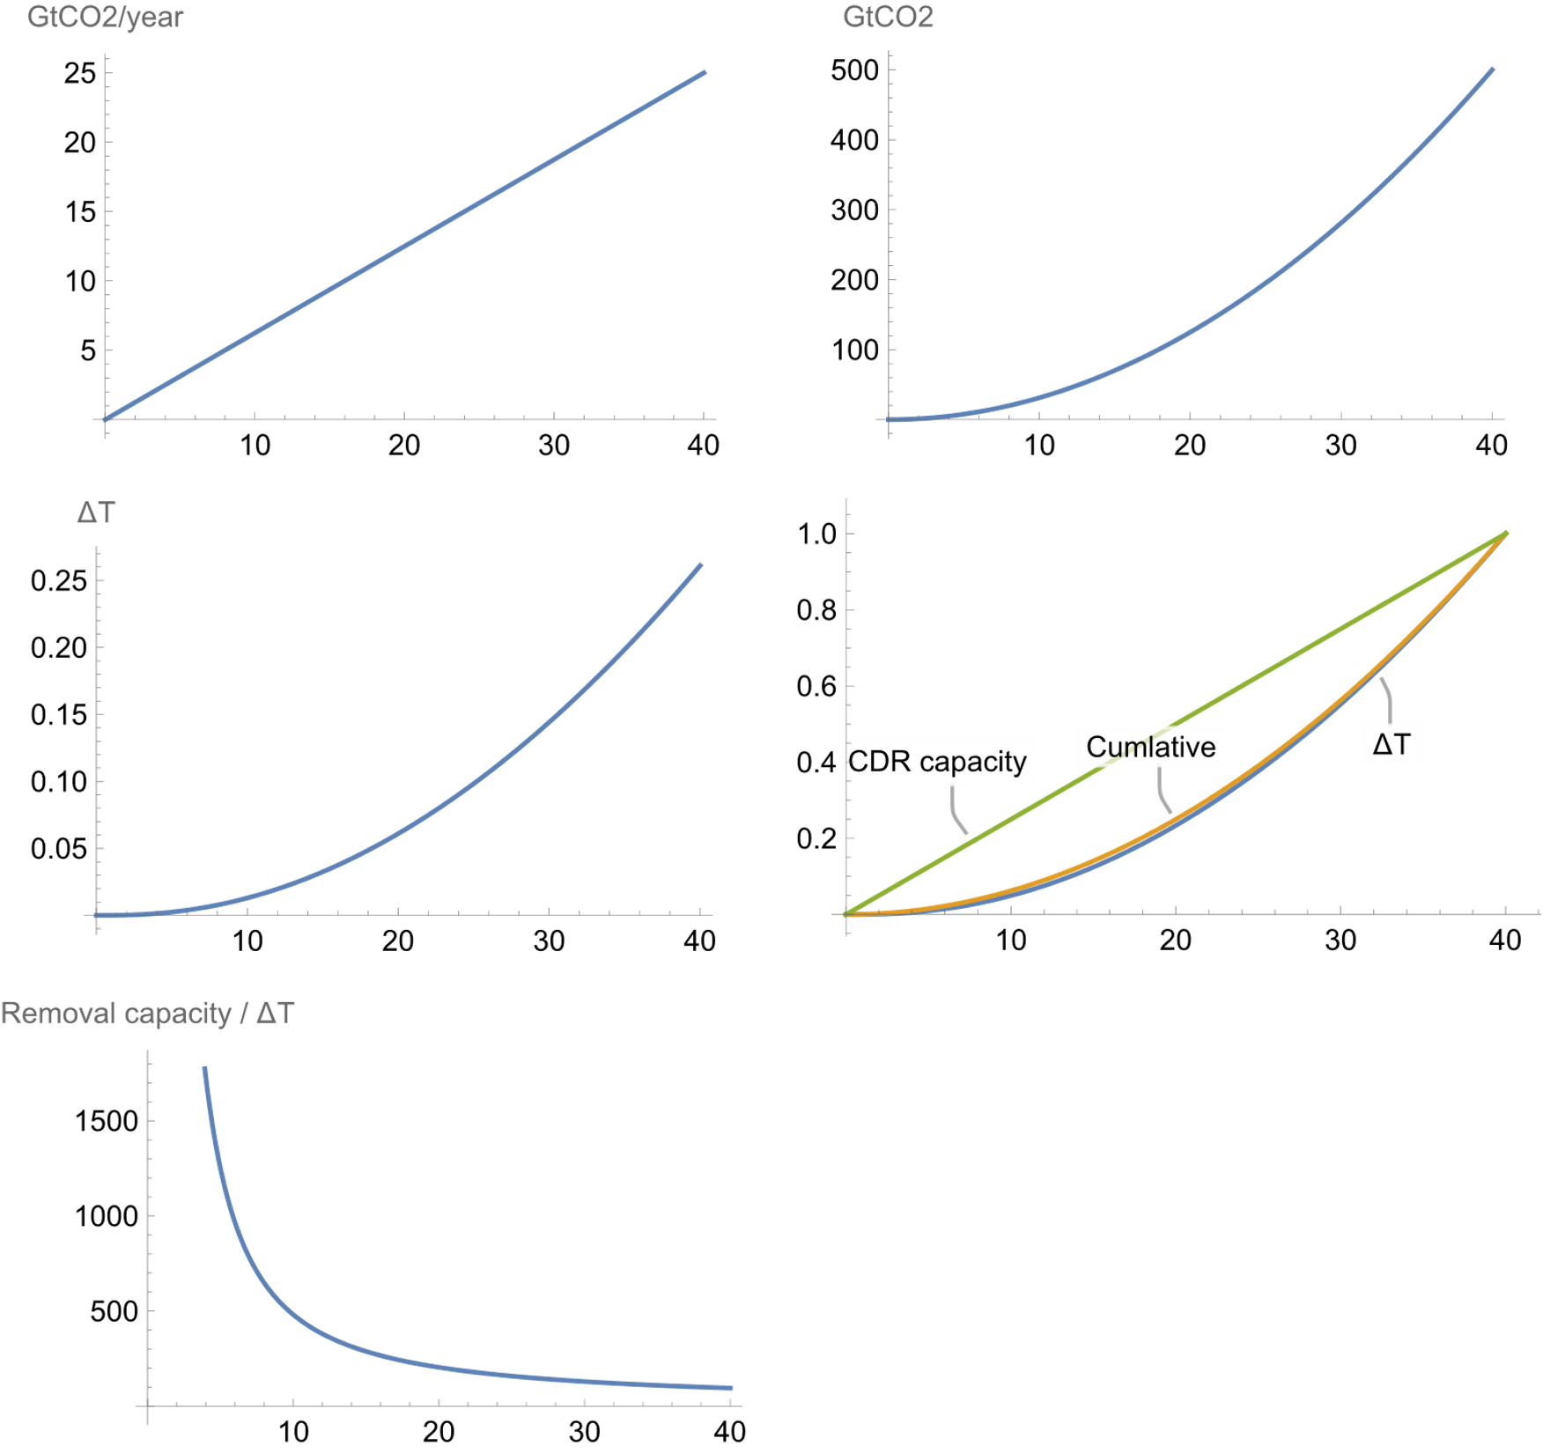
CDR Removal Rate
(Stock of CDR tech)
Cumulative removal
Capacity, removal and T,
normalized to their values @ 40 years
Temperature change due to CDR
Removal-capacity / temperature-change
If you want CDR to lower T fast the
relative weight of construction
impacts becomes very large
Notes:
GtCO2yr⁻¹/K

Slide 27
Example: Air pollution mortality
CDR
Mortality from PM from the across the supply chain
Assume 1500 $/ton-year capacity of DAC + sequestration and energy supply (low now, may be reasonable long-run)
Use current world average deaths/$ GDP of 6×10⁻⁸
Assume mortality/$ for heavy construction = economy avg (underestimate)
SRM
Air quality mortality from SRM
10,000 direct mortality per year for sulfate aerosol SRM doing 1 C from Eastham (2018).
Notes:
1000*.05=50 $

Slide 28
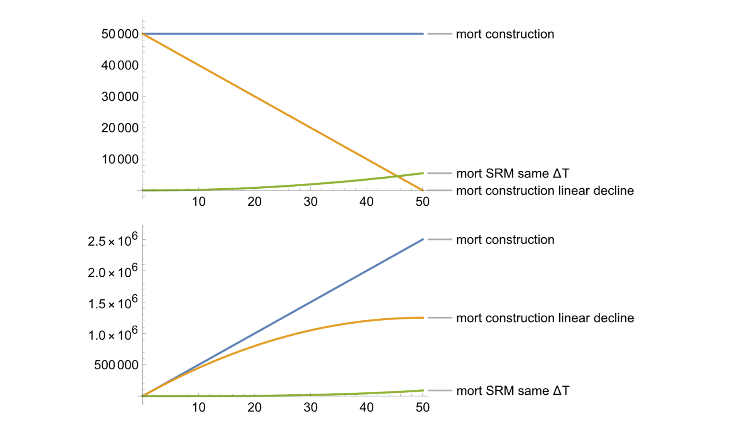
Example 1: Air pollution mortality
Orange line assumes economy cleans over 50 years.
Annual mortality
Cumulative mortality

Slide 29
Comparing risks SRM and CDR
Suppose SRM and CDR are used to achieve the same marginal (small) amount of cooing at some future date:
  If the date is a few century's out → risks of SRM > CDR
  If the date a few decades out → risks of CDR > SRM

Slide 30
Fossil fuels forever
Emissions cut to zero
Climate risks
SRM
Emissions cuts &
Carbon removal &
Sunlight reflection
Emissions cuts & Carbon removal
Time
Notes:
Fall 2019 version

Slide 31
Day Zero
Start large-scale
carbon removal
Start solar
geoengineering
End solar
geoengineering
Climate risks
Start
emission
cuts
SRM
Time
Notes:
Fall 2019 version

Slide 32


emission
cuts
large-scale
carbon removal
solar
geoengineering
Preference
large-scale
carbon removal
solar
geoengineering
emission
cuts
Time
Notes:
To do
Make background of faces grey (save white versions on other slide)
Make faces same size and align ctrs
On time axis, work to make the stack look good with three arrows, and then animate so it goes emissions cuts, SG, CDR

Slide 33


Slide 34
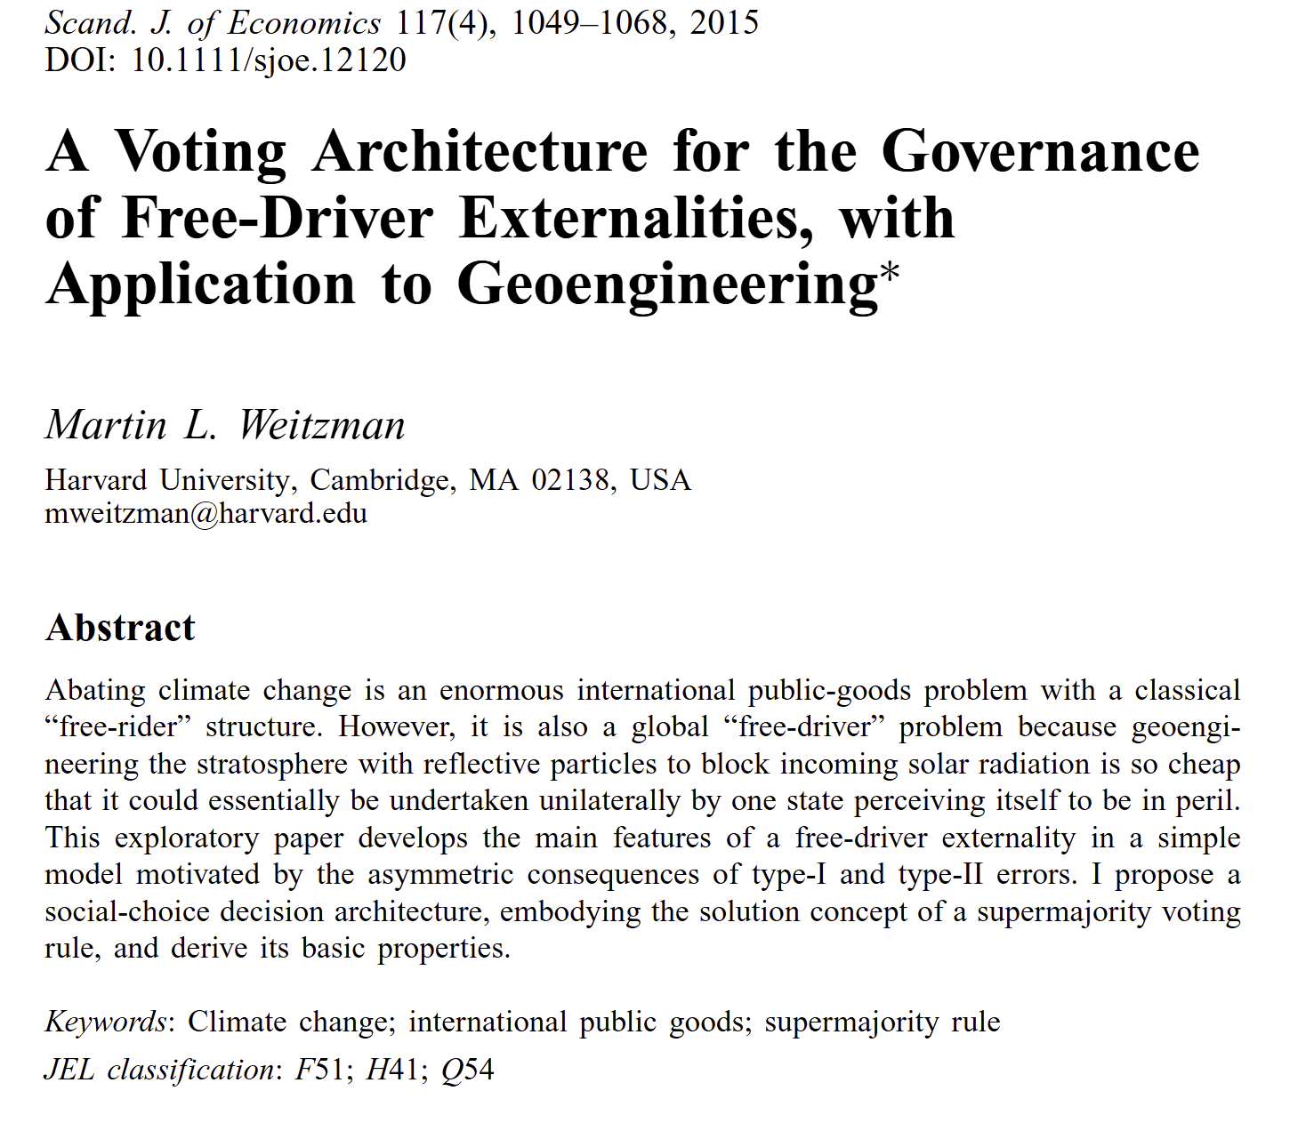

Slide 35
?

