Slide 1
Arthur H. Compton Lecture Series: An Intro to Climate Systems Engineering
Lecturer: Professors David Keith and Tiffany Shaw
15st November 2025

Slide 2
 | Speakers | Topics
Oct 4 | Keith | Introductions. Climate in 4 Dimensions. Emissions are peaking. Adaptation. Climate in Context.
Oct 11 | Archer | Carbon cycle and natural geochemical processes as basis to understand carbon removal.
Oct 18 | Shaw | Scientific basis for predicting climate changes in response to emissions of greenhouse gases and aerosol pollution.
Oct 25 | Cael | Carbon removal, including ocean alkalinity enhancement, land-based methods, bioenergy with carbon capture, and direct air capture with storage.
Nov 1 | Keith | Sunlight Reflection Methods (SRM) Part 1: How to Reflect Sunlight, the history of SRM, and why stratospheric sulfur aerosols are most plausible now.
Nov 8 | MacAyeal & Keith | MacAyeal on science of glaciers and interventions to prevent glacial melt. Keith on developing DAC technologies at Carbon Engineering, and lessons for cleantech.
Nov 15 | Shaw & Keith | The climate responses to SRM, potential side effects, and what can be learned from past aerosol pollution, highlighting the limits and uncertainties of experiments.
Nov 22 | Keith & Shaw | The future of climate systems engineering, and climate engineering in context.

Slide 3
Outline
Keith: How much to trust predictions about the consequences of reflecting sunlight?
Keith: Breaking the problem in half.
Keith: How to control a system you don’t understand?
Shaw: using perturbed physics ensembles to assess uncertainty.
Keith: The case for reliability.
Shaw & Keith: Discussion.

Slide 4
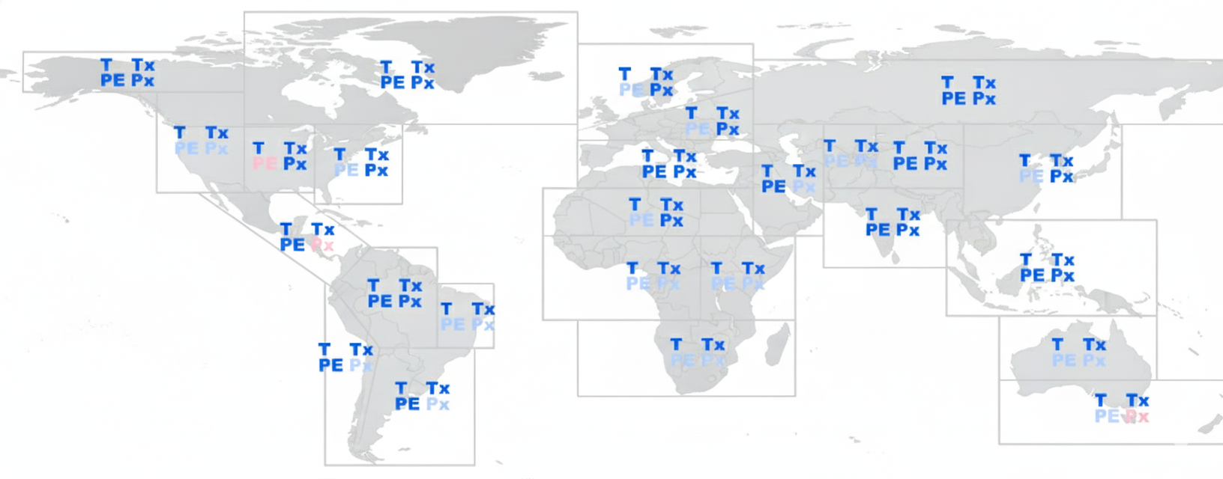
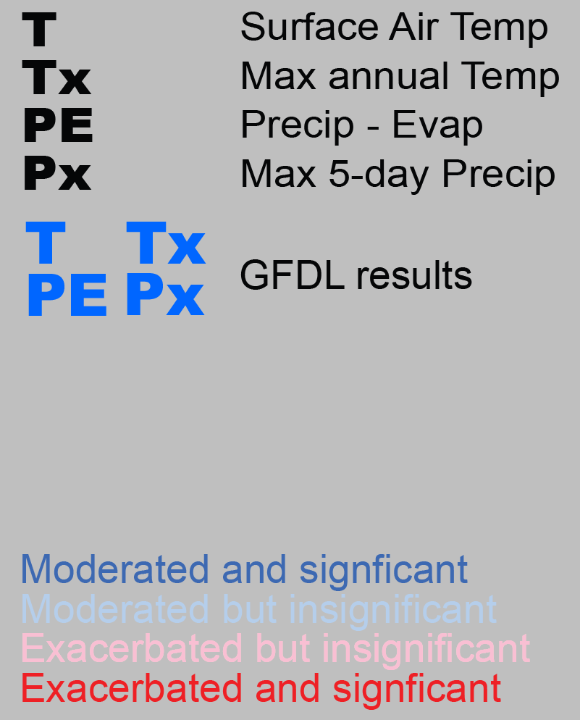
Variable
Effect and statistical significance
Moderated and significant
Moderated but not statistically significant
Exacerbated but not statistically significant
Exacerbated and significant
Moderated = move towards pre-industrial = less climate change ≈ better
Exacerbated = move away from pre-industrial = more climate change ≈ worse
Halving warming with idealized solar geoengineering moderates key climate hazards. Irvine, Emanuel, He, Horowitz, Vecchi, Keith. Nature Climate Change, 2019.

Slide 5
How well can sunlight reflection reduce climate changes?
…it depends
Any statement about performance of SRM is contingent on assumptions about how it’s used
The amount of sunlight reflection (e.g., how much cooling?)
The spatial distribution of reflection (e.g., were is sunlight reflected, how patchy?)
The method used (e.g., sulfur, diamonds, marine cloud brightening, space mirrors?)
Bad choices → bad outcomes
Use SRM as substitute for emission cuts → ocean acidification & risks that grow forever
Use SRM only in northern hemisphere → shift tropical rainfall belt → droughts
Stop suddenly → rapid heating, the termination shock

Slide 6
A scenario
Aerosol
Sulfate aerosol precursors (e.g. H₂S) injected from aircraft in the stratosphere
Aerosol injection adjusted using feedback to be even and to balanced across hemispheres
Cooling starts at zero in 2030 and increases by 0.1C/decade to 2080 and is constant thereafter.

Slide 7
Breaking the problem in half
Figure out how to approximate turning-down-the-sun
Model climate response to turning-down-the-sun
Feedback control
Predicted climate change
Aerosol injection
Distribution of reflectivity
Climate model

Slide 8
Q: How can you engineer a system
whose behavior you don’t understand?
Ron Prinn on geoengineering as quoted Oliver Morton
A: Feedback

Slide 9

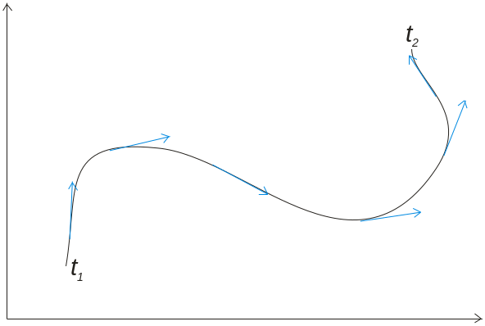
Chaos = extreme sensitivity to initial conditions
×
One might assume: Weather is chaotic ➔ control is impossible
Not so!
Control of chaotic systems requires four things
A model (initial conditions → future state).
Observations.
An appropriate lever.
Feedback.
X-29 NASA-DFRC
Improved observations
Improved models
Improved analysis/forecast systems
A bigger lever ➔ Smaller perturbations needed to achieve a given degree of weather control
See Ross Hoffman, “Controlling the global weather”,
Bulletin of the American Metrological Society February 2002 : 241-248

Slide 10
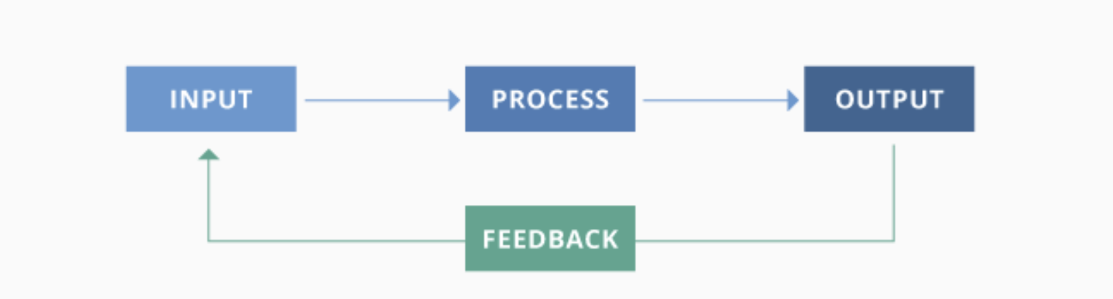
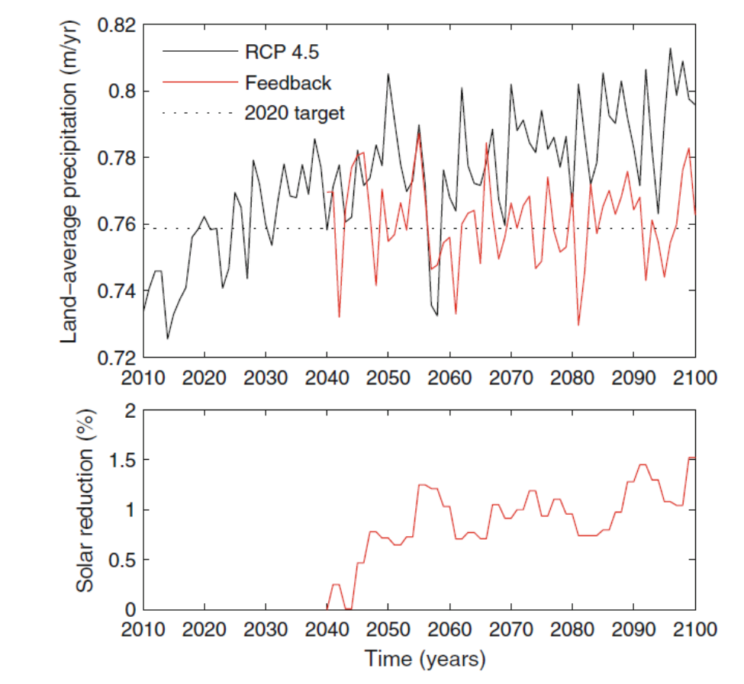
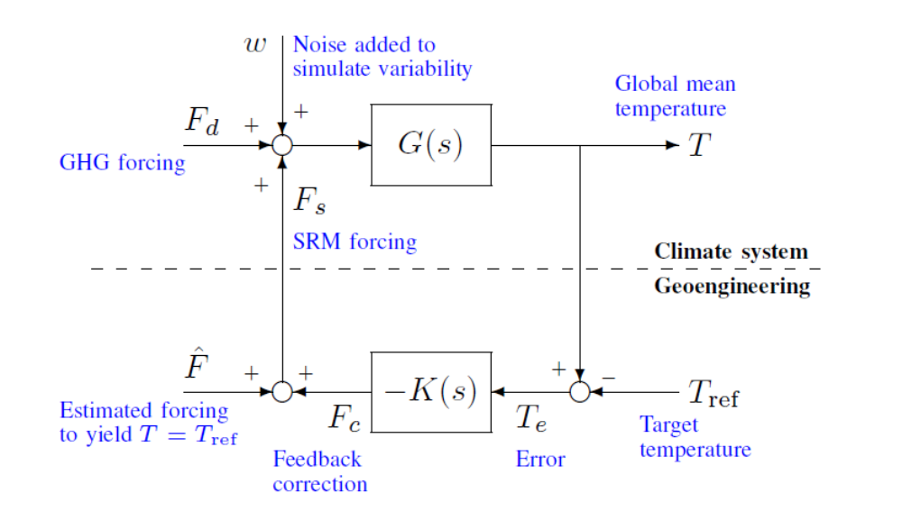
Dynamics of the coupled human-climate system resulting from closed-loop control of solar geoengineering.
D. G. MacMartin, B. Kravitz, D. W. Keith and A. Jarvis. (2013), Climate Dynamics.
Notes:
https://gravityflow.io/articles/5-elements-of-a-successful-feedback-loop/

Slide 11
?
Figure out how to approximate turning-down-the-sun
Model climate response to turning-down-the-sun
Aerosols heat stratosphere by absorbing sunlight
Aerosols falling into troposphere change cirrus clouds
Predicted climate change
Aerosol injection
Distribution of reflectivity
Climate model
Changed stratospheric circulation
Feedback control

Slide 12
Limits to breaking the problem in half
If SAI radiative forcing approximately uniform and comparatively small
Then the climate response is well approximated by turn-down-the-sun.
And overall impact of SAI is well approximated by:
turn-down-the-sun + direct effect of aerosol
Uncertainty in turn-down-the-sun is not more uncertain than response to CO₂
Uncertainty in direct effect of aerosol is understood because of research on sulfur pollution

Slide 13
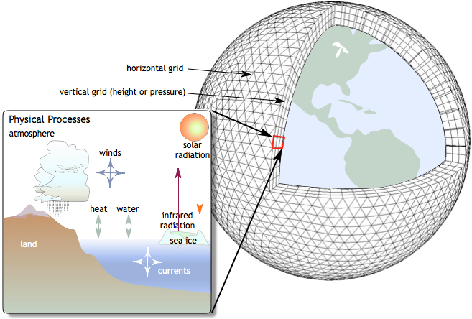
Structural uncertainty exists due unconstrained parameters associated with small-scale physics
Well understood large—scale physics
Small scale physics: Structural uncertainty
Image: Wikipedia

Slide 14
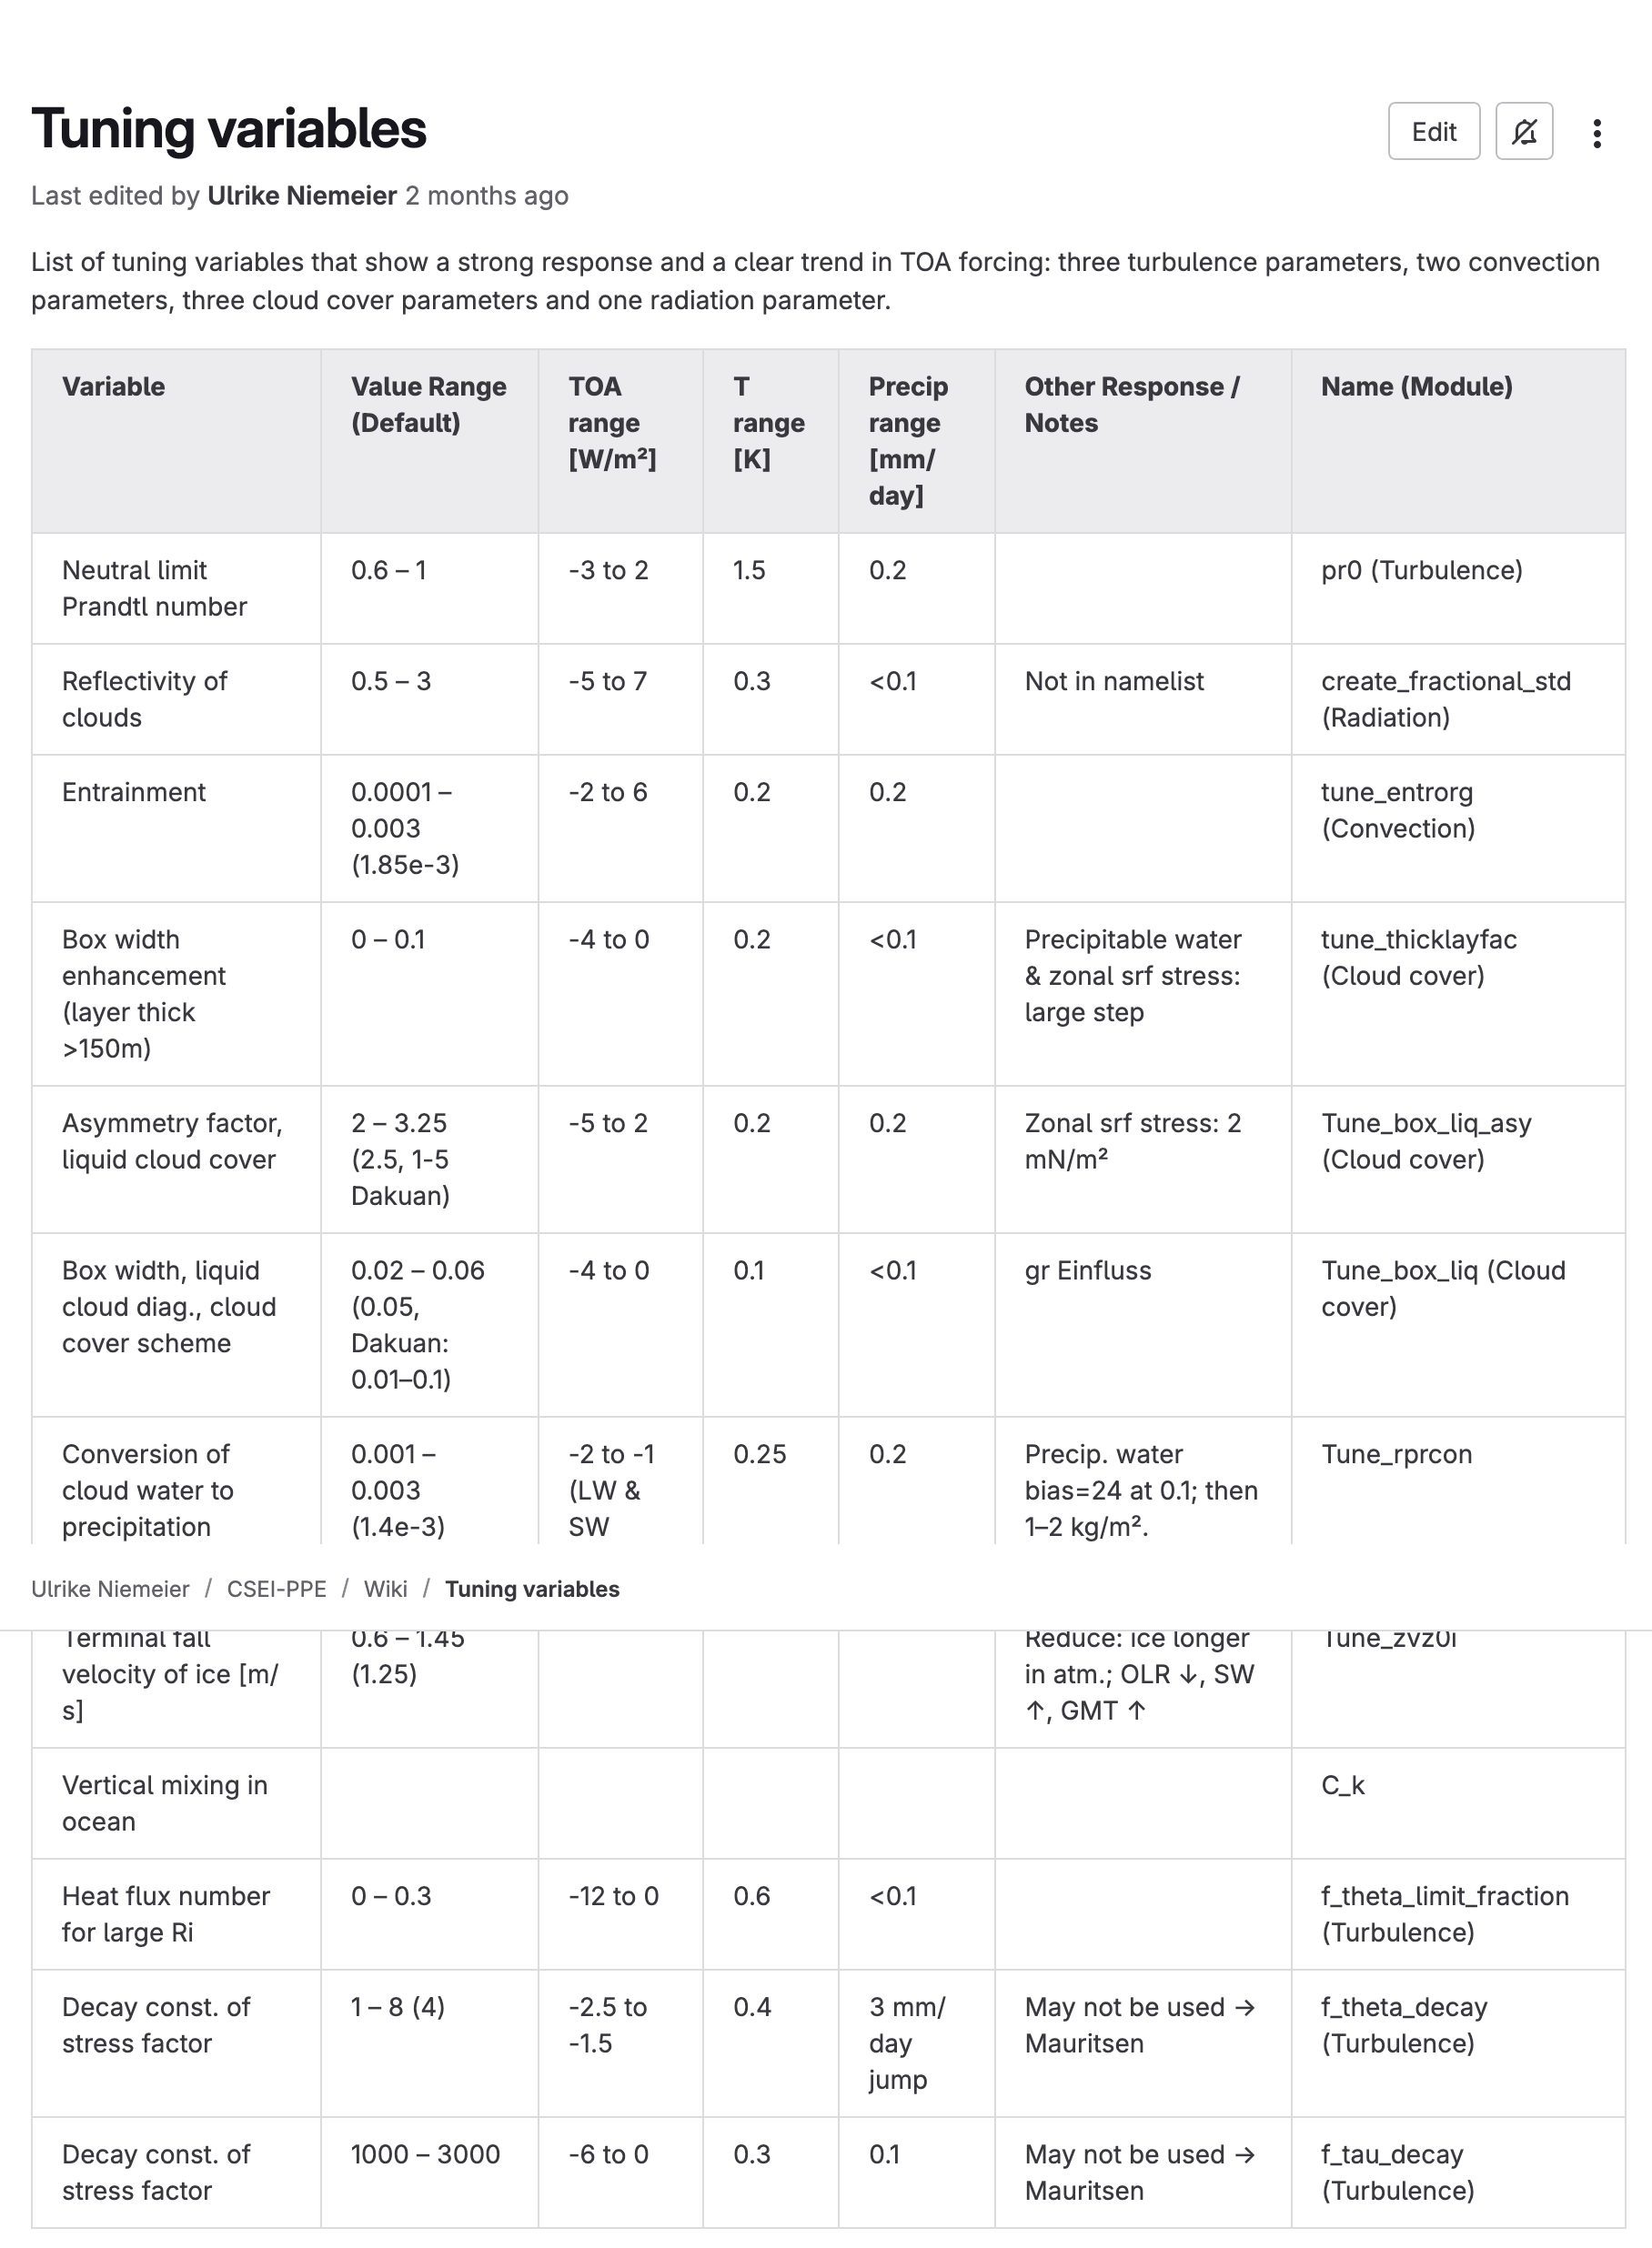
Many parameters associated with small-scale physics
Niemeier et al. (2025)

Slide 15
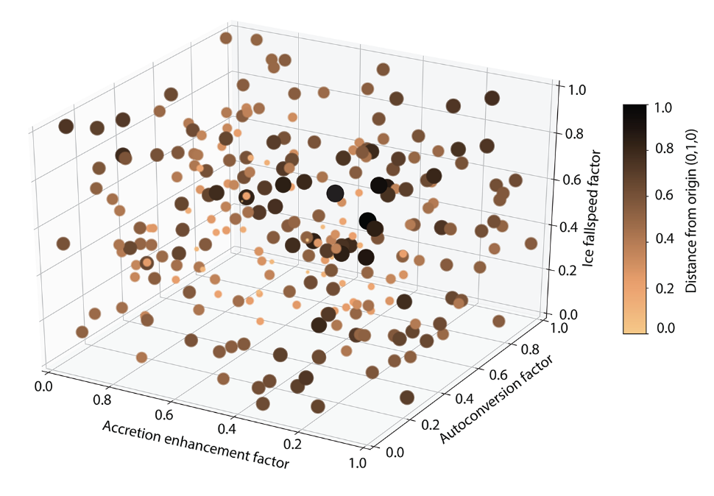
Perturbed parameter ensembles quantify structural uncertainty
Example of Latin Hypercube sampling
Eidenhammer et al. (2024)

Slide 16
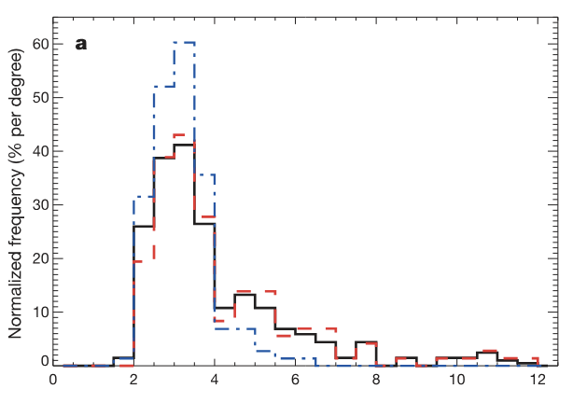
Uncertainty in the global-mean temperature response to 2xCO2 connected to cloud parameters
Perturbations to entrainment coefficient
Cloud-to-rain conversion threshold
Warming response to 2xCO2 (K)
Stainforth et al. (2005)

Slide 17
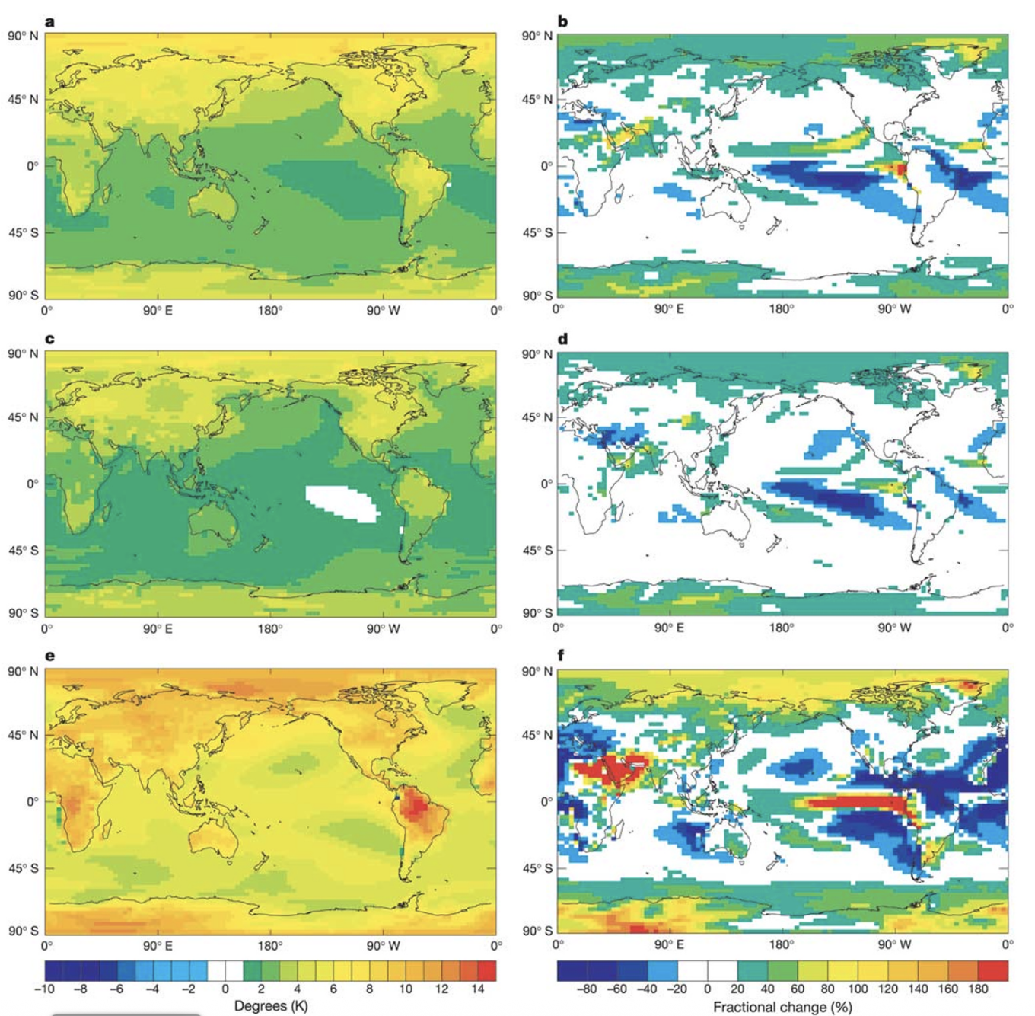
Regional temperature and precipitation responses vary with small scale cloud parameters
Unperturbed
(CS 3.4K)
Perturbed 1
(CS 2.5K)
Perturbed 2 (CS 10.5K)
Stainforth et al. (2005)

Slide 18
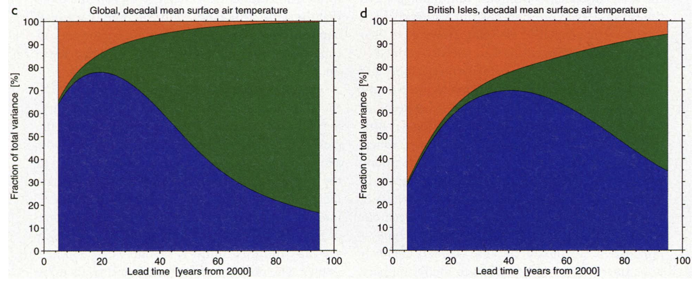
Feeds into the quantifying climate model uncertainty due to scenario, noise and structural uncertainty
Initial condition uncertainty
Scenario
Uncertainty
Structural Uncertainty
Hawkins & Sutton (2009)

Slide 19
The case for reliability
Ansatz: the reliability of a body of research increases with the duration of the research theme, the volume of research in the theme, the intellectual diversity of the research community, and the absence of commercial influence.
Examples:
  New medical research shows how to extend lifespans: “Inhibition of IL-11 signaling extends mammalian healthspan and lifespan,” Nature, July 2024.
  The standard model of quantum electrodynamic stands another test: “An improved bound on the electron’s electric dipole moment”, Science, July 2023.
Factors that suggest SRM research is unreliable:
  Duration: most research done in the last decade
  Intellectual diversity: much done by a small clique of researchers,
  Volume: is low, funding for SRM is well under 0.1% of total climate research.

Slide 20
SRM is old: Research on SRM goes back to the early 60’s, it was reviewed in NAS reports of 1977, 1983, 1992. The first GCM simulation was published in 2000 by Bala and Ken. The long duration—albeit on a small scale and with little funding—means there has been time to find serious flaws, particularly given that climate researchers were generally biased against SRM research providing a solid motivation to root out errors.
SRM is better understood as an application of environmental geoscience than as an independent field: If research depended on new methods to study novel atmospheric processes, then the arguments for unreliability would carry more weight.

Slide 21
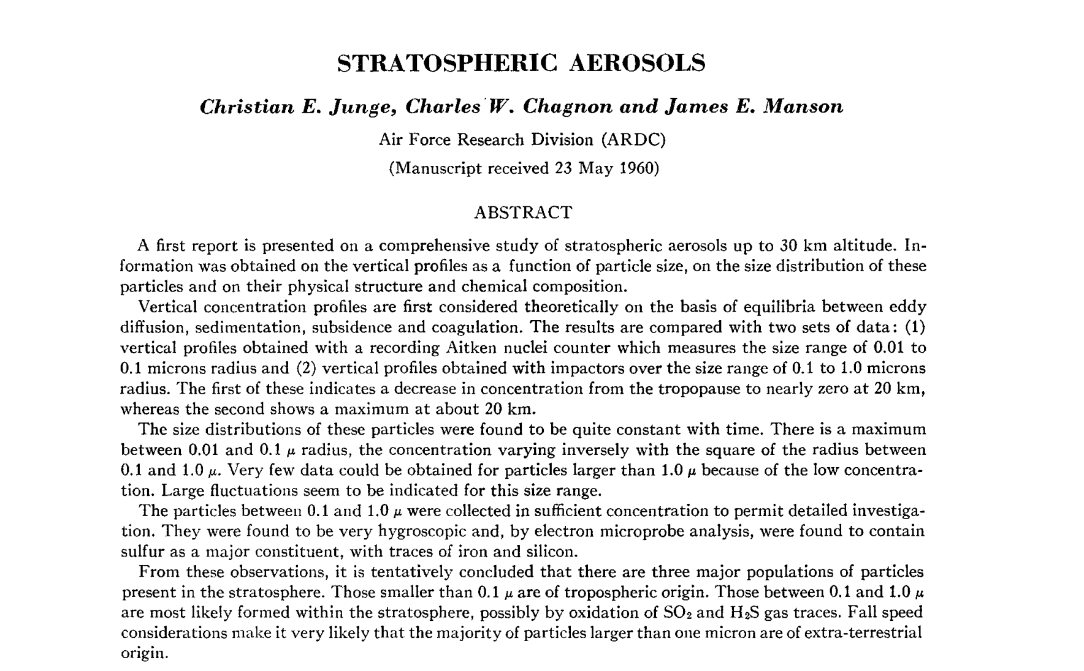
Journal of the Atmospheric Sciences, 1961
Notes:
https://journals.ametsoc.org/view/journals/atsc/18/1/1520-0469_1961_018_0081_sa_2_0_co_2.xml

Slide 22
Existing research tools may allow quantification of benefits and risks
Consequences of SRM depend on scenario (amount, spatial-distribution, method) → ~no general statements possible.
A scenario: sulfates, cooling by 0.1C/decade for 50 years, hemispheric balance.
Policy-relevant benefits and harms of this scenario can be substantially quantified with existing research tools.
Applied research is needed—and rapid progress is possible—because of deep reservoir of existing knowledge that can be applied and extended with new applied research.
Progress requires goal-directed applied research and assessment to understand the harmful impacts of moderate well designed SRM.
Risk-to-risk:
A quantitative example
Given 1C cooling in 2080 with sulfate SRM
Temperature-attributable mortality reduced by 400,00/year
Added sulfate air pollution mortality:
7,000/year
Added morality from sulfate-mediated ozone loss:
4,000/year
Benift:Harm ratio ~ 10-100:1
Impact of Solar Geoengineering on Temperature-Attributable Mortality. Harding, Keith, Yang, Vecchi, PNAS, 2024.
Notes:
Atmospheric physics, aircraft engineering, …

Slide 24
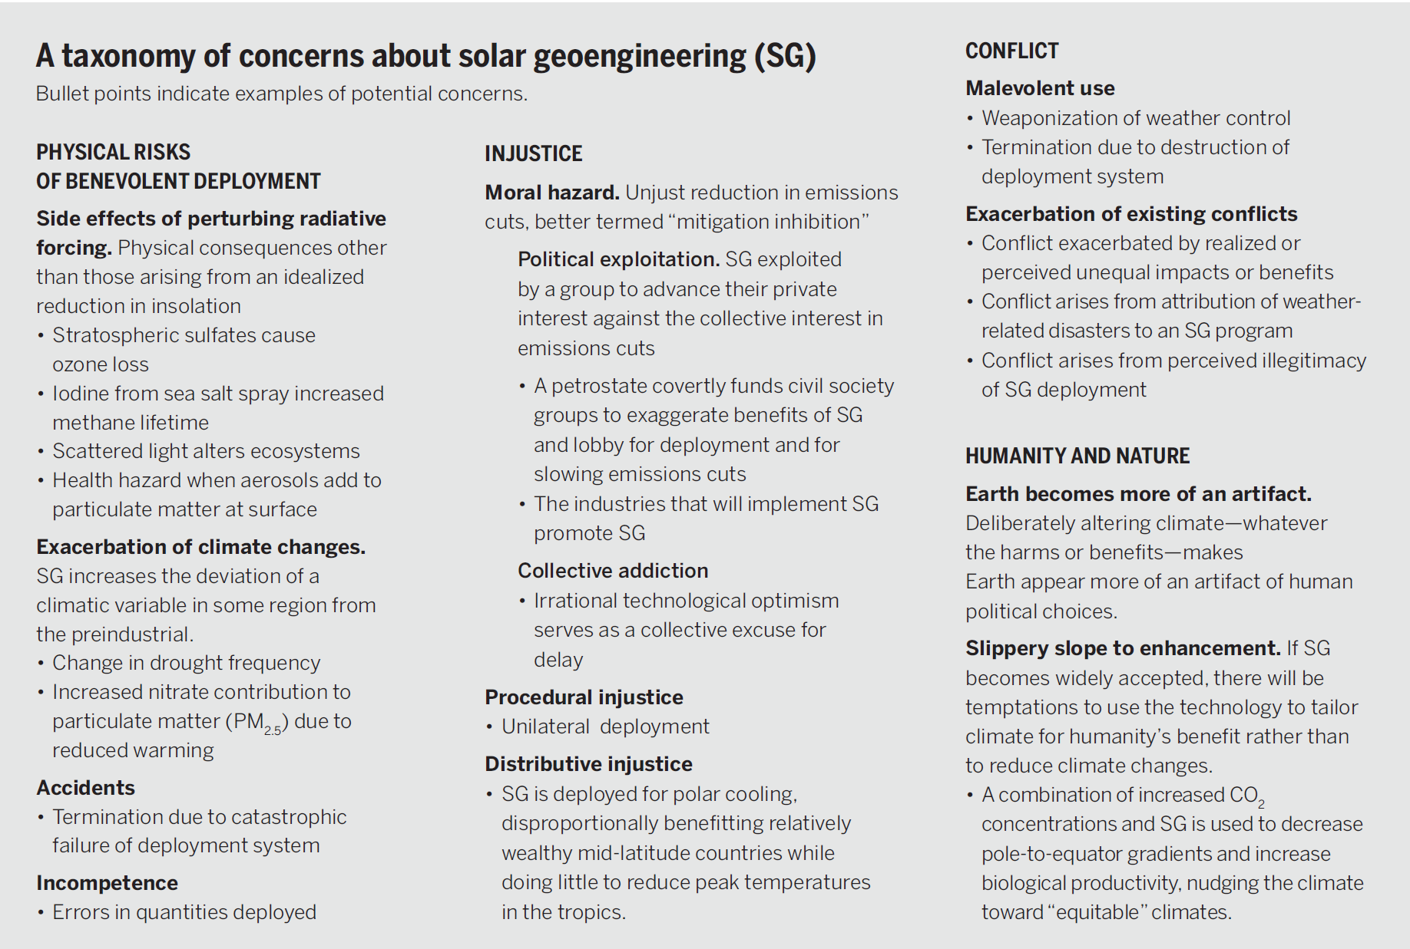
Towards constructive disagreement about geoengineering, David Keith. Science, 2021.

Slide 25
Aerosol precursor
Radiative forcing

Slide 26
Figure out how to approximate turning down the sun
Model climate response to turning down the sun
Aerosols heat stratosphere by absorbing sunlight
Feedback control
Aerosols falling into troposphere change cirrus clouds
Predicted climate change
Aerosol injection
Distribution of reflectivity
Climate model
Changed stratospheric circulation

Slide 27
fascism
Sir David Attenborough
"....it’s batshit crazy and a powder-keg for priming a global explosion of the law of unintended consequences."
Anthony Watts of What’s Up With That?
a rogue proposition
Naomi Klein
insane, utterly mad and delusional in the extreme
Al Gore
Notes:
https://slate.com/technology/2015/02/nrc-geoengineering-report-climate-hacking-is-dangerous-and-barking-mad.html
title: "Climate Hacking Is Barking Mad"
Here's another from some climate deniers / skeptics: What's up with that - a climate denial website described it as batshit crazy
https://wattsupwiththat.com/2011/06/17/leaked-smoke-and-mirror-geoengineering-ideas-from-the-ipcc/
"....it’s batshit crazy and a powder-keg for priming a global explosion of the law of unintended consequences."

