Slide 1
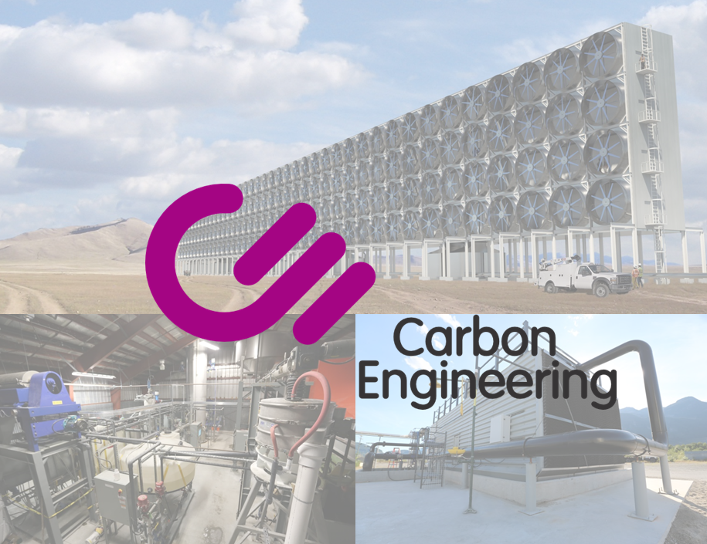
Notes:
DK Talk
Core, why not CCS, and air to fuels right up front.
-CCS cheaper, dac allows c-neutral fuels.
-DAC allows low c-elec to make fuels for transport that can't be electrified.
State performance metrics/phenomena for each device before showing data.
-AC: pressure drop, mass transfer, drift.
-PR: loading and retention (how much goes into pellets vs fines)
-CLCR: loading rate (can't know till you test), and fouling.
->stable steady-state operation with high loading rate.

Slide 2
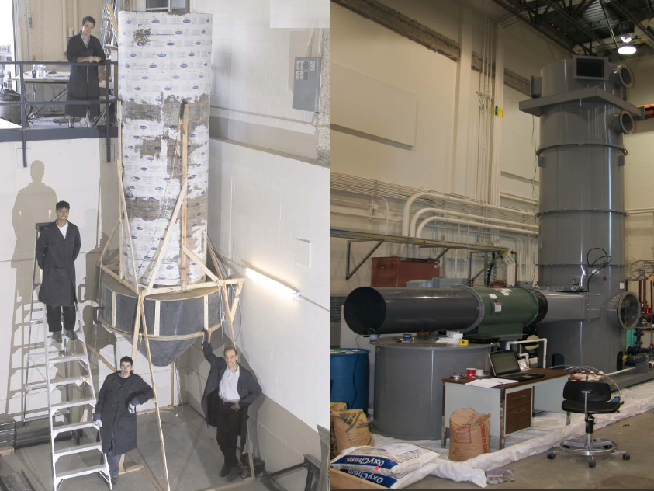
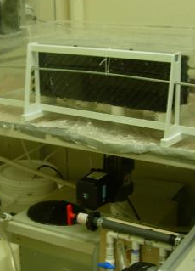
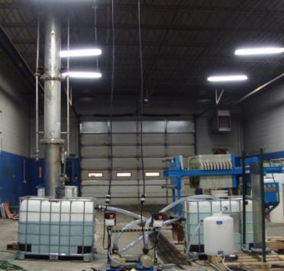
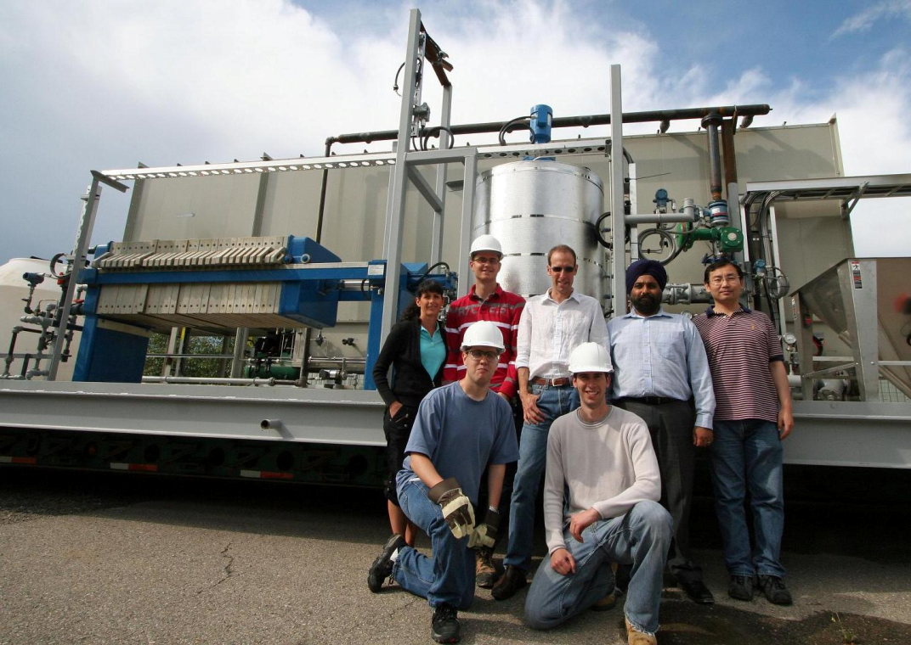
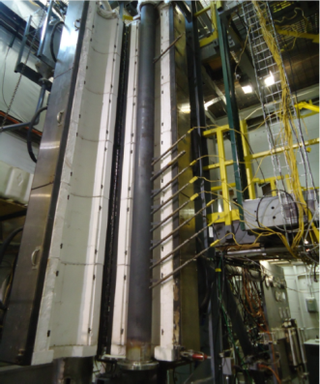
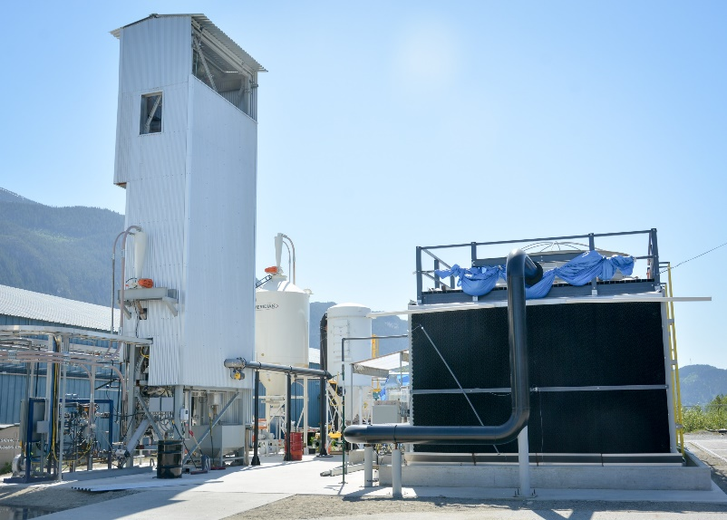
2005: Spray Tower
2008: Packed Tower
2010: Lab Air Contactor
2011: Pellet Reactor Tests
2011-2012: Air Contactor Prototype
2013: Calciner Tests
2015-2018: End-to-End Pilot Plant
Hardware-focused business-oriented development from day one

Slide 3
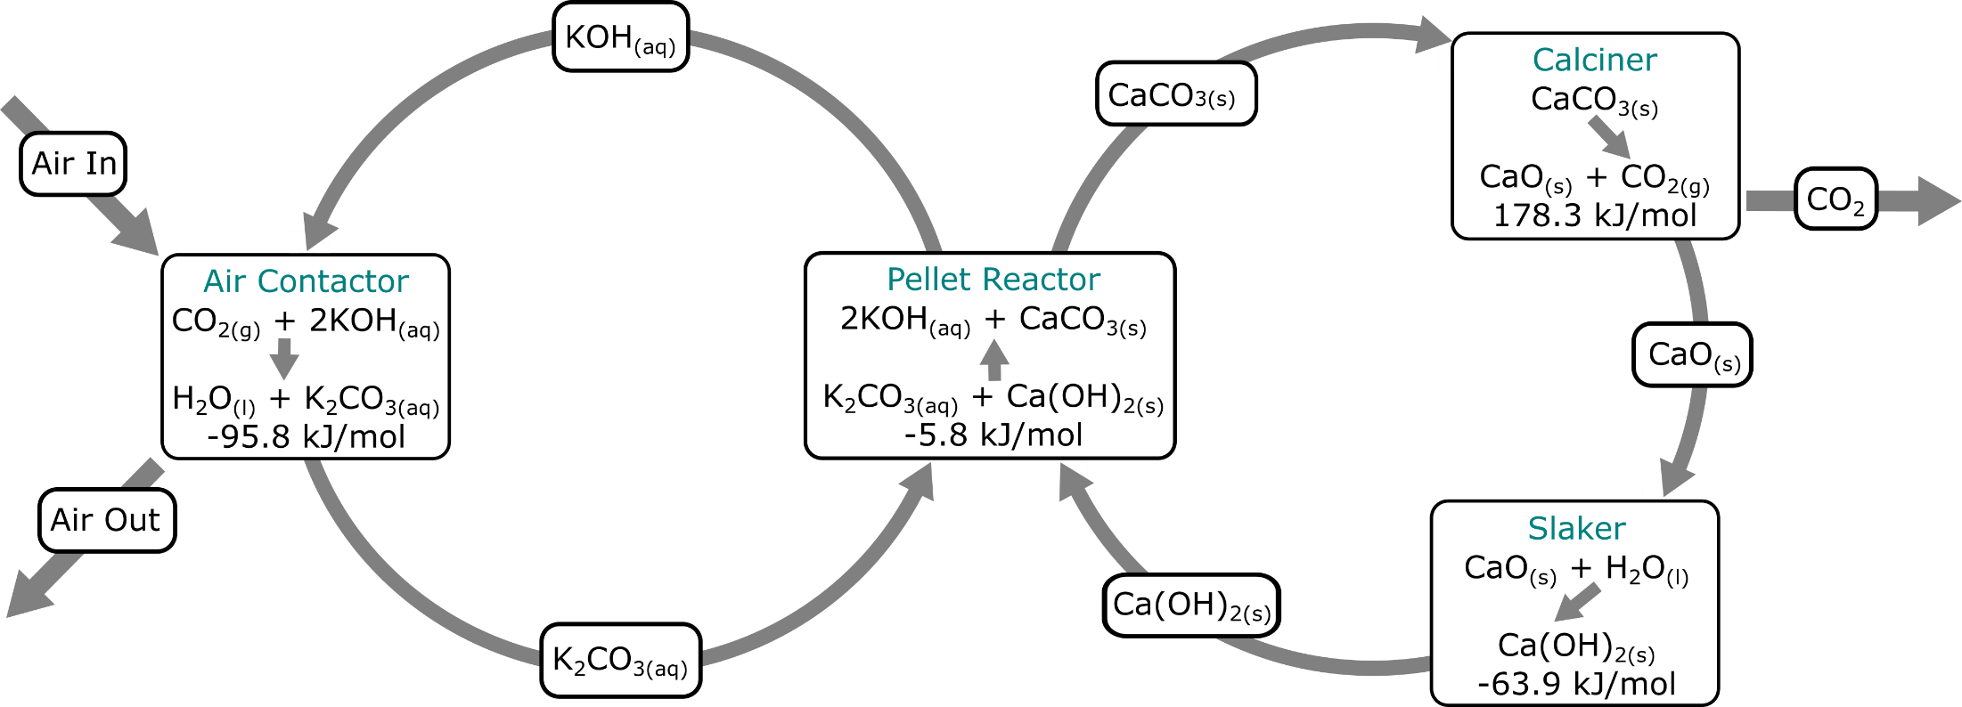
Direct Air Capture – Chemical Looping, CO₂ from 0.06 → 98%
OH⁻ 1 mol/L
CO₃²⁻ 0.5 mol/L
K⁺ 2 mol/L
Heat In
45% CO₂
0.06% CO₂
98% CO₂
Heat Out
(Evaporation)
2% CO₂
CO₂ concentrations shown as mass fractions
Heat Out
Two-loop process with a century-long history

Slide 4
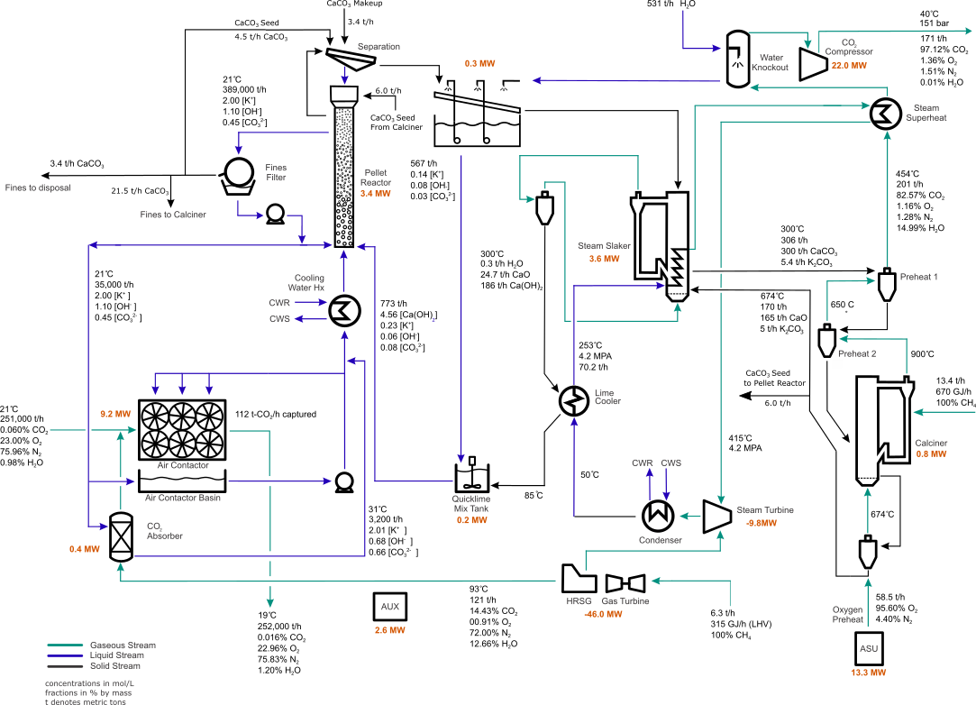
Innovative integration of industrially proven technologies

Slide 5
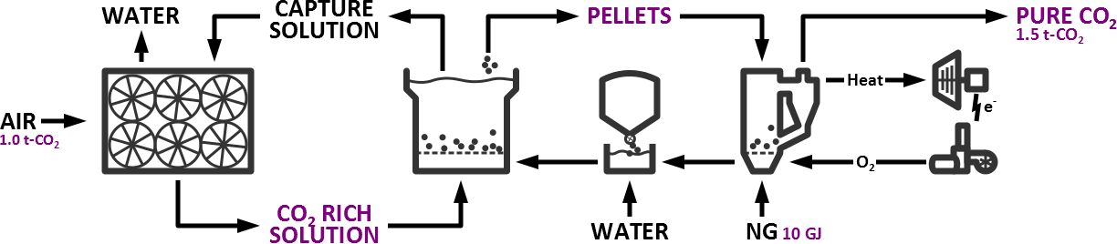



CE’s DAC Technology – Supplier Relationships
Leading global cooling tower supplier.
Key technical similarities with CE air contactor.
Supplying CE air contactor.
Joint engineering and development.
Pelletization technology holders for wastewater.
Three years collaboration on CE’s pellet reactor unit.
Supplying CE pellet reactor.
Continued joint development.
Global EPC, plus ore roasters and kilns.
Joint development of CE’s CFB kiln.
Technical oversight for CE pilot calciner.
Calciner technology provider.
Credible suppliers enable scale-up
Notes:
CE has developed a technology platform which we call Air to Fuels
abundant renewable resources including sunlight, air, and water and synthesize liquid hydrocarbon fuels like diesel, gasoline, and Jet fuel.
Inside this process,
-Solar or other clean sources of electricity are used to produce hydrogen via electrolysis of water.
-Direct Air Capture, CO2 is captured from the atmosphere and is then
-Fuel synthesis is an established industrial process to produce synthetic hydrocarbons that are completely compatible with today’s engines and infrastructure.
4 most important things I want you to take away about why A2F makes sense today:
Low cost renewables:
-Solar and Wind have become the lowest cost sources of electricity on the planet in the last couple years. Contracts for solar in the best locations are now being bid at below $20/MWh.
-Large scale electrolysis to produce hydrogen is available and the markets are expanding, driving down costs.
-Direct Air Capture: CE has now demonstrated a scalable platform that can capture and deliver industrial quantities of atmospheric CO2 for $100-150/ton
Collectively,
$1/liter in early plants with a clear path to costs of around $0.60/l.
CE’s A2F platform produces liquid fuels with the carbon footprint of renewables that can address all segments of the transportation sector.

Slide 6
Contactor

Slide 7
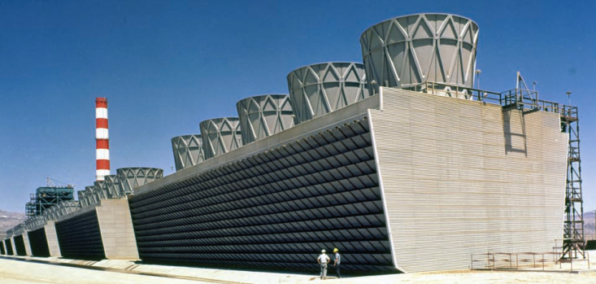
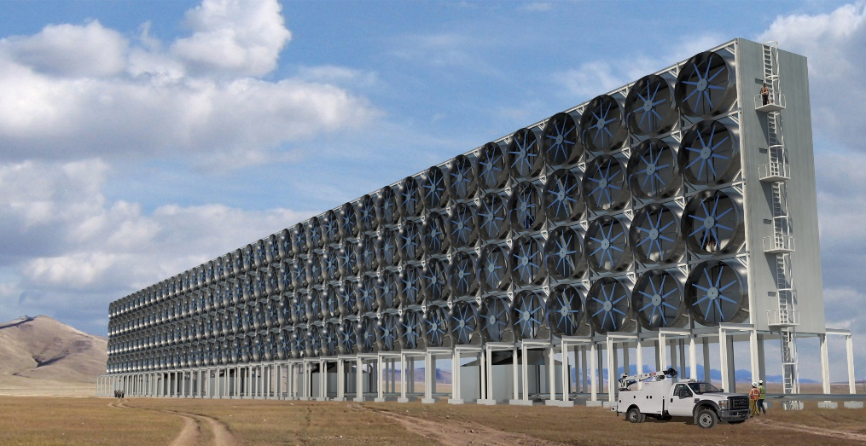
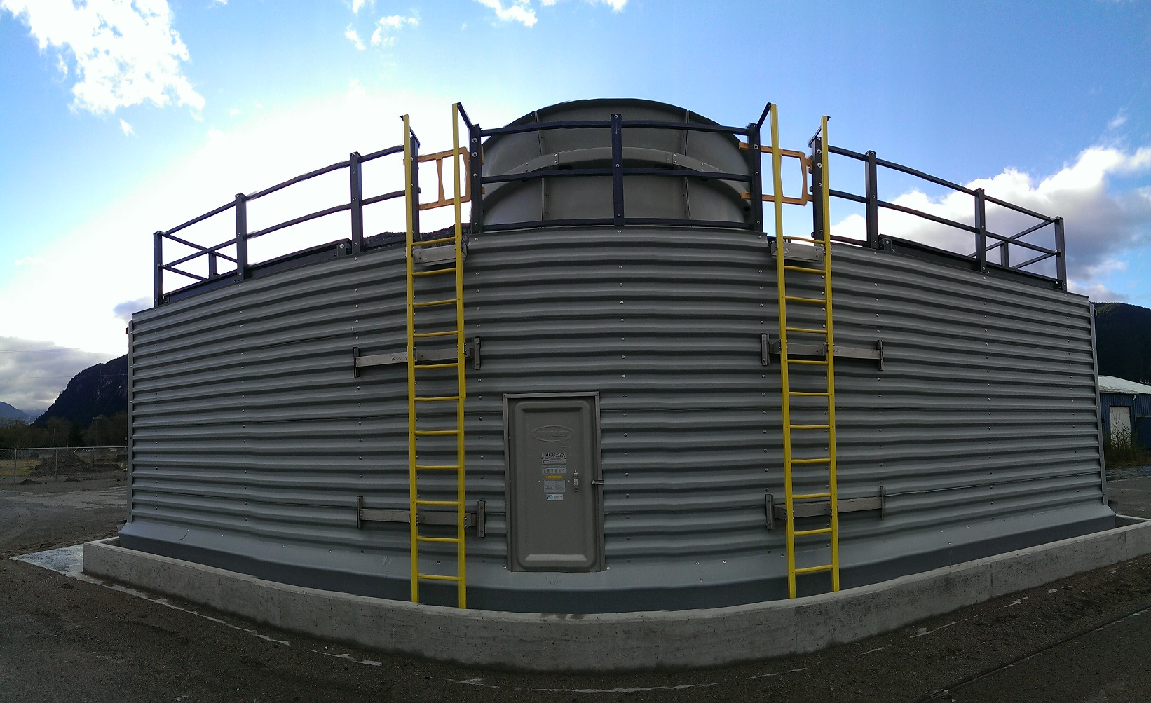
Aqueous Air Contactor
Aqueous capture process
Continuous operation
Cooling tower heritage → low capital cost, long life and tolerance for dust and impurities.
Less than 90 kWhr/t-CO₂ capture energy
More than 20 t-CO₂ m⁻²/year capture rate
Solution is easily transported to recovery unit using industrial pumps and piping
CE’s platform technology – the crucial enabler of low cost DAC

Slide 8
Pellet Reactor

Slide 9
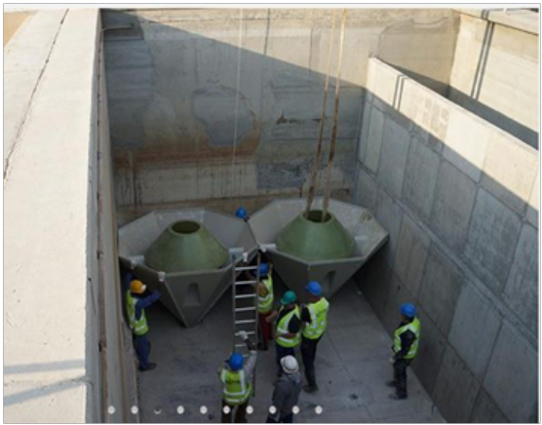
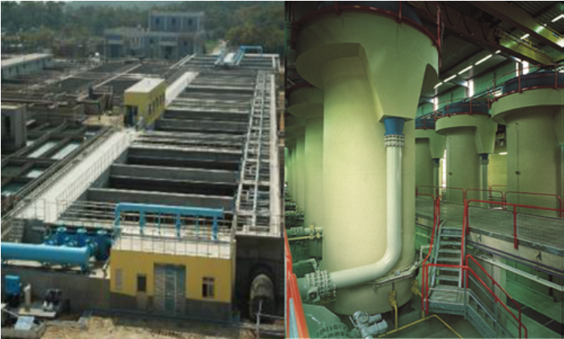
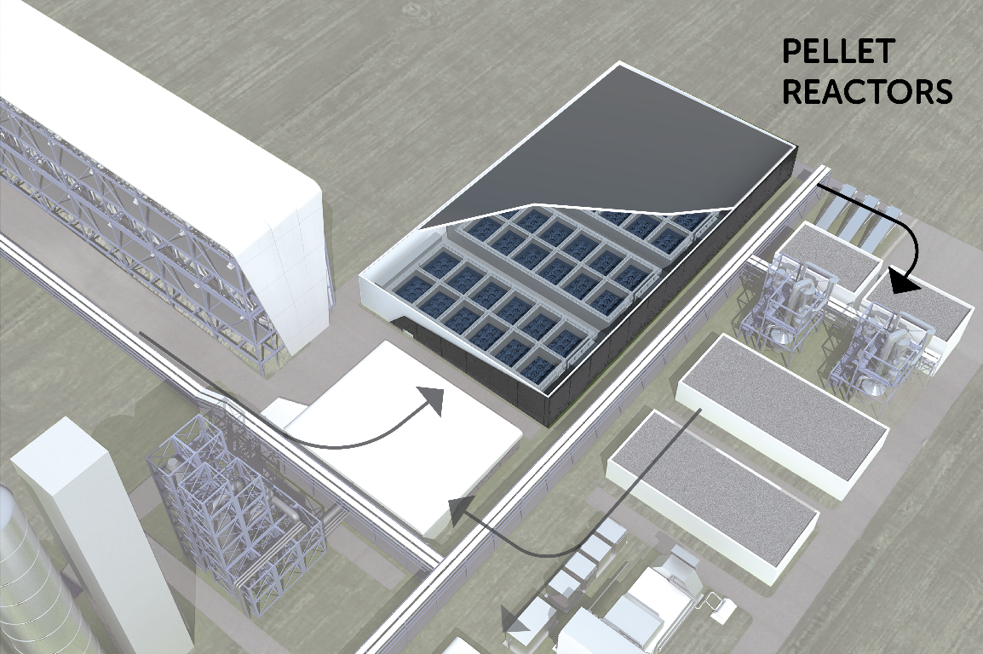
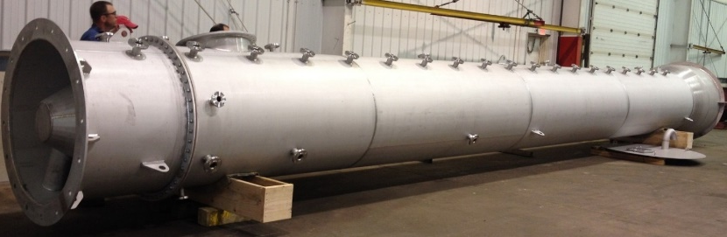
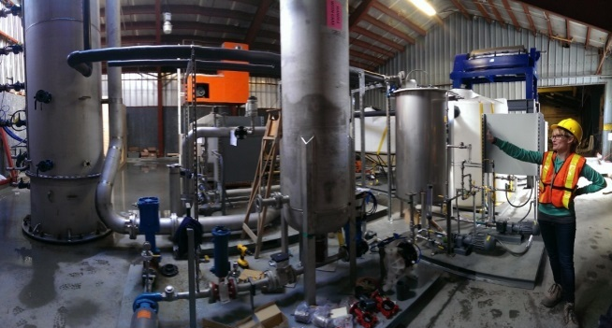
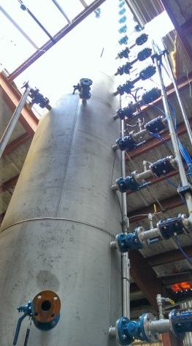
Pellet Reactor – Design
Borrowed from waste water treatment
Eliminates hard-to-dewater lime mud
Makes porosity pellets that are easily washed, energy efficient to de-water, and easy to store and convey
Enables oxy-fired fluidized bed
Key innovation beyond Kraft caustic recovery

Slide 10
Calciner/Slaker

Slide 11
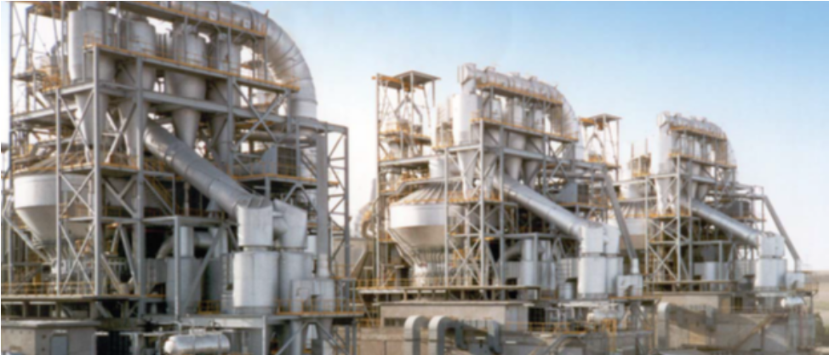
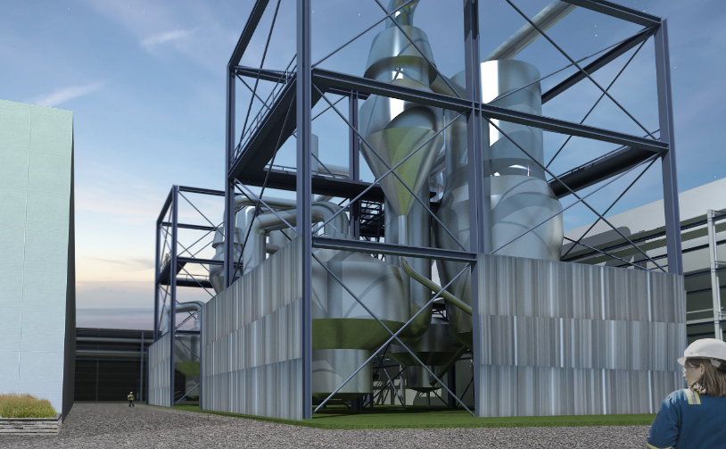
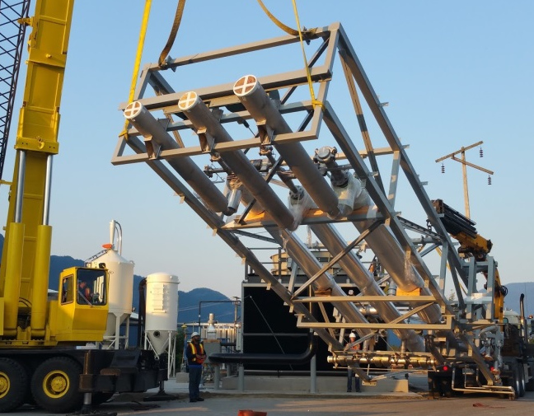
Calciner – Design
Biased on circulating fluid bed ore roasters
CFB design minimizes equipment footprint
Oxy-firing ensures high capture fraction and puts all separation energy into the fuel-derived carbon
Highest single-train throughput capacity

Slide 12
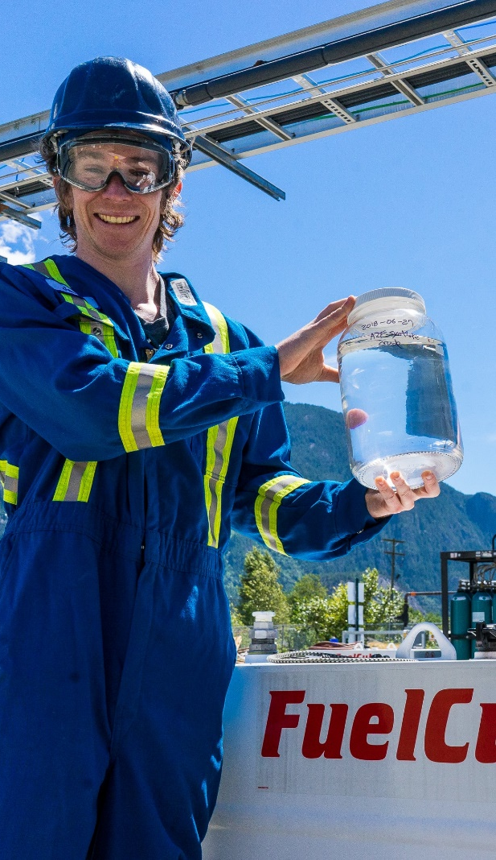
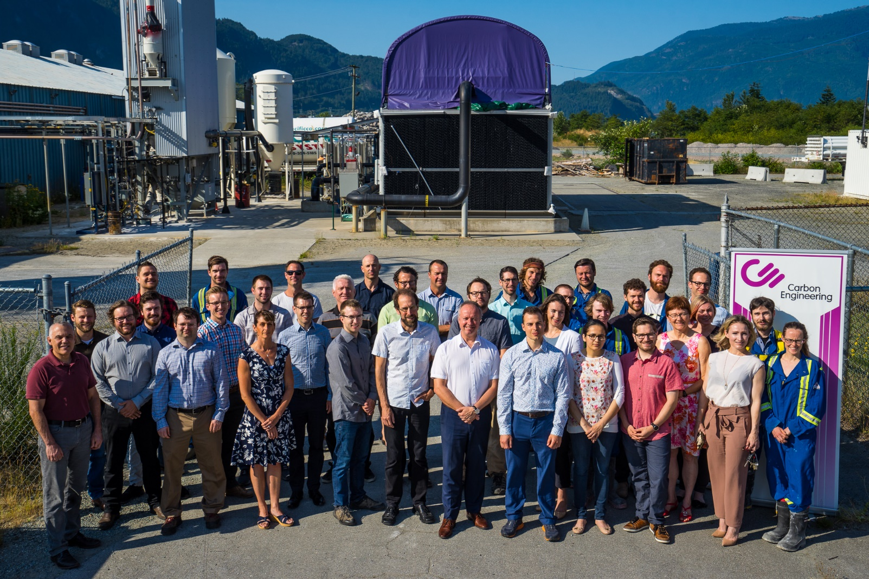
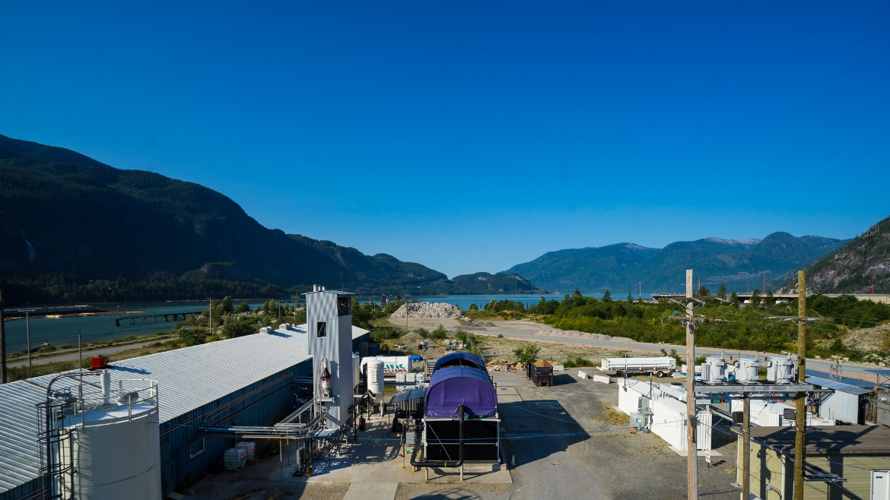
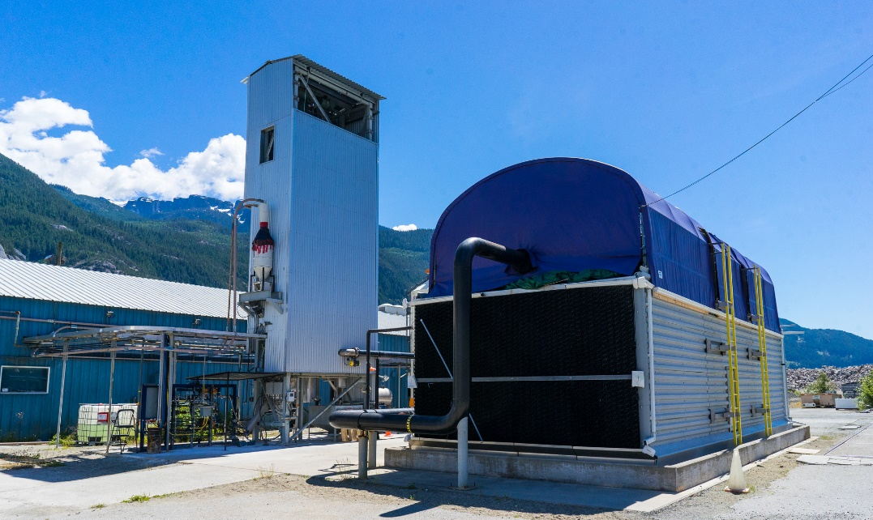

Slide 13
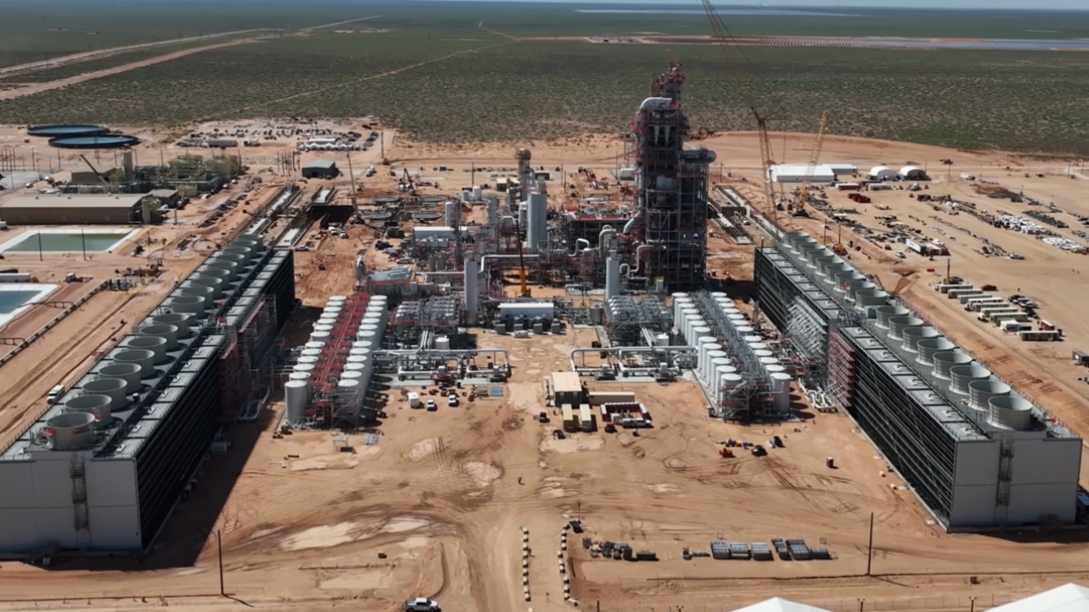

Slide 15
