Slide 1
Arthur H. Compton Lecture Series: An Intro to Climate Systems Engineering
Lecturer: Professor David Keith
October 4, 2025

Slide 2
 | Speakers | Topics
Oct 4 | Keith | Introductions. Climate in 4 Dimensions. Emissions are peaking. Adaptation. Climate in Context.
Oct 11 | Archer | Carbon cycle and natural geochemical processes as basis to understand carbon removal.
Oct 18 | Shaw | Scientific basis for predicting climate changes in response to emissions of greenhouse gases and aerosol pollution.
Oct 25 | Cael | Carbon removal, including ocean alkalinity enhancement, land-based methods, bioenergy with carbon capture, and direct air capture with storage.
Nov 1 | Keith | Sunlight Reflection Methods (SRM) Part 1: How to Reflect Sunlight, the history of SRM, and why stratospheric sulfur aerosols are most plausible now.
Nov 8 | MacAyeal & Keith | MacAyeal on science of glaciers and interventions to prevent glacial melt. Keith on developing DAC technologies at Carbon Engineering, and lessons for cleantech.
Nov 15 | Shaw & Keith | The climate responses to SRM, potential side effects, and what can be learned from past aerosol pollution, highlighting the limits and uncertainties of experiments.
Nov 22 | Keith & Shaw | The future of climate systems engineering, and climate engineering in context.

Slide 3
Outline
Reflecting sunlight, introduction
Why aerosol, why stratosphere, why sulfur?
Engineering
Comparing SRM methods
Climate response
Concerns

Slide 4
Economy
Emissions
Concentrations
Climatic change
Impacts
Decarbonization
Carbon removal
Sunlight reflection
Adaptation
Decarbonization breaks the link between economy and emissions
Ex: solar, nuclear, wind, carbon capture and storage…
Carbon removal breaks the link between historical emissions and climate change
Ex: enhanced rock weathering, ocean alkalinity, direct air capture…
Sunlight reflection weakens the link between concentrations and climate change
Ex: stratospheric aerosols, marine cloud brightening, cirrus thinning…
Adaptation weakens the link between climate change and harm
Ex: solar air conditioning, climate-resilient agriculture, early warning…

Slide 5
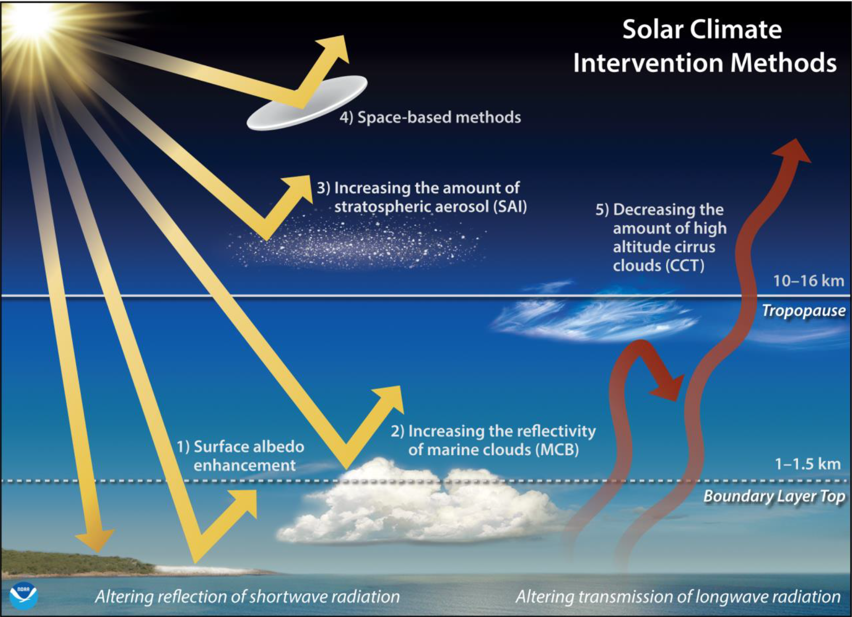

Slide 6
Why sulfuric acid aerosol is only plausible option for next few decades
SAI
Aircraft to deliver >0.3 Mt-S to >15 km exist today (e.g., 30 G650)
Multiple development pathways to 20 km alt aircraft
Very high confidence that sulfate aerosol are formed, have >1 year lifetime, and will cool Earth.
MCB
Significant uncertainty about cloud albedo response to additional CCN
No current development path to climate-relevant deployment tech.
CCT
Substantial uncertainty about cirrus cloud response to ice nuclei—easy to produce the wrong sign.
No current development path to deployable systems – but number of nuclei required is so low that there is a chance deployment tech is easer than MCB.
Space: no plausible deployment path in next two decades
Surface: no methods with > 0.5 Wm⁻² and low environmental impact

Slide 7
Why aerosol, why stratosphere, why sulfur?
Notes:
Mikhail Budyko, a preeminent Russian climate scientist, was the first to propose spraying sulfur from airplanes to counteract global warming, calling it an “artificial volcano”. The year was 1974, a year marked (or marred) by bell-bottom jeans and the launch of Motorola’s 8080, the first successful general-purpose microprocessor. How can sulfur from airplanes still be the leading idea half a century later? Where is the innovation?

Slide 8
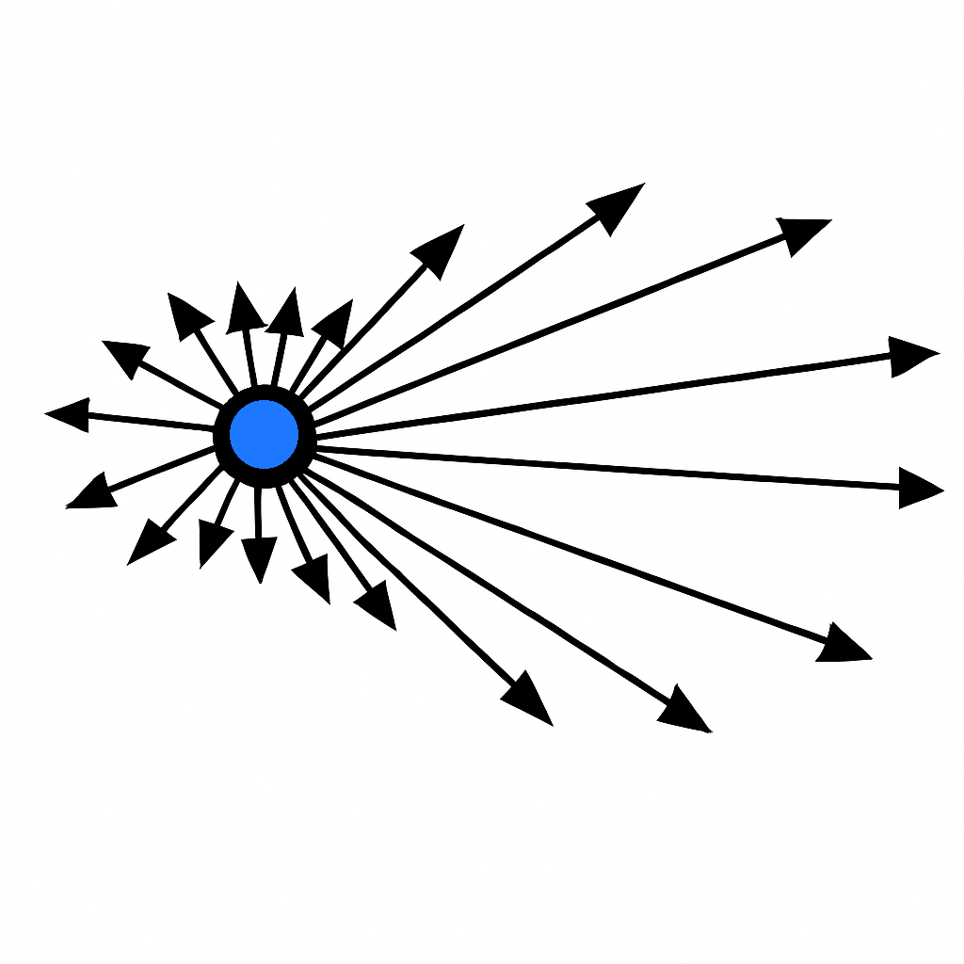
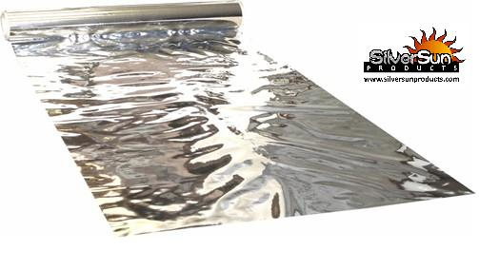
Why aerosols?
Incoming sunlight
Aerosol means any particle, solid or liquid, small enough to stay suspended in the air for a long time.
If particle that’s about as big as the wavelength of light, then it scatters light backwards about as efficiently as if were a tiny perfect mirror about ½ the diameter of the particle.
Particles are super efficient reflectors: a 0.5 µm particle scatters ~100× more light per unit mass than an everyday 50 µm mylar film.
Aerosol are the seeds from which clouds grow → tiny amounts of aerosol can have a big impact on cloud brightness and lifetime.
Scattered sunlight

Slide 9
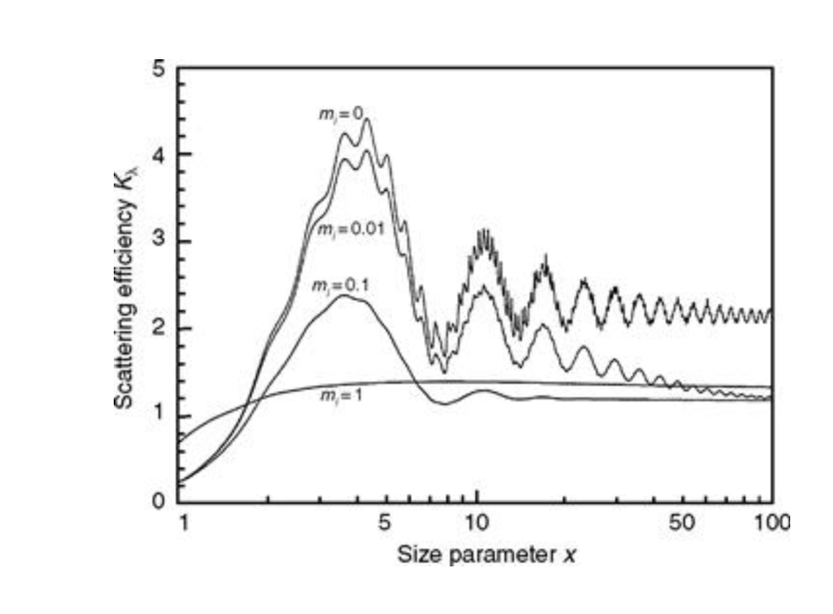
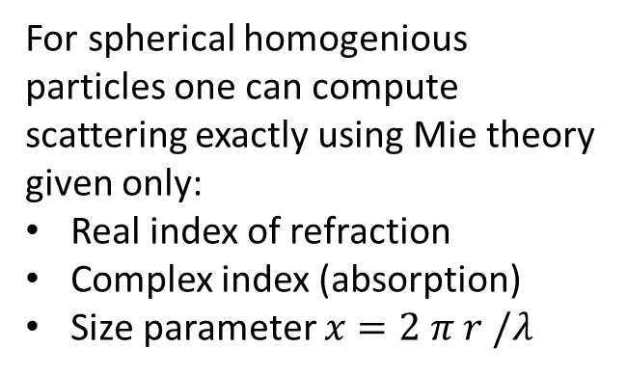
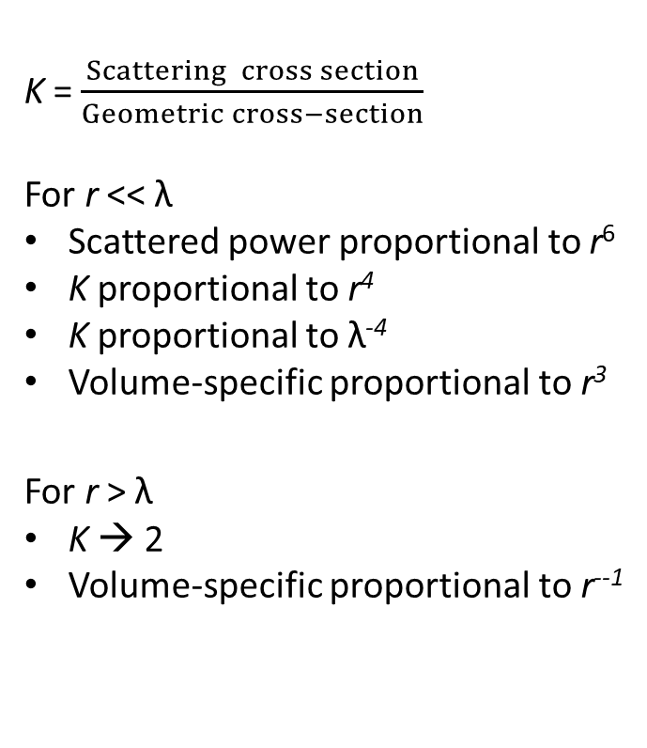
Scattering from particles
For spherical homogenious particles one can compute scattering exactly using Mie theory given only:
Real index of refraction
Complex index (absorption)
Size parameter $x=2 π r /λ$
K = $\frac{Scattering cross section}{Geometric cross−section}$
For r << λ
Scattered power proportional to r⁶
K proportional to r⁴
K proportional to λ⁻⁴
Volume-specific proportional to r³
For r > λ
K → 2
Volume-specific proportional to r⁻⁻¹
Incoming sunlight
Scattered sunlight

Slide 10
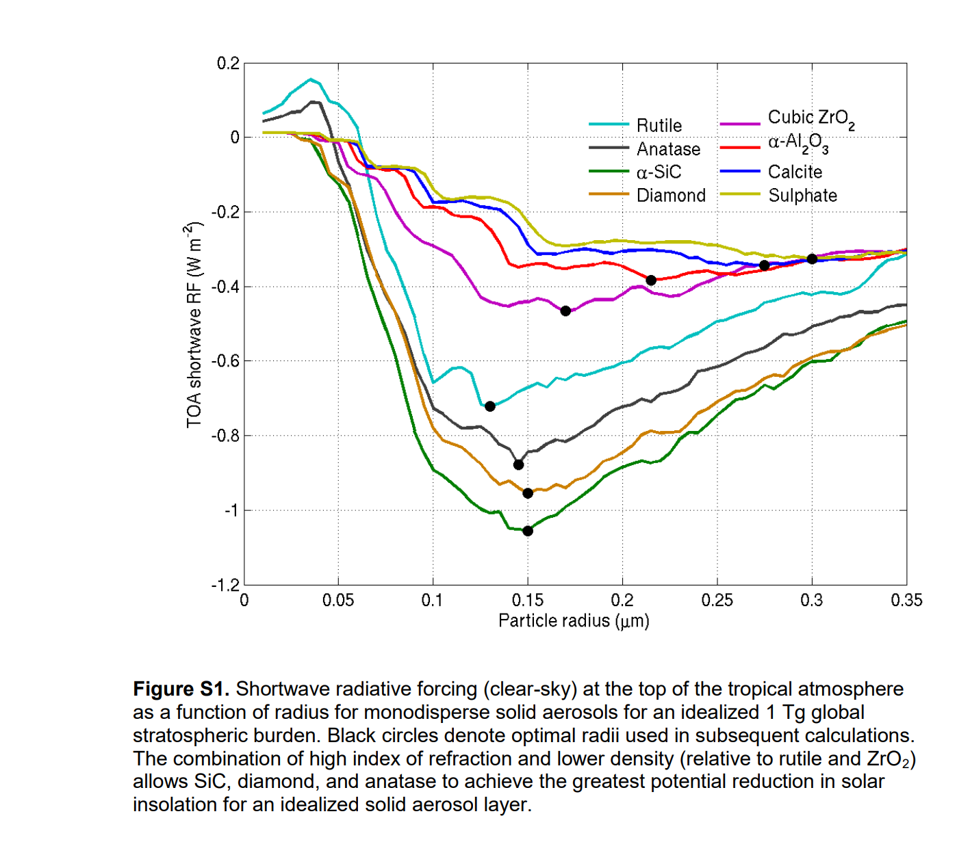
At 0.3 µm radius, 1 Tg of uniformly distributed sulfate aerosol has RF of 0.35 Wm⁻².

Slide 11
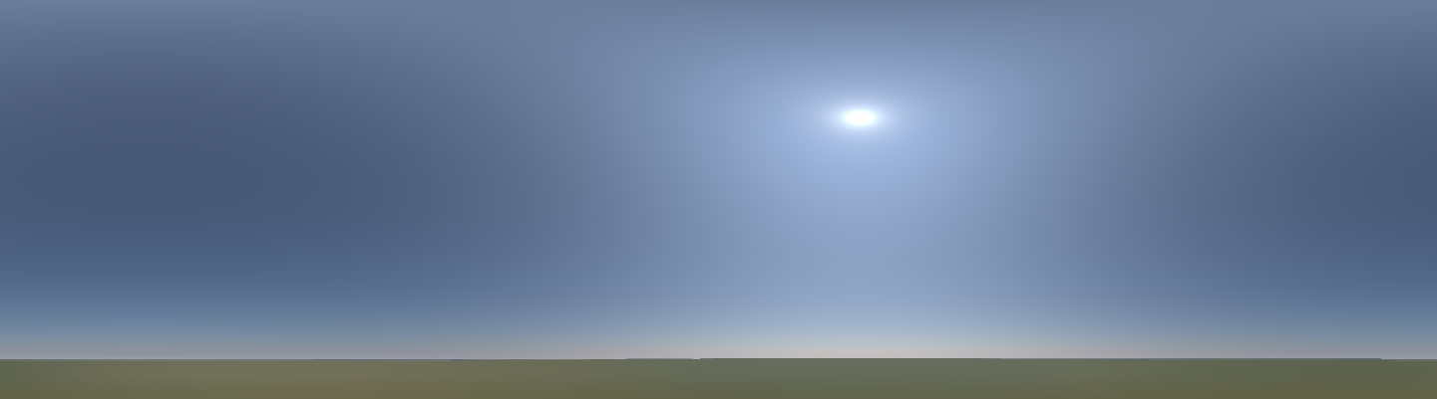

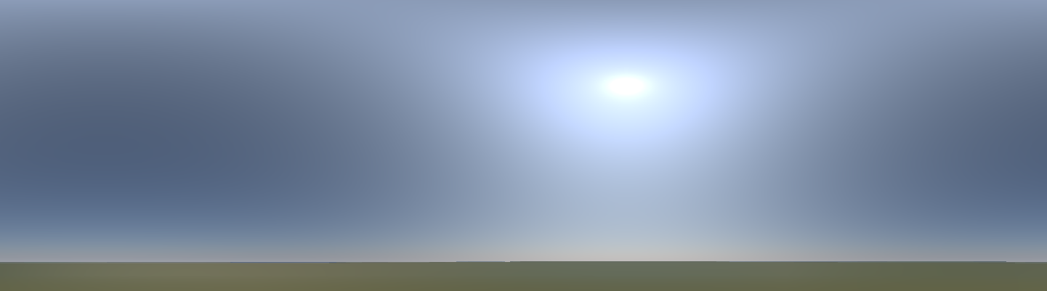
Visual impact of climate engineering that cools Earth ~ 1°C with aerosols
Clear Sky
Diamond
Sulfate
Lemon, Keith, and Albers, “Under a Not so White Sky: Visual Impacts of Stratospheric Aerosol Injection.” ERL, 2025

Slide 12
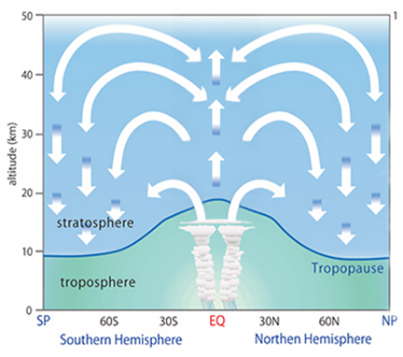
Why the stratosphere?
Stratosphere: air is stratified, flow is laminar, and air can take years to cycle through.
Aerosols live about 100× longer in the stratosphere than in the troposphere (the lowest 90% of the atmosphere).
100× longer lifetime → 100× less aerosols need to be added each year to reflect the same amount of sunlight.
Troposphere: Air is mixed by cycling thorough rain clouds roughly once a week.

Slide 13
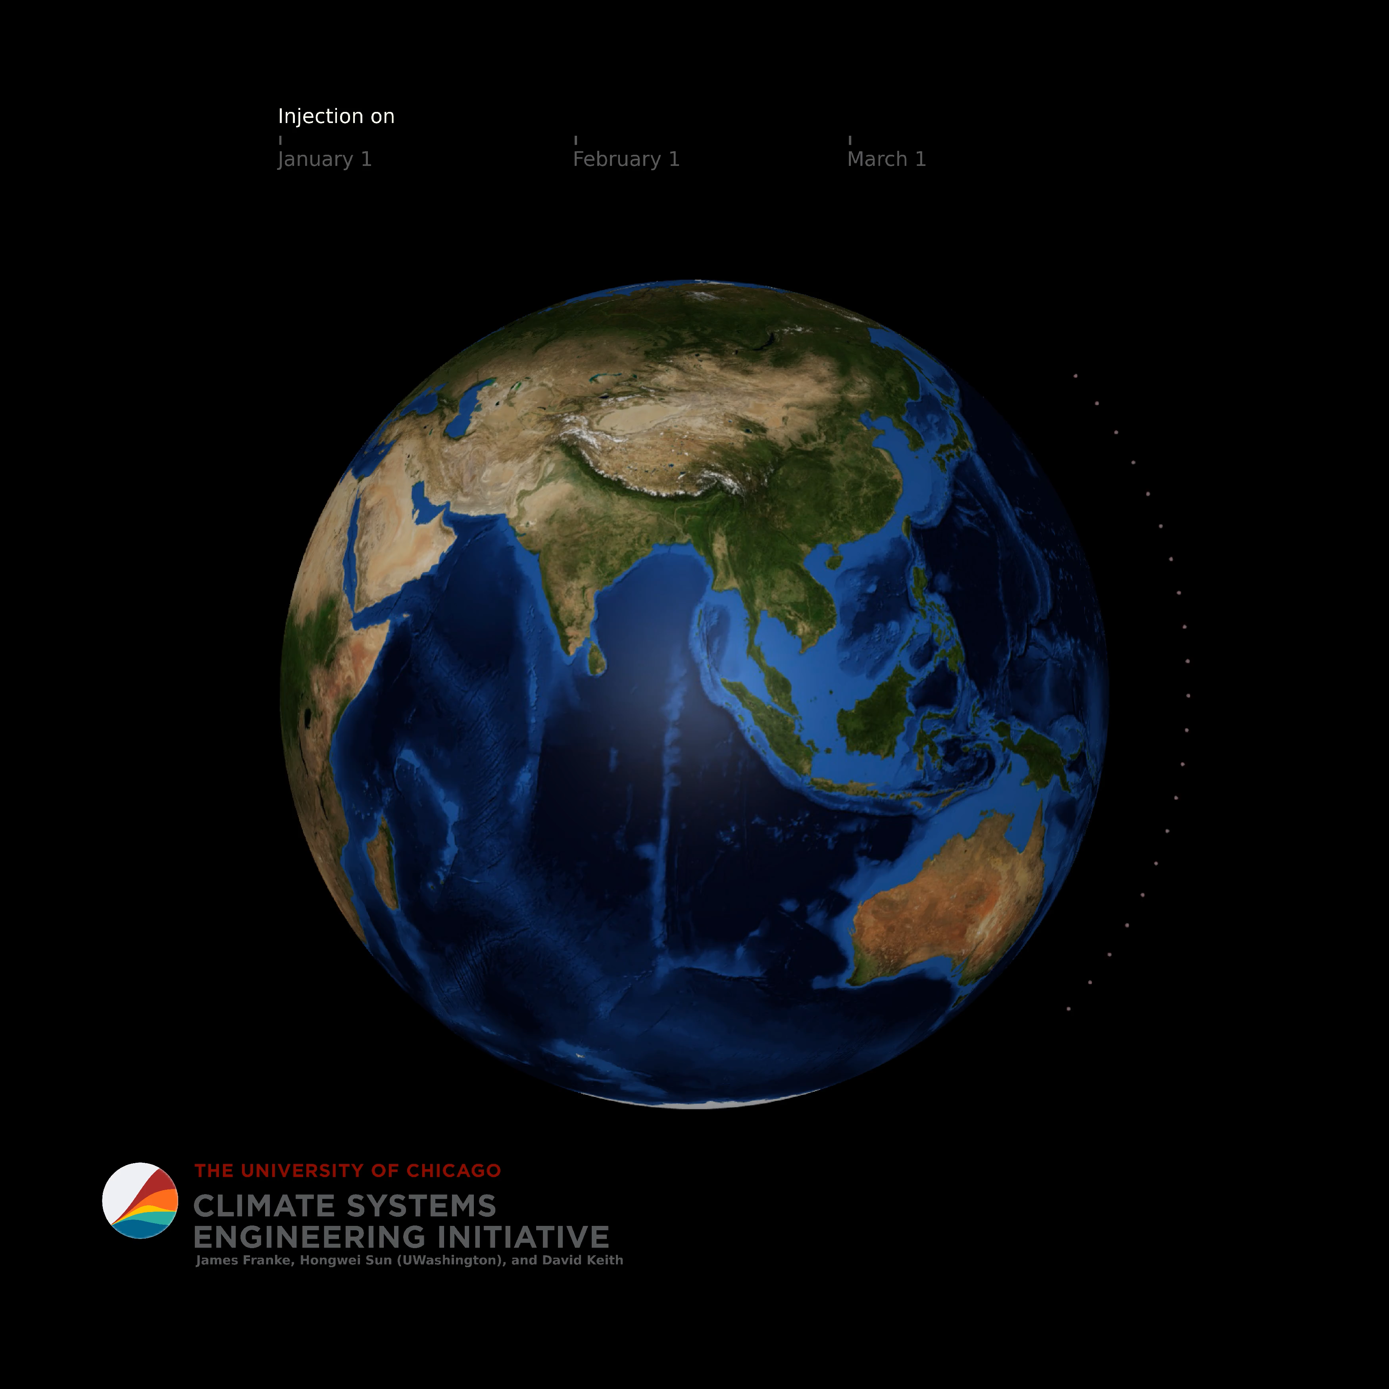
Injected aerosols are quickly distributed by strong zonal winds in stratosphere
Injection at 20 km altitude across range of latitudes (21 points @ 60N-S, 180E) for 1 month duration.
Key Takeaways:
Reasonable even global coverage after only a few months.
Localization is impossible for stratospheric aerosol injections.
Details: Lagrangian particles with settling. Wind data is high from high resolution reanalysis starting Jan 1, 2020. Hongwei Sun and Jim Franke

Slide 14
Why sulfur?
Sulfur required for cooling is comparatively small:
(Mt-S/year)
Industrial emissions:
1980: 70 (peak global S pollution)
2025: 30
Pinatubo: 8
Global industrial sulfur market: 85
Amount needed to cool Earth 0.5 C: ~1.5
The most common natural aerosol in the stratosphere.
Ocean plankton make Dimethyl sulfide (DMS) that is a major source of stratospheric sulfate aerosols.
These plankton are one of Lovelock’s Gaia feedback’s
Warming world → plankton make more DMS
→ more stratospheric aerosols → cooling
So, sulfate aerosol SRM is (arguably) a Nature Based Solution.
The environmental and climate impacts of sulfate aerosols have been studied in >10,000 scientific papers over a century. This deep knowledge greatly reduces chance of unknown unknowns.

Slide 15
Engineering

Slide 16
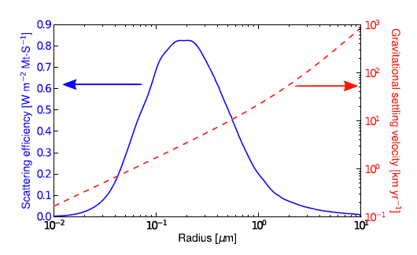
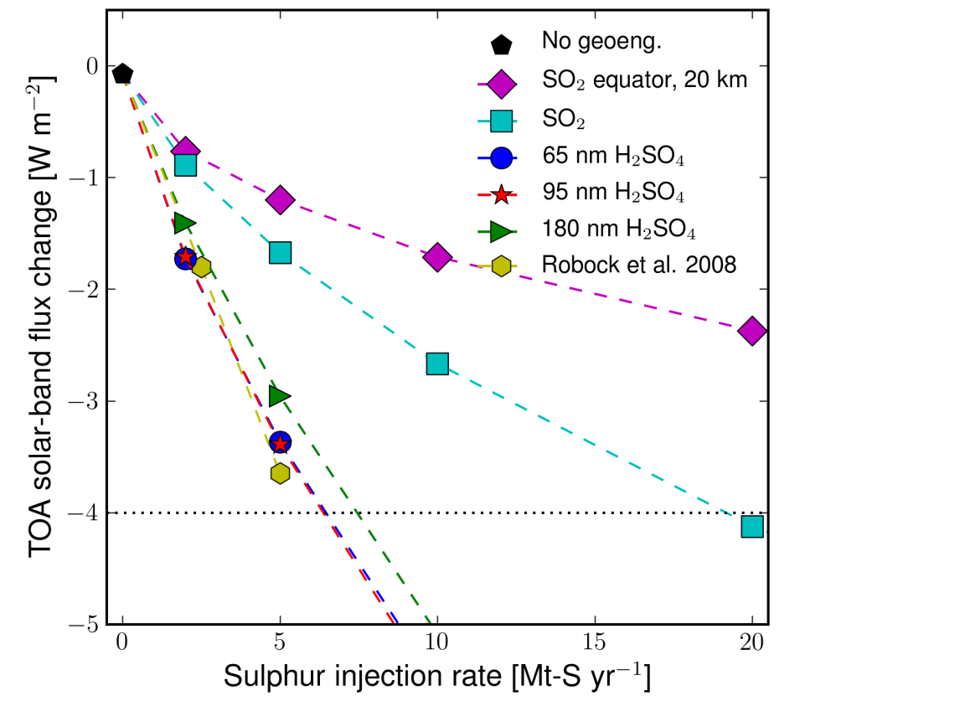
Problem: copying volcanoes (SO₂) does not work very well
Scattering gets much less effective when droplets are bigger than ~0.5 µm.
SO₂ takes about a month to make condensable H₂SO₄
When a condensable gas is added slowly and evenly almost all of it ends up on existing droplets.
SO₂ injection makes particles that are too to be effective
See: Hekendorn et al, The impact of geoengineering aerosols
on stratospheric temperature and ozone, ERL, 4 2009.

Slide 17
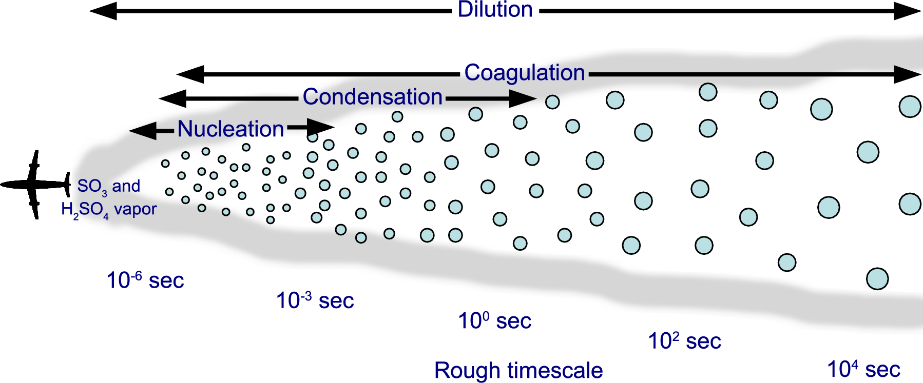
Partial solution: add H₂SO₄ directly in a aircraft plume
Direct H₂SO₄ injection can make small particles with well controlled sized distribution.
➔ Much more effective.
Efficient formation of stratospheric aerosol for climate
Engineering by emission of condensable vapor from aircraft,
Pierce, Weisenstein, Heckendorn, Peter and Keith, GRL, 2010

Slide 18
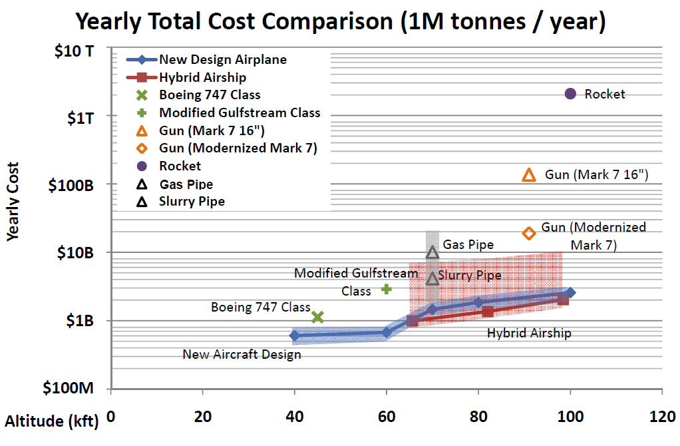
About 1 $/kg to the lower or middle stratosphere by several methods
Kilometers: | 12.2 | 18.2 | 21.3 | 24.4 | 30.5
Thousands of Feet (kft): | 40 | 60 | 70 | 80 | 100

Slide 19
 | Mass/S | Toxic risk | Aerosol formation | Technical Uncertainties
SO₂ | 2.0 | H | Weeks | Vaporization of droplets
H₂S | 1.1 | H | Days to SO₂ | Cost of production
S | 1.0 | L | SO₂ is product | In situ combustion
CS₂ | 1.2 | M | Half to OCS? → long lifetime | Vaporization or in-situ combustion, production cost
H₂SO₄ | 3.1 | M | Fast (sec) → accumulation mode aerosol | Minimal, vaporization
SO₃ | 2.5 | H |  | Vaporization
Assume
SO₂, H₂S, and SO₃ are carried as cold liquified gasses at 1 bar.
CS₂, SO₃, and H₂SO₄ are carried as liquids
Notes:
→ SO₃ weeks
→ SO₂ (days) → SO₃ weeks

Slide 20
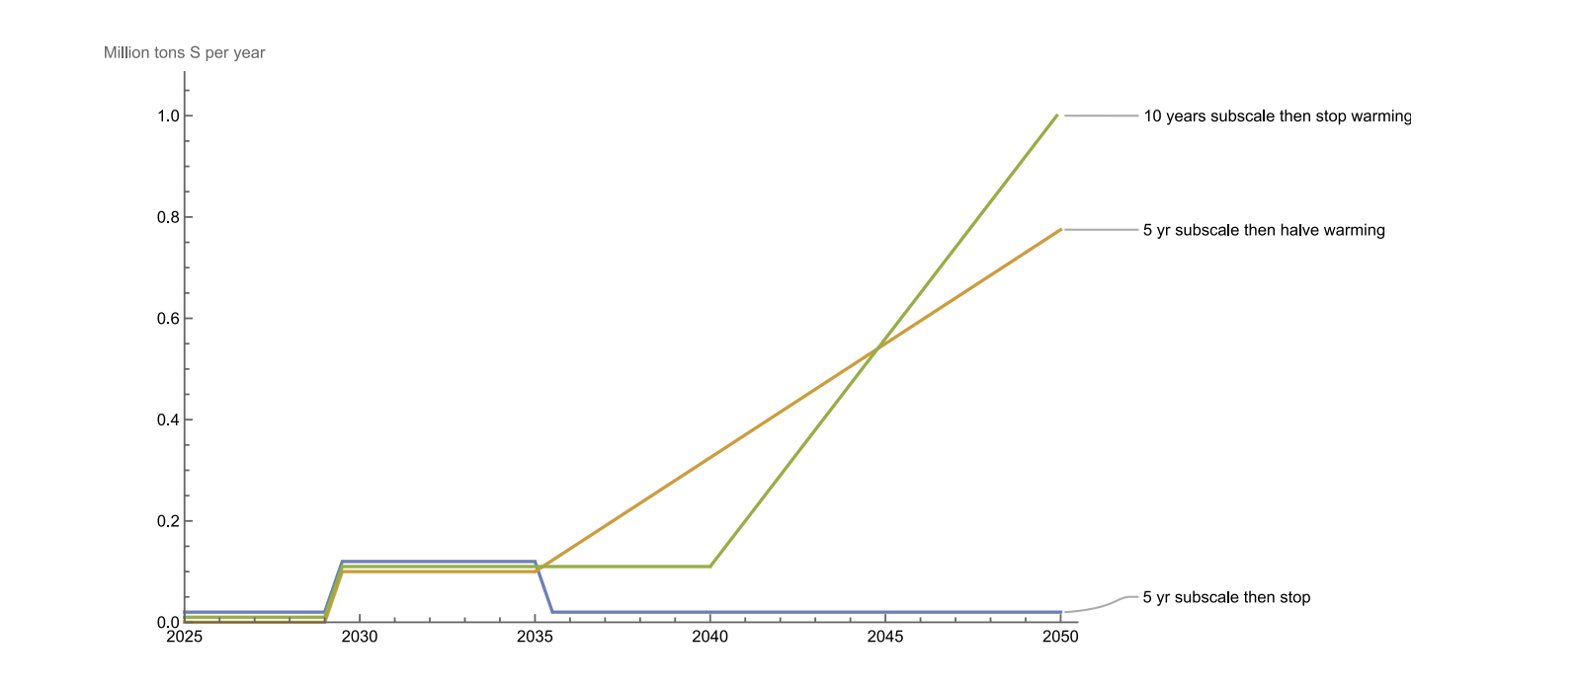
Sub-scale deployment
10 modified business jets can put about
0.1 Mt-S/year into the mid-latitude stratosphere.
This is about the same as the background flow of S into the stratosphere.
Cooling of order 0.02 C or about 1 year of warming.
Assumptions:
Payload of 10,300 lb for Gulfstream G650 at 51,000 feet with 6,400 lb fuel sufficient for takeoff and climb (3,000 lb), diversion loiter and reserve (2,500 lb), and decent and landing (900 lb).
600 lb tankage and plumbing for carrying SO₂ or H₂S as chilled liquid at 1 bar.
Flight tempo: 6 sorties /day (roughly 1 hour per cycle), 330 operational days per year.
These assumptions yield ~ 10 ktons per aircraft per year to 15.5 km altitude.
Solar geoengineering could start soon if it starts small Technology Review, 2024. Keith & Smith

Slide 21
Comparing SRM methods

Slide 22
Method | Confidence that substantial global ΔRF (e.g. > 3 Wm⁻²) is achievable | Advantage | Disadvantage
Strat sulfates | Very high: Current technologies can likely be adapted to loft materials and disperse SO₂ and relevant scales | Similarity to volcanic sulfate gives empirical basis for estimating efficacy and risks | Hard to adjust zonal distribution; ozone loss; stratospheric heating
Other strat aerosol | Moderate: depends on aerosol, lofting similar to sulfate but aerosol dispersal much more uncertain | Some solid aerosols may have less strat heating and minimal ozone loss | Hard to adjust zonal distribution; higher uncertainty than sulfates
Marine clouds | Uncertain: observations support wide range of CCN impact on albedo; significant work on development of spray systems, but no system-level analysis of cost of deployment | Ability to make local alterations of albedo; ability to albedo modulate on short timescales. | Only applicable on marine stratus covering ~10% of earth means RF inherently patchy; fast timescale raises termination risk
Cirrus | Uncertain: deep uncertainty about fraction of cirrus strongly depended on homogeneous nucleation; no studies of dispersal technologies nor system studies examining diffusion off CCN and link to flight profiles | Works on LW more than SW so could provide better compensation than “perfect” strat or space-based scatters; better RF uniformity that MCB | More ability to adjust zonal distribution that strat aerosols, perhaps less meridional adjustability.
Space based | Low physical uncertainty, but deep technological uncertainties about cost and feasibility | Possibility of near “perfect” alteration of solar constant. Spectral tailoring may be easier | Some methods (e.g. L1 point) would not allow zonal or meridional tailoring of RF
Solar geoengineering as part of an overall strategy for meeting the 1.5°C Paris target, MacMartin, Ricke, and Keith, Philosophical Transactions of the Royal Society, 2018

Slide 23
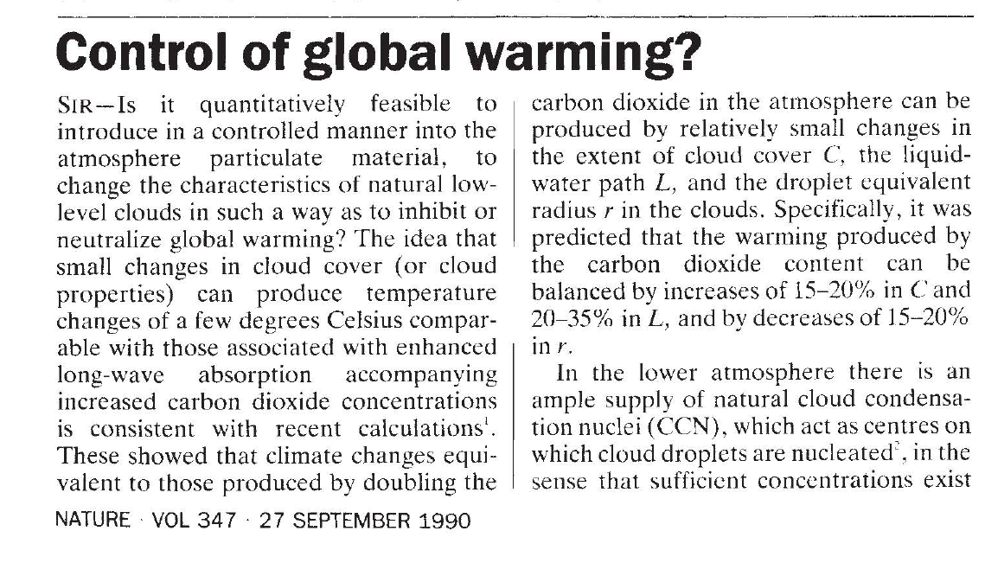
Latham 1990

Slide 24
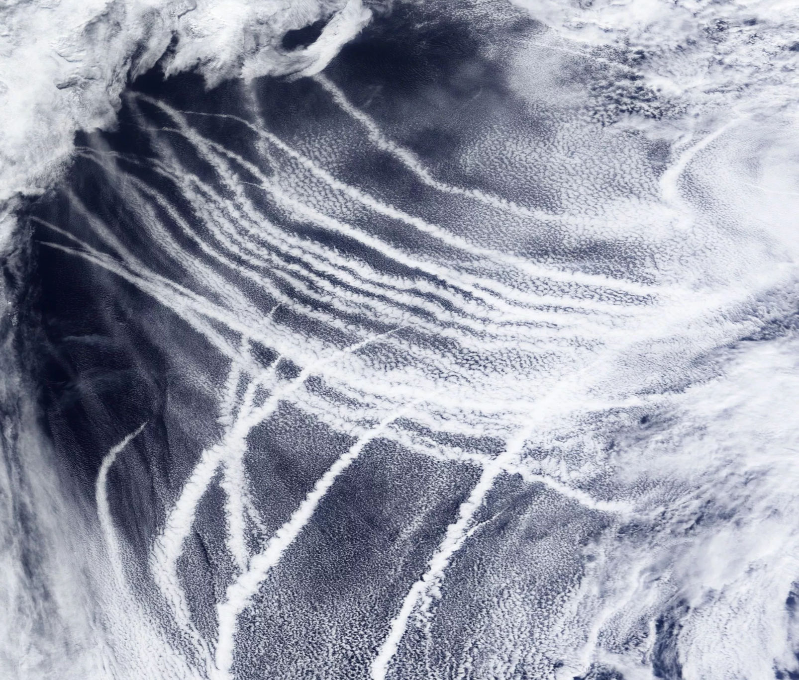

Slide 25
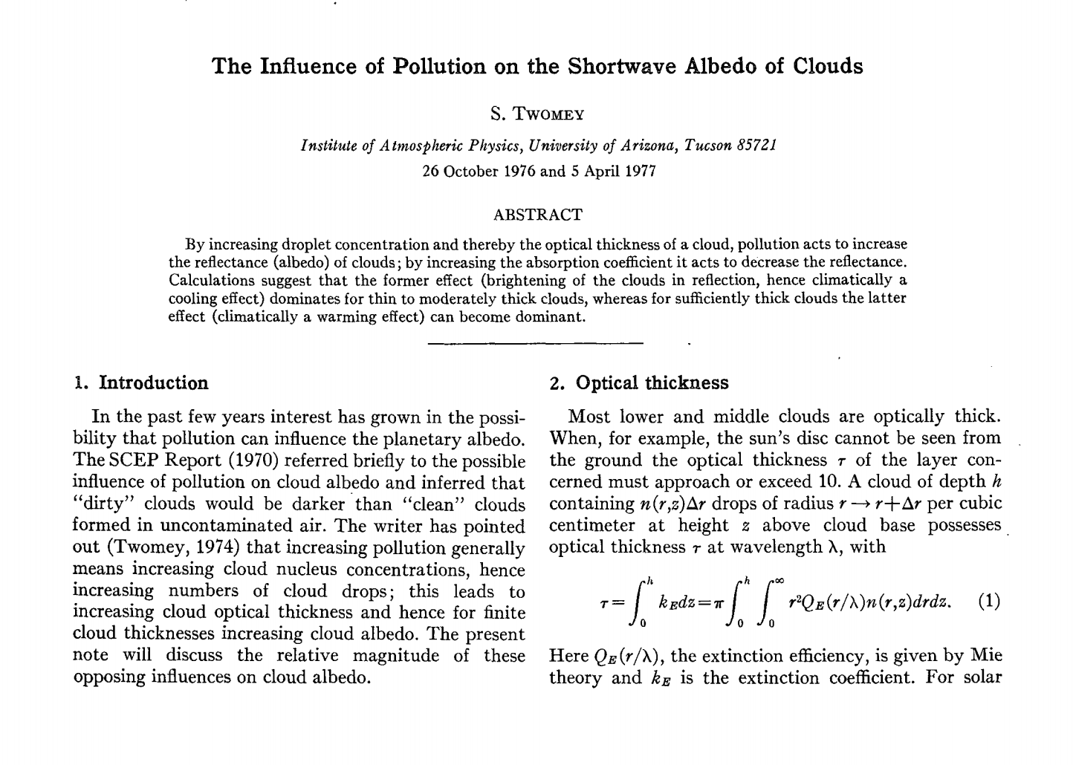

Slide 26
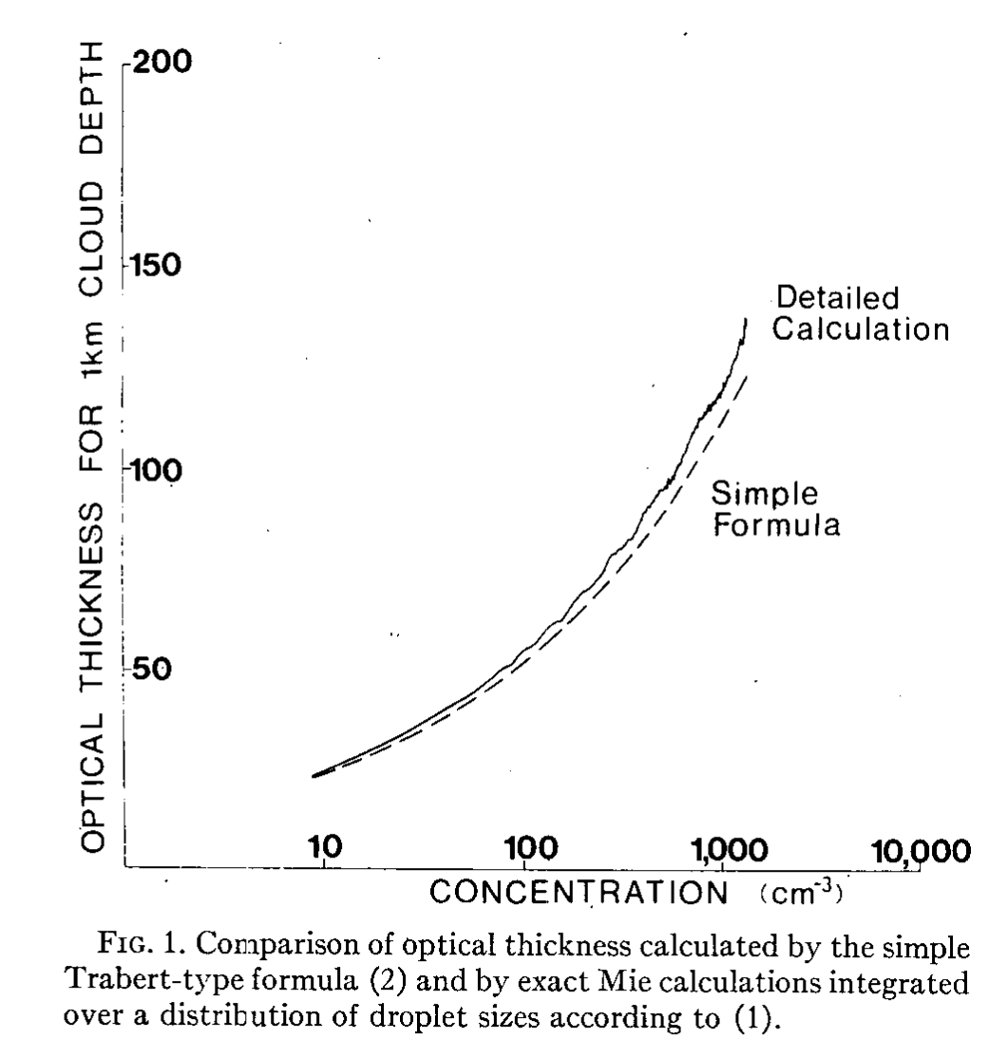
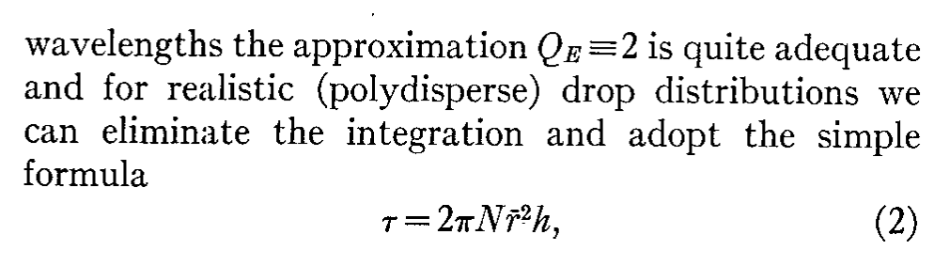
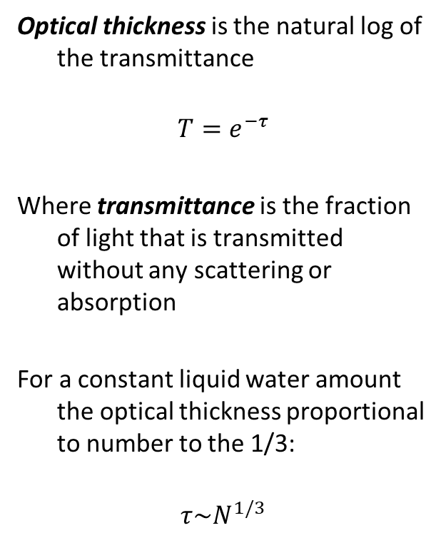
Optical thickness is the natural log of the transmittance
$$T=e^{−τ}$$
Where transmittance is the fraction of light that is transmitted without any scattering or absorption
For a constant liquid water amount the optical thickness proportional to number to the 1/3:
$$τ\sim N^{1/3}$$

Slide 27
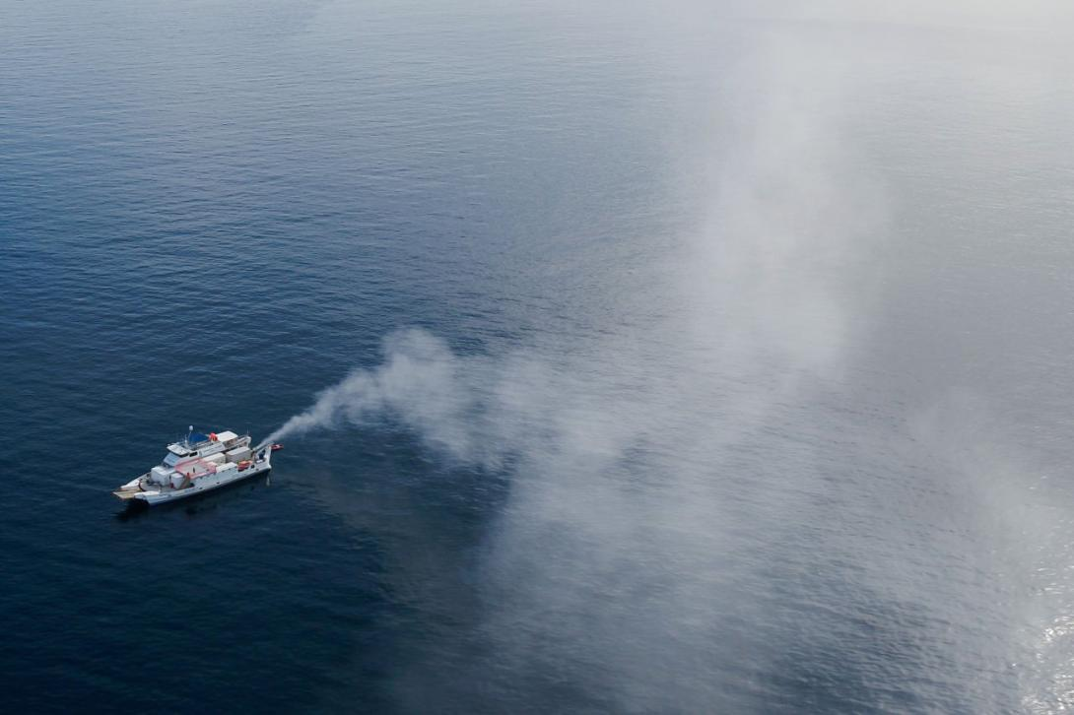
Credit: Brendan Kelaher, Southern Cross University
Notes:
https://www.climaterepair.cam.ac.uk/events/bright-side-new-developments-marine-cloud-brightening-technology
Image Credit: Brendan Kelaher, Southern Cross University

Slide 28
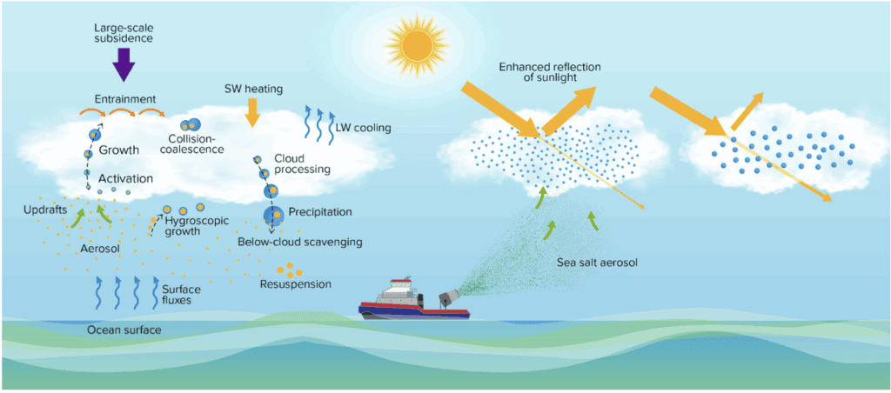
Credit: Sorooshian et al
Notes:
Credit: Sorooshian et al

Slide 29
Method | Confidence that substantial global ΔRF (e.g. > 3 Wm⁻²) is achievable | Advantage | Disadvantage
Strat sulfates | Very high: Current technologies can likely be adapted to loft materials and disperse SO₂ and relevant scales | Similarity to volcanic sulfate gives empirical basis for estimating efficacy and risks | Hard to adjust zonal distribution; ozone loss; stratospheric heating
Other strat aerosol | Moderate: depends on aerosol, lofting similar to sulfate but aerosol dispersal much more uncertain | Some solid aerosols may have less strat heating and minimal ozone loss | Hard to adjust zonal distribution; higher uncertainty than sulfates
Marine clouds | Uncertain: observations support wide range of CCN impact on albedo; significant work on development of spray systems, but no system-level analysis of cost of deployment | Ability to make local alterations of albedo; ability to albedo modulate on short timescales. | Only applicable on marine stratus covering ~10% of earth means RF inherently patchy; fast timescale raises termination risk
Cirrus | Uncertain: deep uncertainty about fraction of cirrus strongly depended on homogeneous nucleation; no studies of dispersal technologies nor system studies examining diffusion off CCN and link to flight profiles | Works on LW more than SW so could provide better compensation than “perfect” strat or space-based scatters; better RF uniformity that MCB | More ability to adjust zonal distribution that strat aerosols, perhaps less meridional adjustability.
Space based | Low physical uncertainty, but deep technological uncertainties about cost and feasibility | Possibility of near “perfect” alteration of solar constant. Spectral tailoring may be easier | Some methods (e.g. L1 point) would not allow zonal or meridional tailoring of RF
Solar geoengineering as part of an overall strategy for meeting the 1.5°C Paris target, MacMartin, Ricke, and Keith, Philosophical Transactions of the Royal Society, 2018

Slide 30
Climate response

Slide 31
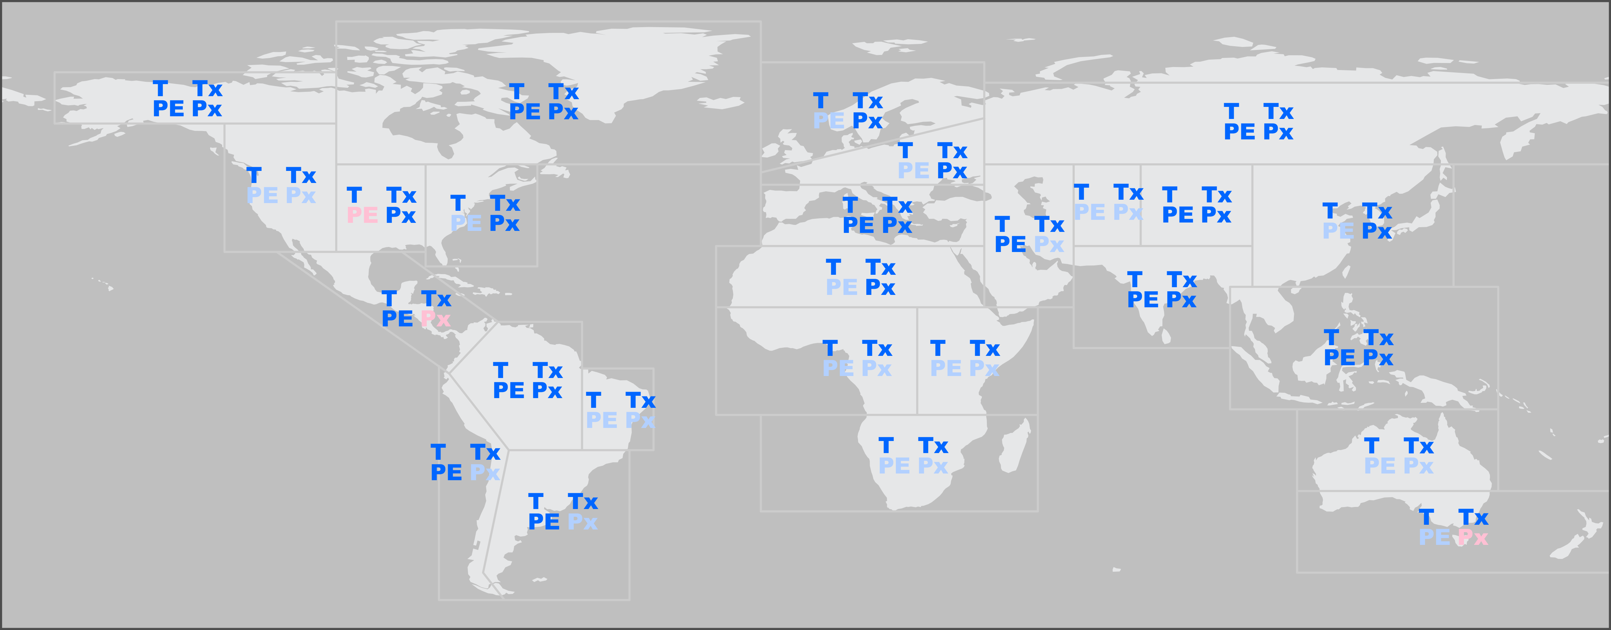
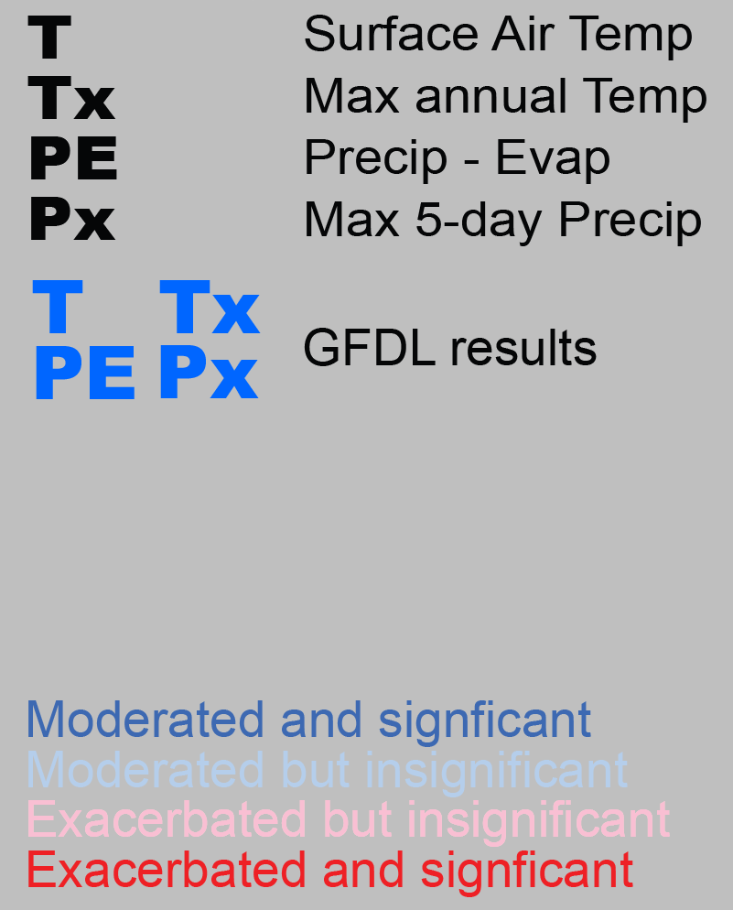
No red symbols → None of the climate hazards is significantly exacerbated in any region
Variable
Effect and statistical significance
Moderated = move towards pre-industrial = less climate change ≈ better
Exacerbated = move away from pre-industrial = more climate change ≈ worse
Halving warming with idealized solar geoengineering moderates key climate hazards. Peter Irvine, Kerry Emanuel, Jie He, Larry W. Horowitz, Gabriel Vecchi, David Keith. Nature Climate Change, 2019.

Slide 32
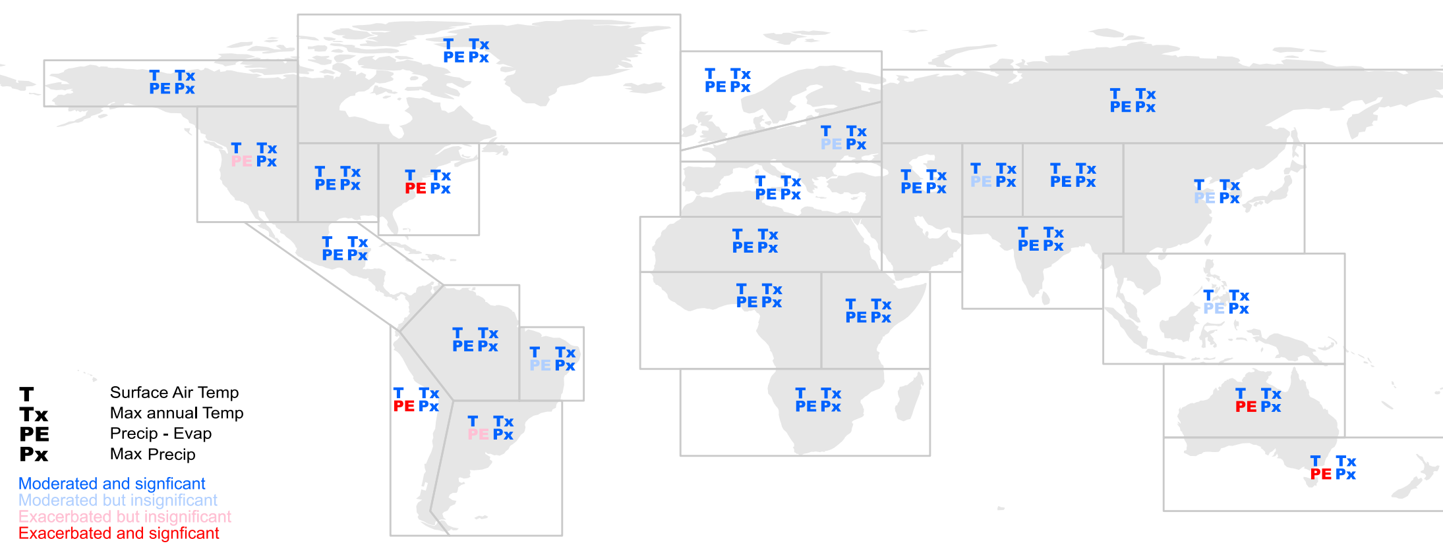
For all the 4 regions where PE is exacerbated it is increasing P-E
→ decreasing aridity
Same analysis method as prior but applied to GLENS (stratospheric aerosol geoengineering large ensemble Tilmes et al 2018) using CESM/WACCM.
With half-geoengineering computed by point-by-point linear scaling
Halving warming with stratospheric aerosol geoengineering moderates policy-relevant climate hazards, Peter Irvine and David Keith. ERL, 2020.

Slide 33
Concerns

Slide 34
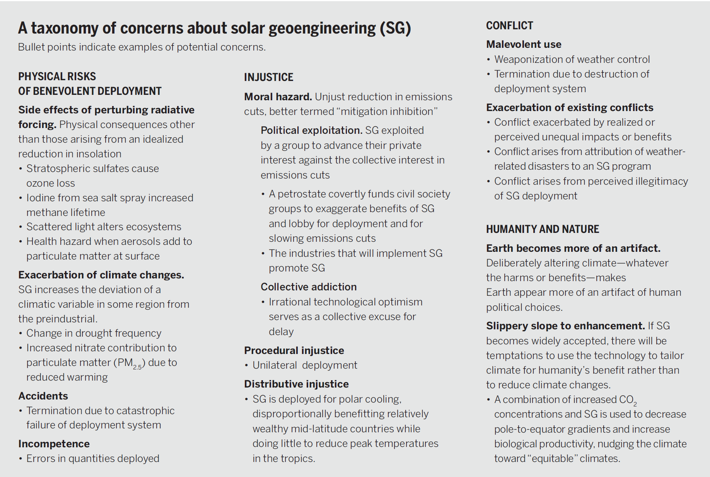
Towards constructive disagreement about geoengineering, David Keith. Science, 2021.

Slide 35
Reliability of Solar Geoengineering Research
Ansatz: the reliability of a body of research increases with the duration of the research theme, the volume of research in the theme, the intellectual diversity of the research community, and the absence of commercial influence.
Examples:
New medical research shows how to extend lifespans: “Inhibition of IL-11 signaling extends mammalian healthspan and lifespan,” Nature, July 2024.
The standard model of quantum electrodynamic stands another test: “An improved bound on the electron’s electric dipole moment”, Science, July 2023.
Factors that suggest SRM research is unreliable:
Duration: most research done in the last decade
Intellectual diversity: much done by a small clique of researchers,
Volume: is low, in part because scientific research funding for SRM is well under 0.1% of total climate research.

Slide 36
Reliability of Solar Geoengineering Research (2)
SRM is old: Research on SRM goes back to the early 60’s, it was reviewed in NAS reports of 1977, 1983, 1992. The first GCM simulation was published in 2000 by Bala and Ken. The long duration—albeit on a small scale and with little funding—means there has been time to find serious flaws, particularly given that climate researchers were generally biased against SRM research providing a solid motivation to root out errors.
SRM is better understood as an application of environmental geoscience than as an independent field: If research depended on new methods to study novel atmospheric processes, then the arguments for unreliability would carry more weight.

Slide 37
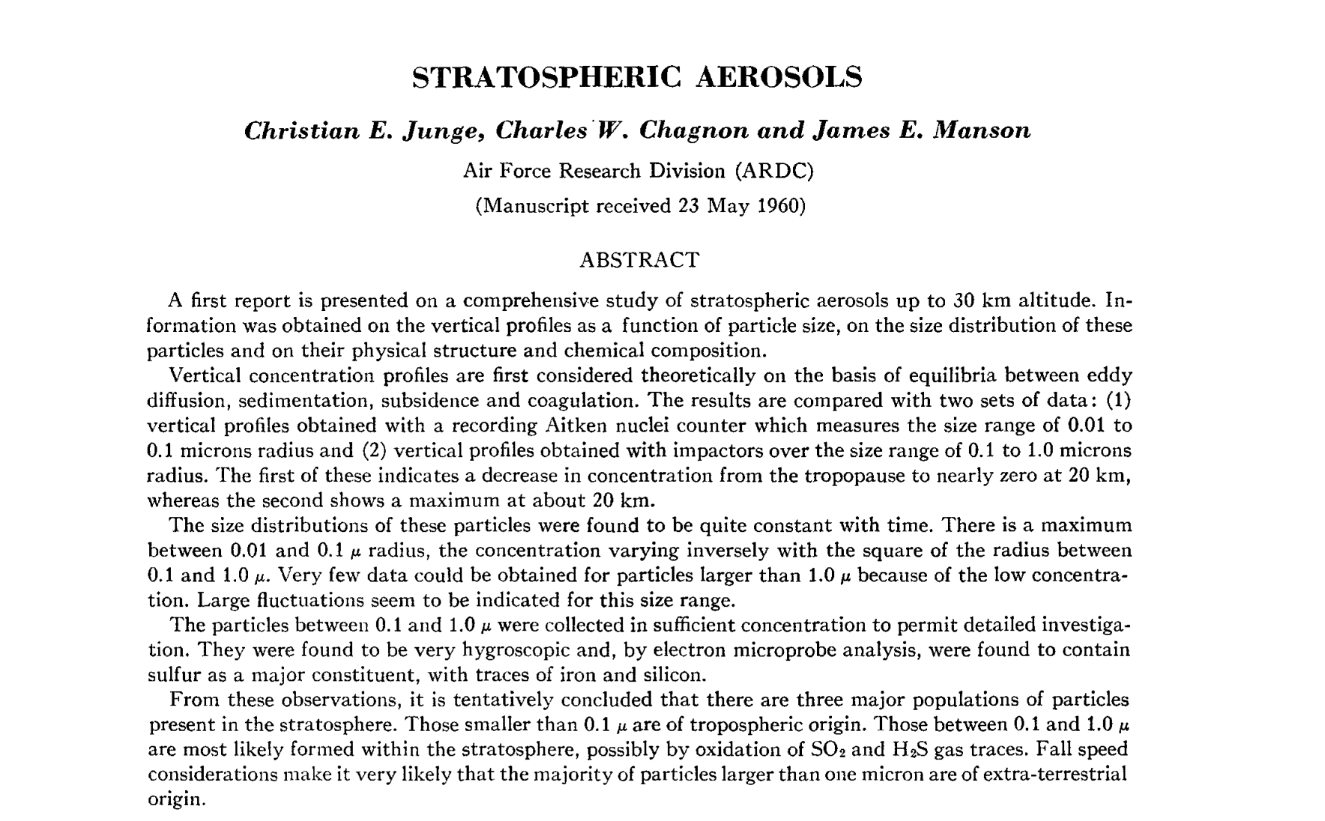
Reliability of Solar Geoengineering Research (3)
Journal of the Atmospheric Sciences, 1961
Notes:
https://journals.ametsoc.org/view/journals/atsc/18/1/1520-0469_1961_018_0081_sa_2_0_co_2.xml

Slide 38
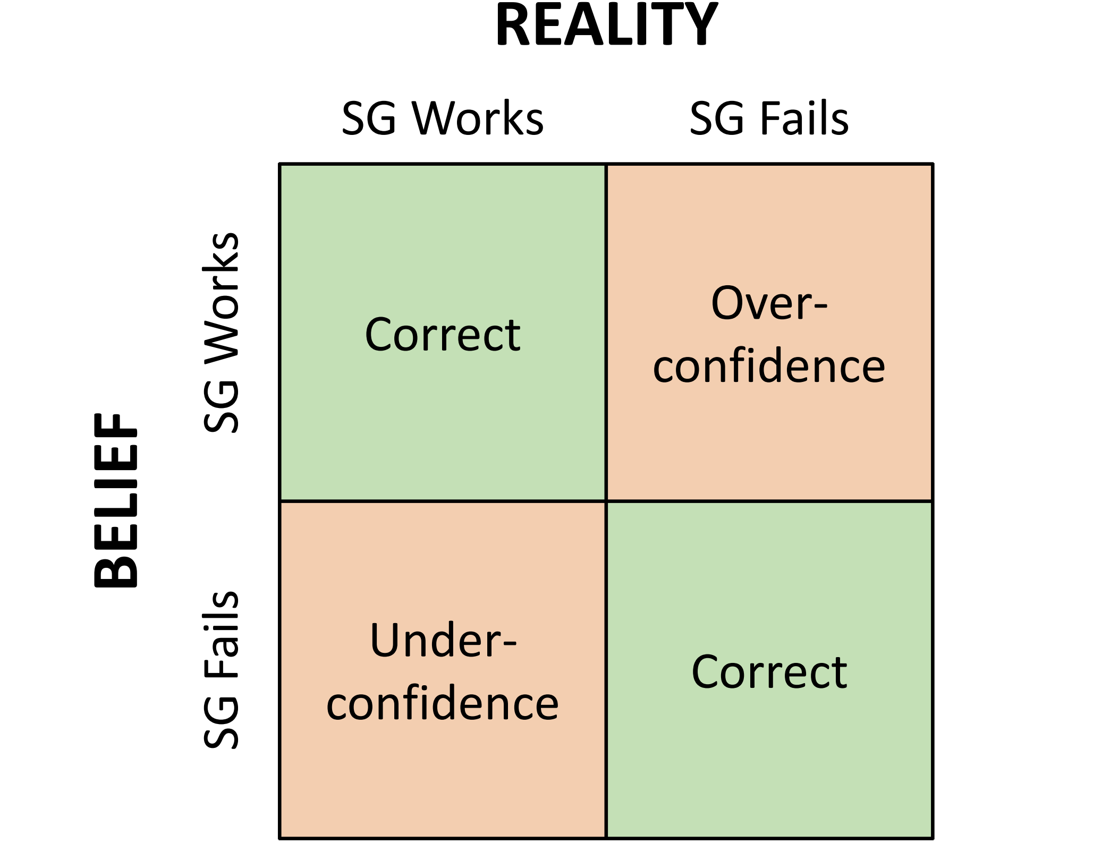
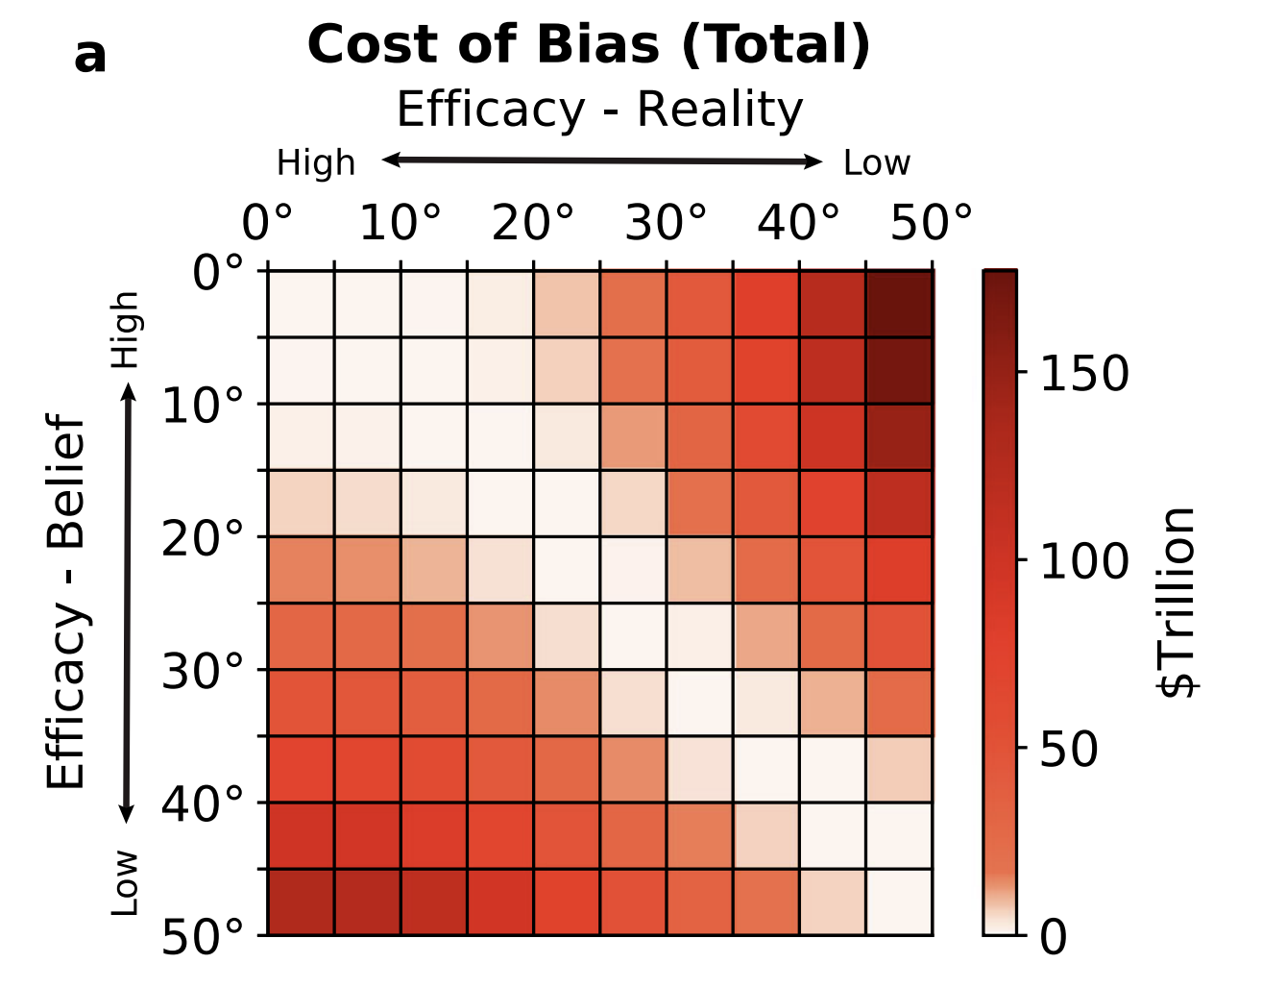
What’s the value of knowing more about SRM?
Reducing uncertainty about performance of SRM by a third in 2030 is worth roughly 4.5 $trillion
Big model full of approximations
Fine print: we compute net present value of optimal policy using a modified version of the Nordhaus DICE model with uncertainty in SRM and in climate sensitivity. Answer depends on many assumptions, but $trillion is right order of magnitude.
The value of information about solar geoengineering and the two-sided cost of bias. Tony Harding, Mariia Belaia, and David Keith. Climate Policy, 2022

