Slide 1
Arthur H. Compton Lecture Series:
An Intro to Climate Systems Engineering Part II
Fossil Carbon
A waste management perspective
Lecturer: David Archer
Allyse and Helmut Heydegger Professor of Environmental Science
Department of the Geophysical Sciences
October 11, 2025

Slide 2


Slide 3
Solid Garbage and Gas Garbage
 | Solid Waste | Gas Waste (CO₂)
Waste mass per American | 1 ton / year | 14 tons / year
Volume of that waste | 2 cubic meters | 7000 cubic meters
Accumulation rate, 1000 ft² house | 4 centimeters | 75 meters
 | 1 ¾ inches | 19 stories

Slide 4
The Battery of the Biosphere
air
CO₂ + H₂O + energy CH₂O + O₂
coal

Slide 5

American average fossil energy use = 50 people-power

Slide 6
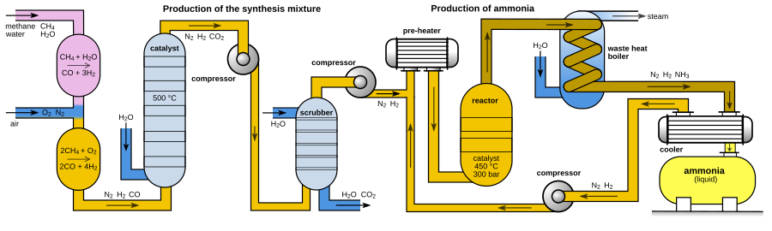
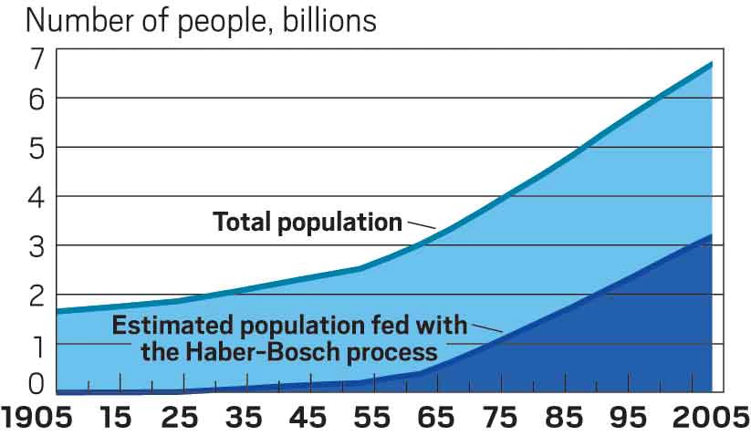
Haber Bosch Process Feeds Humanity

Slide 7
CO2 dissolves into the ocean
CO₂ + CO₃²⁻ + H₂O
2 HCO₃⁻
CO₃²⁻
CO₂

Slide 8
Limestone as Antacid
CO₂ + CO₃²⁻ + H₂O
2 HCO₃⁻
CaCO₃
Ca²⁺ + CO₃²⁻
CO₃²⁻
CO₂

Slide 9
A carbon cycle thermostat
CO₂
Atmosphere
Weathering
CaO + CO₂ + water -> Ca²⁺ + CO₃⁼
Land
CaO
Ocean
Ca²⁺ + CO₃⁼ -> CaCO₃
Subduction
CaO
Sediment

Slide 10
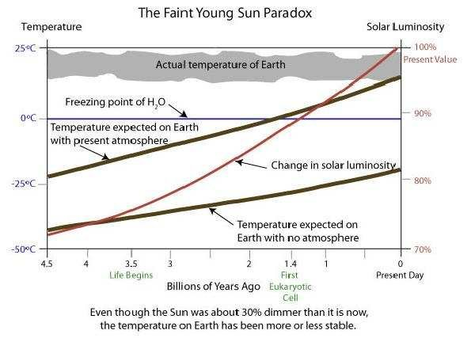
How did Earth not boil or freeze
while the sun kept getting hotter?
Sagan and Mullin 1972

Slide 11
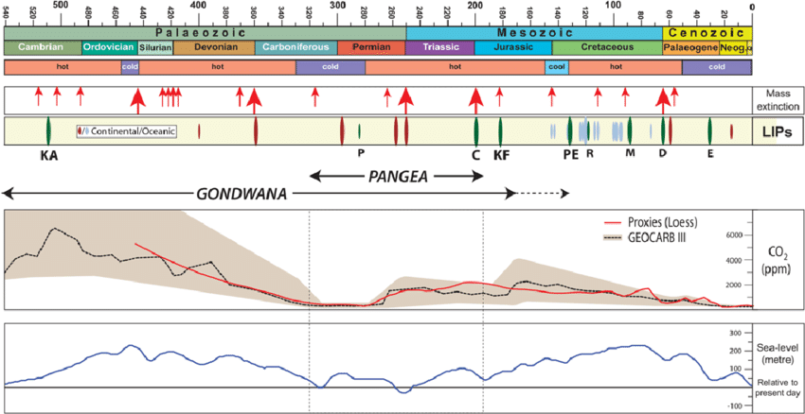

Natural Variations in Earth’s Climate
Extinctions
Eruptions
Hothouse /
Icehouse
Sea Level
Tectonic changes drive the thermostat “set point” CO₂
up and down, hot-house to ice-house climates
Big volcanic eruptions (“large igneous provinces”)
vent CO₂ to the atmosphere, triggering mass extinctions

Slide 12
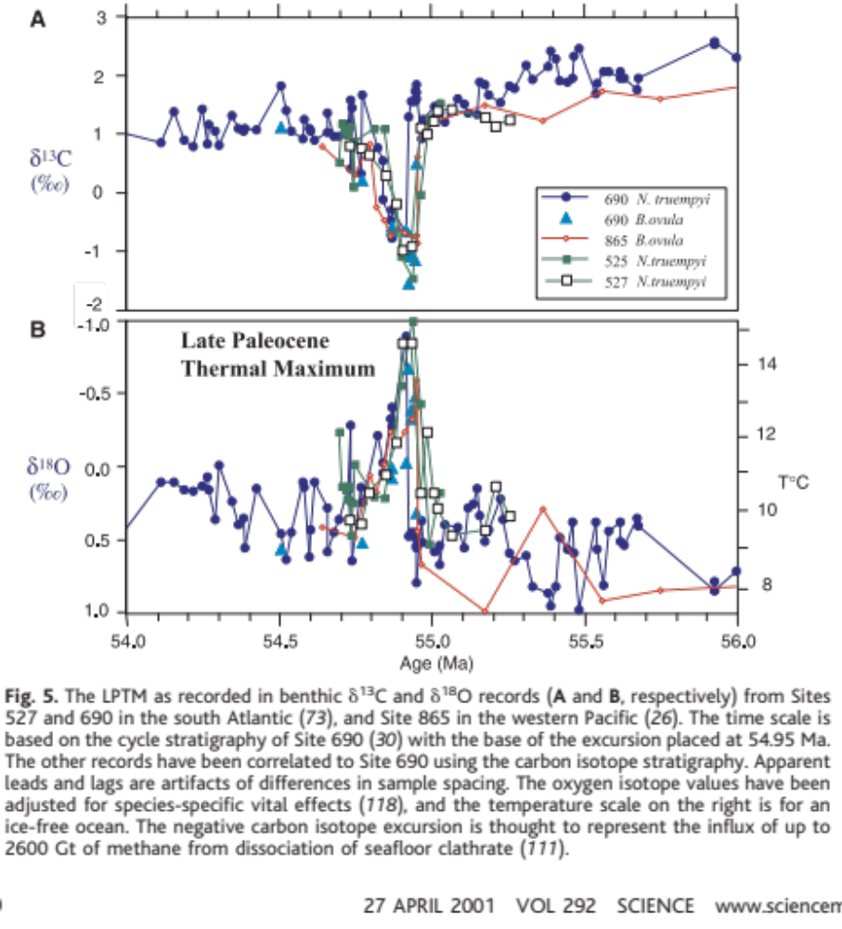
A global warming analog event
55 million years ago
A spike in carbon
(source still uncertain)
Global warming
(deep ocean)
Persisted for 100,000 years
Zachos, 2001

Slide 13
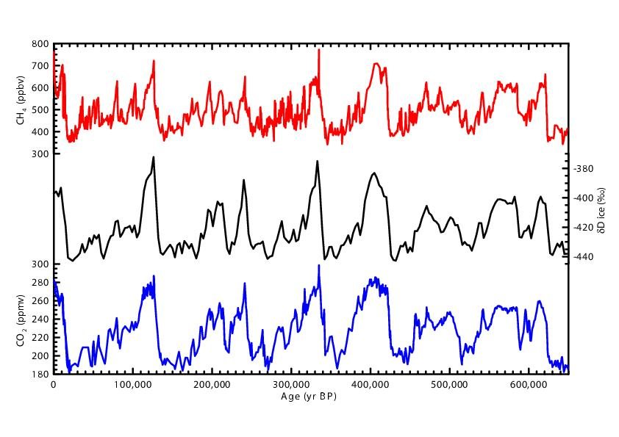
Glacial / Interglacial Cycles
temperature
CO2
The thermostat is not controlling CO2
– it’s too slow
400,000 years
canonical estimate of the thermostat response time

Slide 14
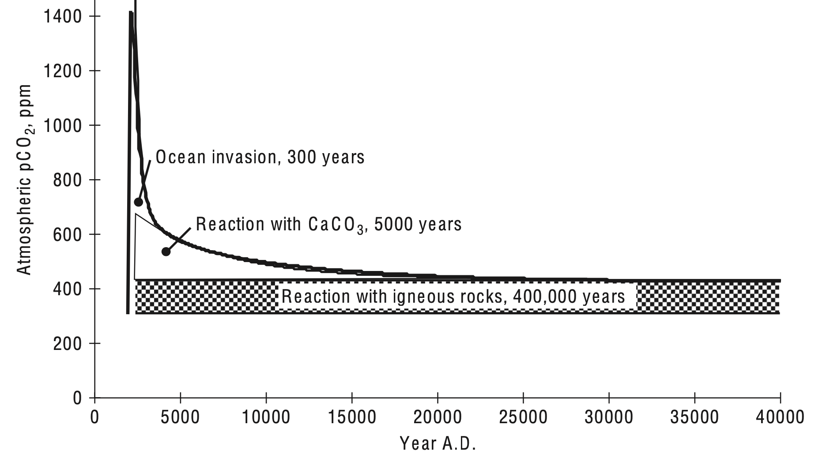
The Long Tail of Fossil Fuel CO₂

Slide 15
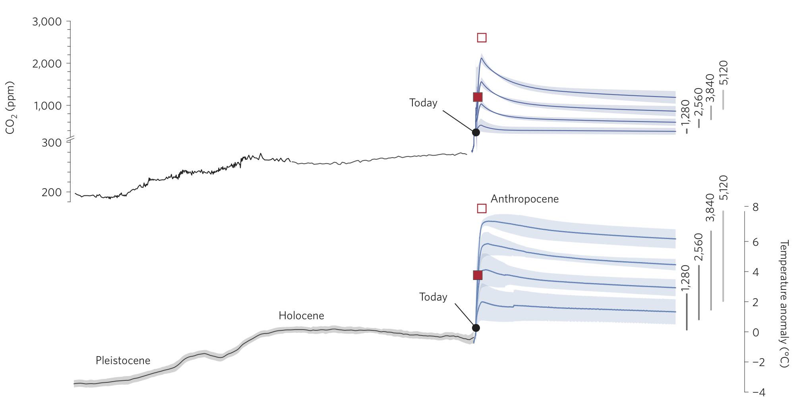
Carbon / Climate / Ice Sheet model results
CO₂ spikes,
then plateaus
at new level.
Temperature
has no spike,
just the plateau.
Persists longer
than the
Holocene
(agriculture)
-20 kyr
0
10 kyr
Years from now
Clark et al 2016

Slide 16
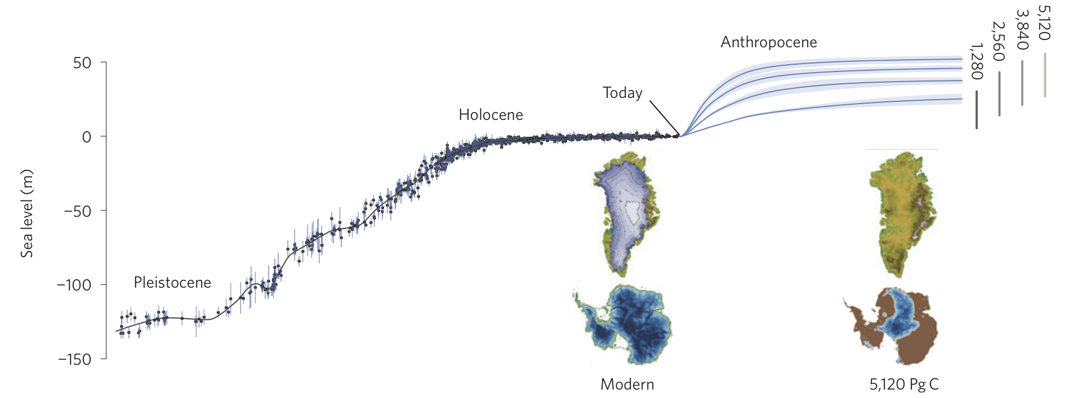
Carbon / Climate / Ice Sheet model results
Up to 50 m
sea level
change.
Loss of most
land ice.
(A few thousand
years from now).
-20 kyr
0
10 kyr
Years from now
Clark et al 2016

Slide 17
Sea Levels and Global Temperatures
From Geologic Reconstructions
Sea Level, m
100
Eocene
40
Myr
ago
50
Pliocene
Much lower sea level
change predicted for
2100 than past changes,
because ice sheets take
1000’s of years to melt.
3
Myr
ago
Global Mean T, °C
Today
5
10
15
IPCC
20
Forecast
-50
Year 2100
Last Glacial
-100
Maximum
20
kyr
ago
-150

Slide 18
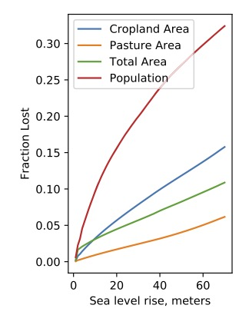
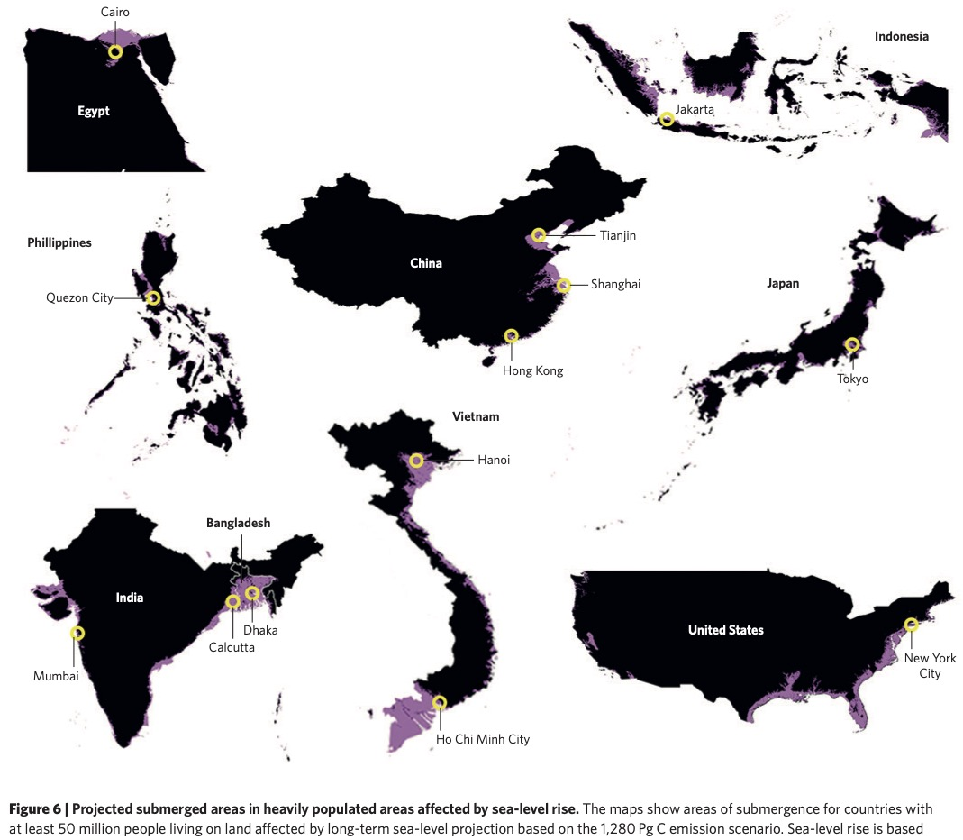
Loss of human habitat with sea level rise
Clark et al 2016
Archer, Kite, and Lusk 2020

Slide 19
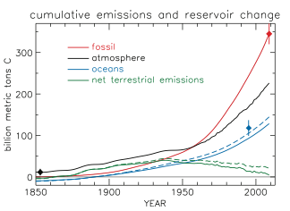
Where the fossil fuel carbon is now
About half in the ocean
Land was a source,
Now mysteriously it balances
Tans 2009

Slide 20
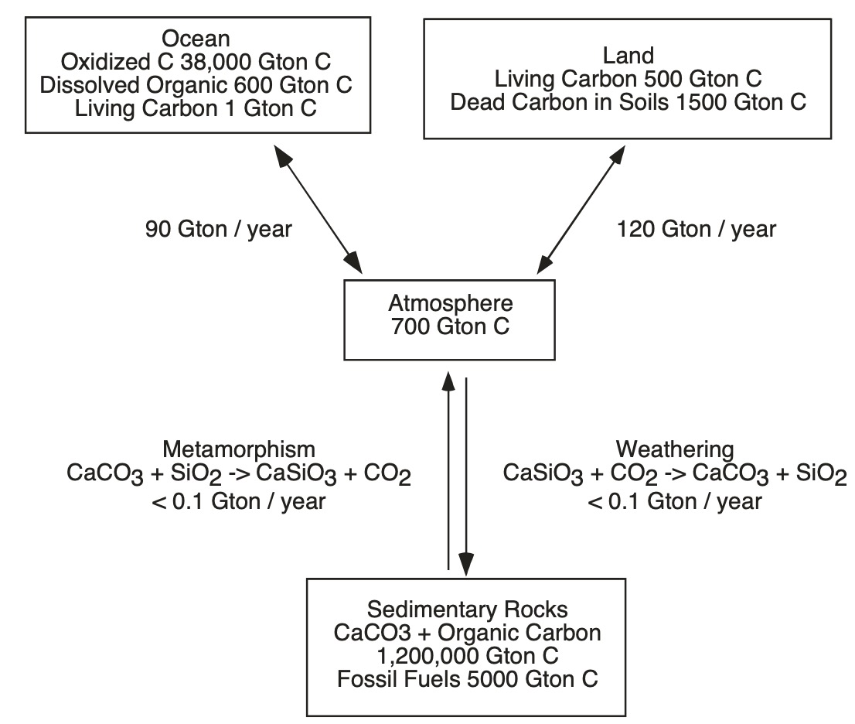

Slide 21
Fossil fuels
Up to 5000 Gton C

Slide 22
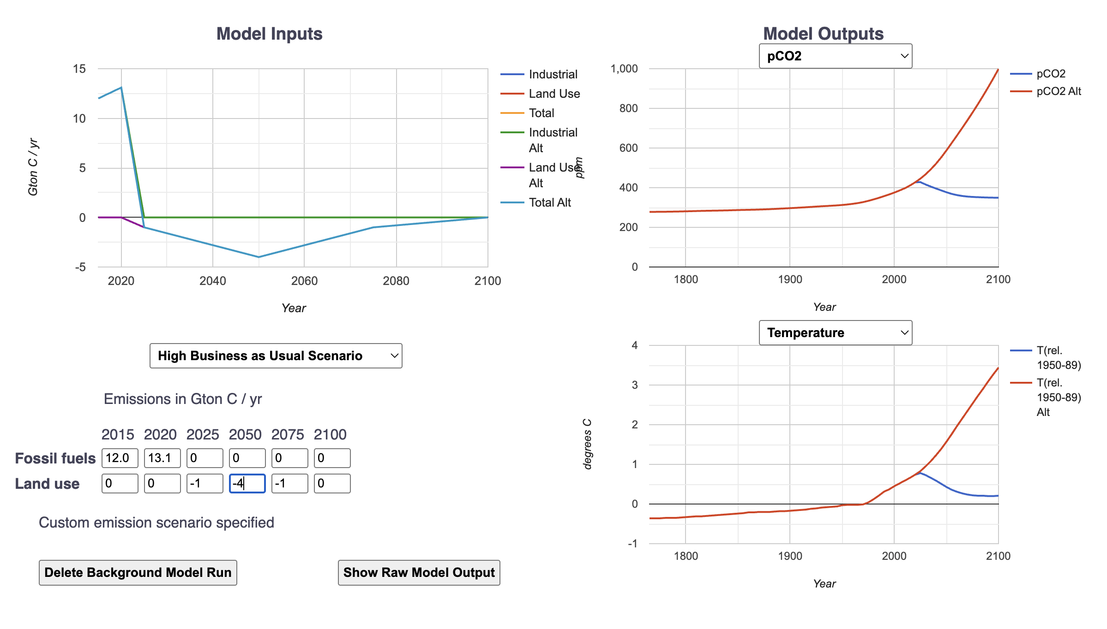
Cleaning CO₂ from the atmosphere
350 ppm
energy balance restored
Decades for
temperatures to fall
From http://climatemodels.uchicago.edu/isam/

Slide 23
Fossil fuels
Cold Turkey now
500 Gton C already
CO₂ Removal
150 Gton C

Slide 24
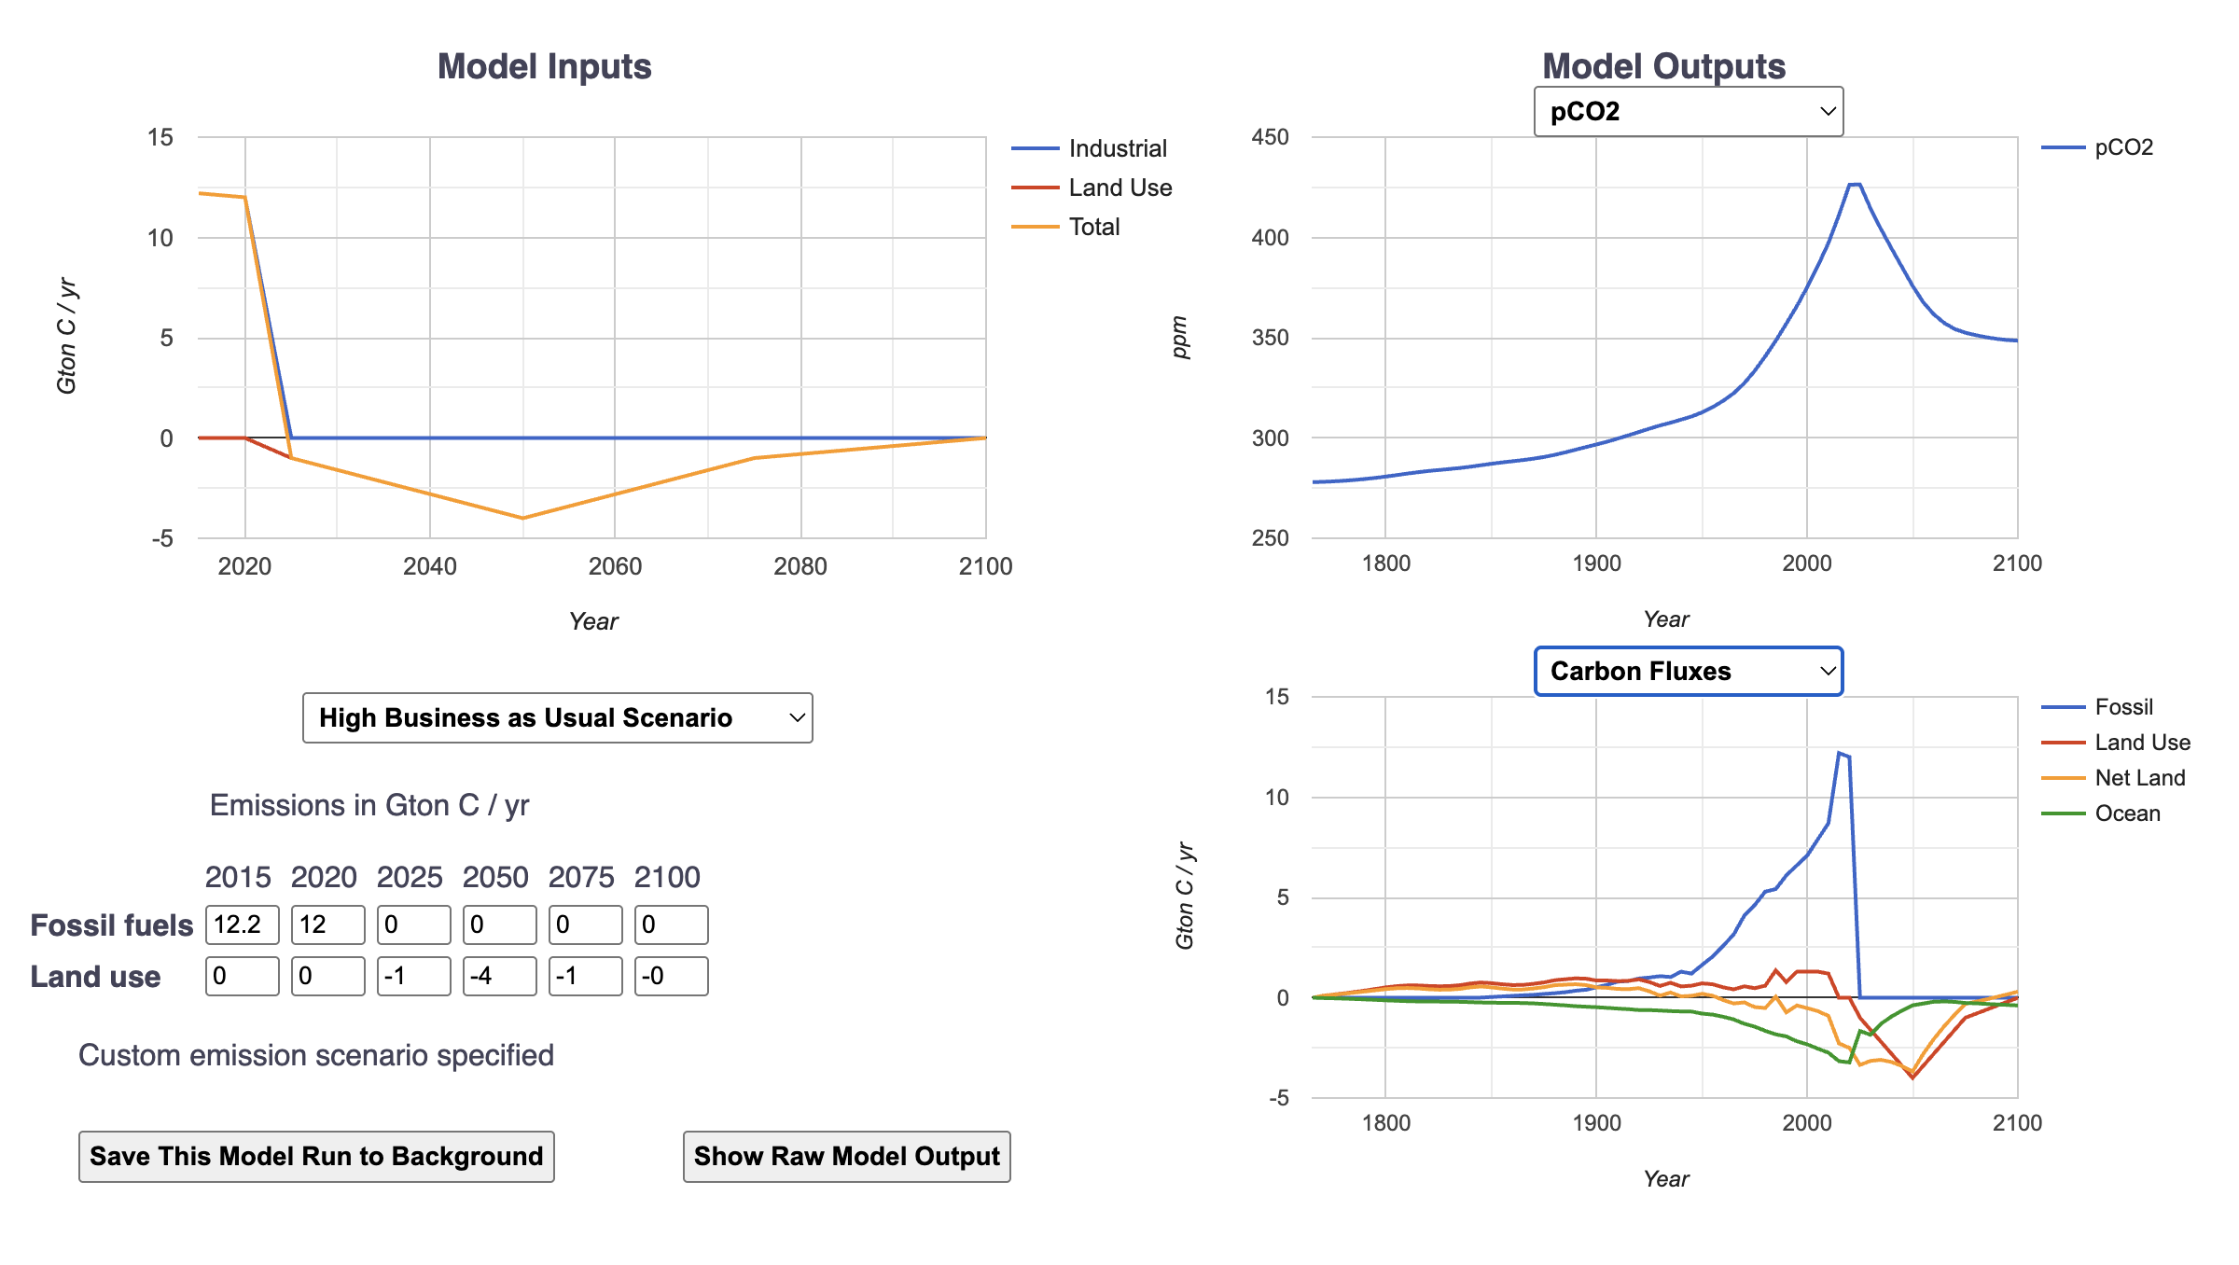
Cleaning CO₂ from the atmosphere
The ocean is not
degassing much

Slide 25
Balance Sheet
Total amount to clean up | 150 Gton C
which also equals | 560 Gton CO₂
CO₂ cleanup cost (roughly) | $100 / ton CO₂
U.S. share of emissions to 1850 | 20-25%
U.S. total cleanup debt | $12 trillion
U.S. debt per capita | $33,000
U.S. annual CO₂ emission per capita | 5 Gton CO₂ / year
U.S. annual per capita debt accumulation | $1300 / year

Slide 26
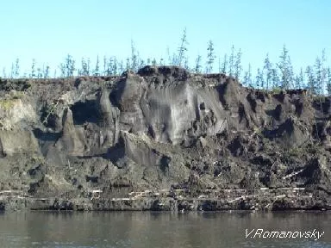
Compound interest from natural carbon sources
Ancient grass roots
frozen in permafrost
100’s Gton C, released as
CO₂ and methane
(Also contains lots of mercury,
another “forever” pollutant)
(Actually CO₂ would be easier
to clean up than mercury,
because half is still in the air)
Will probably release carbon
whether we stop or not

Slide 27
Taking out the CO₂ Garbage
Direct Air Capture
and Sequestration
Plant Trees
Biochar
Kelp forestry
Artificial ocean upwelling
Enhanced Rock Weathering
No-till
Ocean Alkalinity Addition
Ocean Fertilization
Biomass burning energy with carbon capture

