Slide 1
Arthur H. Compton Lecture Series: An Intro to Climate Systems Engineering
Lecturer: Professor David Keith
October 4, 2025

Slide 2



B. B. Cael​
Assistant Professor, Geophysical Sciences​
Interdisciplinary climate and ocean scientist interested in climate mitigation and the natural processes that regulate Earth's climate and carbon cycle.
Tiffany Shaw​
Professor, Geophysical Sciences​
Physicist and climate scientist interested in understanding the physical mechanisms controlling the planetary and regional response to climate changes so that we can have greater confidence in climate predictions.
David Keith​
Professor, Geophysical Sciences​
Faculty Director, Climate Systems Engineering Initiative​ (CSEi)
Physicist and climate scientist who has worked near the intersection of climate science, technology, and public policy since 1991.

Slide 3


David Archer
Professor, Geophysical Sciences​
Scientist working on models of Earth’s carbon cycle and its interaction with global climate, fossil fuel neutralization by calcium carbonate, methane hydrate formation, ocean mercury cycling, and the deep future of global warming/climate change.
Douglas MacAyeal
Professor, Emeritus, Geophysical Sciences​
Glaciologist researching the dynamics and stability of ice shelves in Antarctica, their response to climate change, and their ultimate impact on climate-driven sea-level rise.

Slide 4
 | Speakers | Topics
Oct 4 | Keith | Introductions. Climate in 4 Dimensions. Emissions are peaking. Adaptation. Climate in Context.
Oct 11 | Archer | Carbon cycle and natural geochemical processes as basis to understand carbon removal.
Oct 18 | Shaw | Scientific basis for predicting climate changes in response to emissions of greenhouse gases and aerosol pollution.
Oct 25 | Cael | Carbon removal, including ocean alkalinity enhancement, land-based methods, bioenergy with carbon capture, and direct air capture with storage.
Nov 1 | Keith | Sunlight Reflection Methods (SRM) Part 1: How to Reflect Sunlight, the history of SRM, and why stratospheric sulfur aerosols are most plausible now.
Nov 8 | MacAyeal & Keith | MacAyeal on science of glaciers and interventions to prevent glacial melt. Keith on developing DAC technologies at Carbon Engineering, and lessons for cleantech.
Nov 15 | Shaw & Keith | The climate responses to SRM, potential side effects, and what can be learned from past aerosol pollution, highlighting the limits and uncertainties of experiments.
Nov 22 | Keith & Shaw | The future of climate systems engineering, and climate engineering in context.

Slide 5
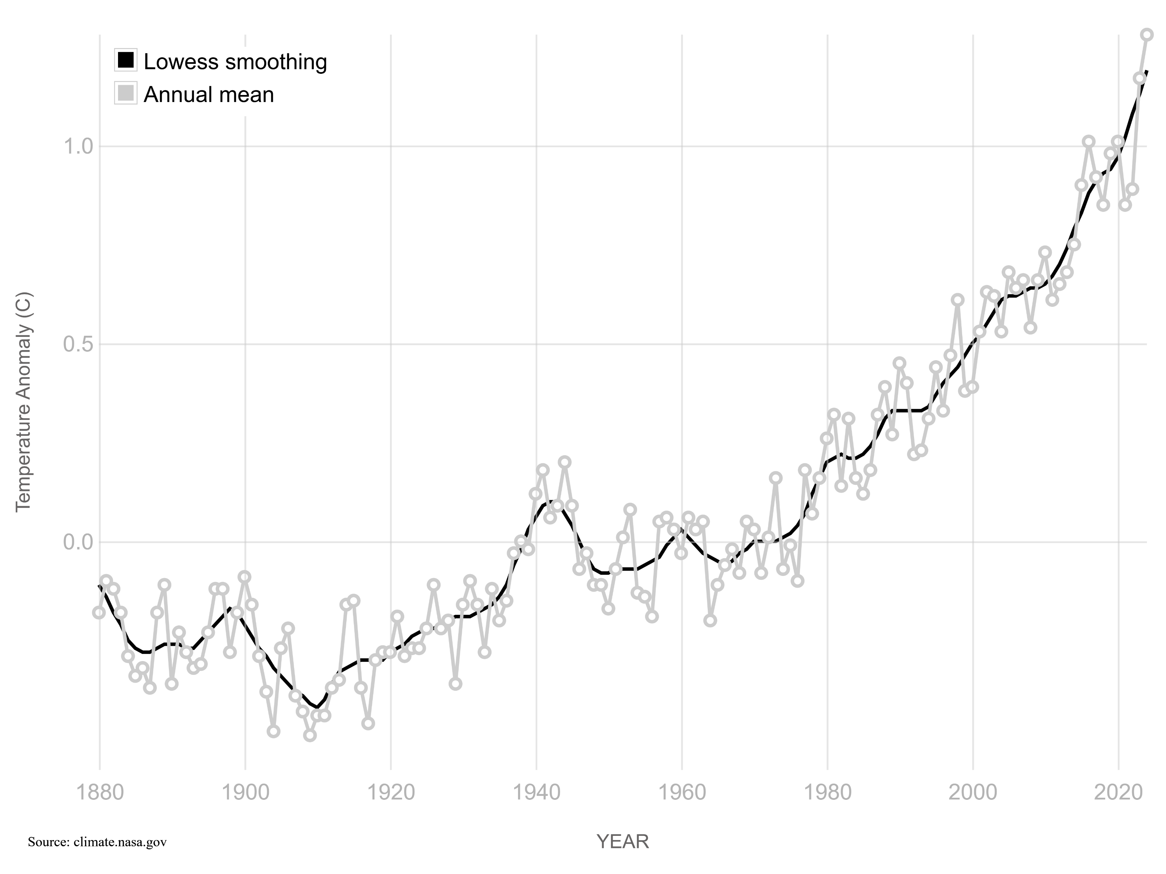
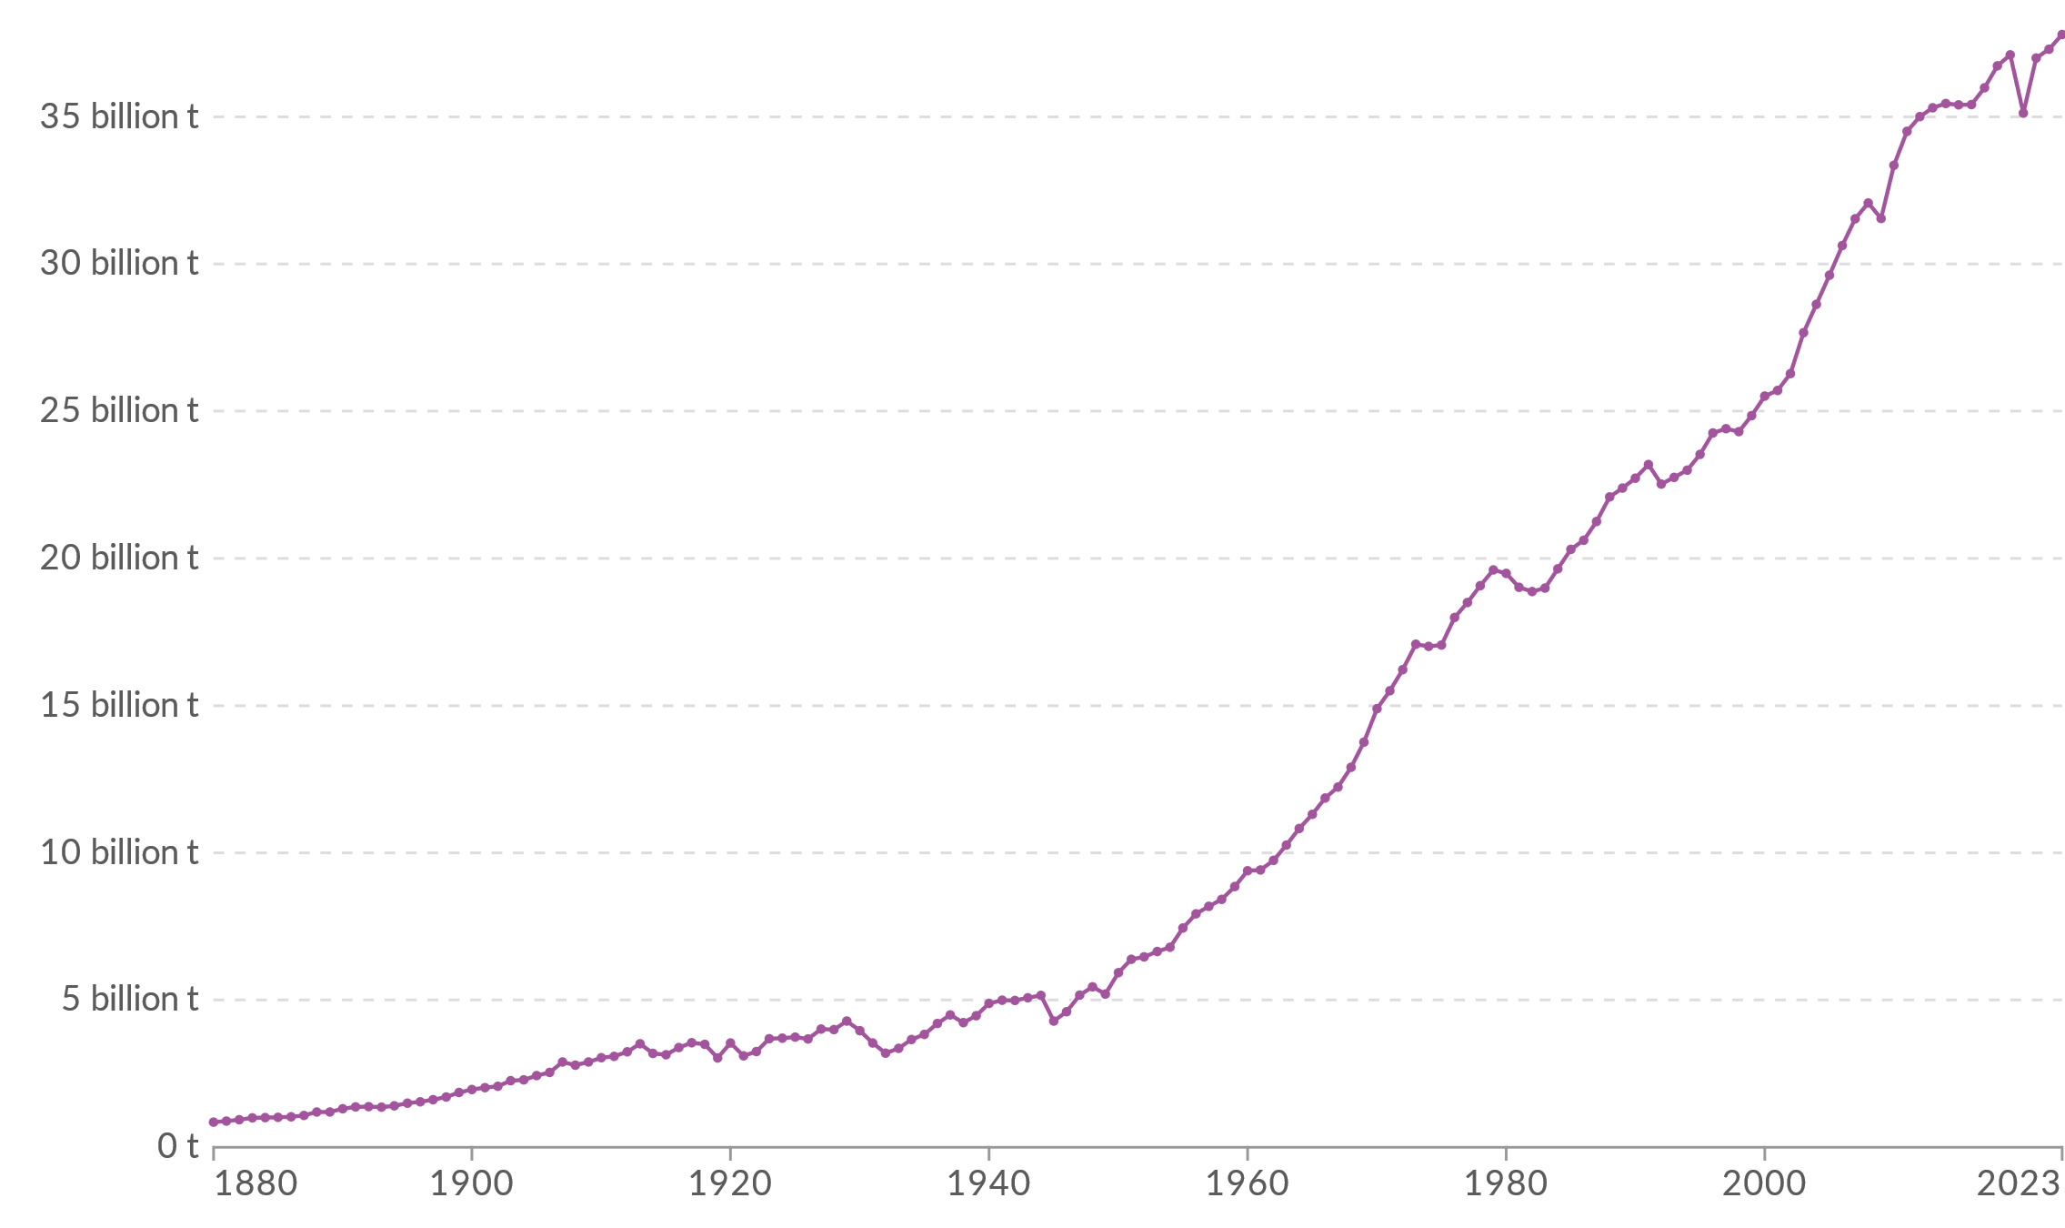
A
Global average surface temperature anomaly
B
Then, what happens to temperatures by 2100??
C
D
E
Your job: choose the letter that you bet is closest to the correct answer
2050
2100
Global CO₂ emissions
If, emissions are cut to zero by 2050
2050
2100

Slide 6
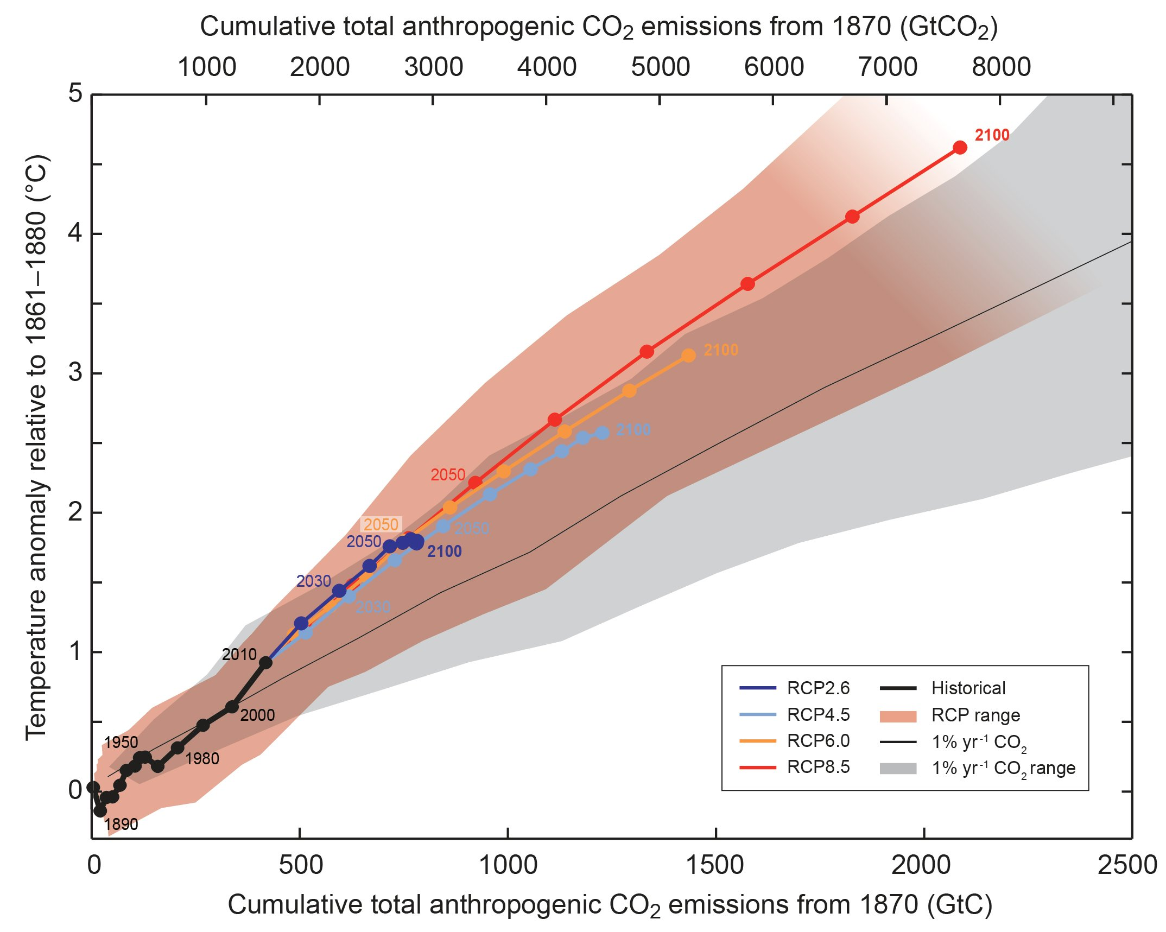
The first law of climate change:
Warming is proportional to cumulative emissions
Implications of first law
Net zero required if humans want a stable climate.
Stopping emissions stops it getting warmer but doesn't cool it back down.
Caveats
“Law” works best for this century, less accurate further out in time.
Even with net zero some things will keep getting worse—ice sheets.
Notes:
https://www.ipcc.ch/report/ar5/wg1/summary-for-policymakers/figspm-10/

Slide 7
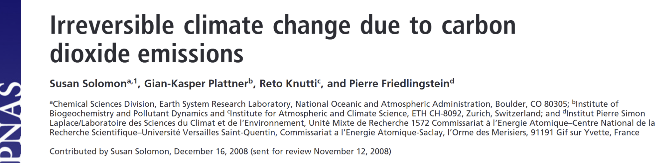
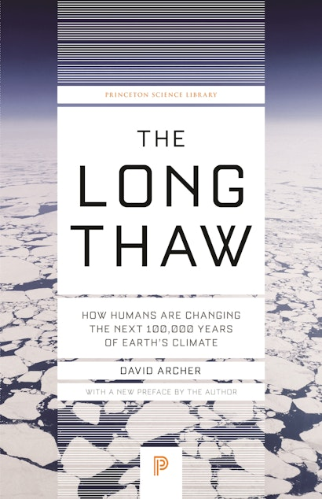
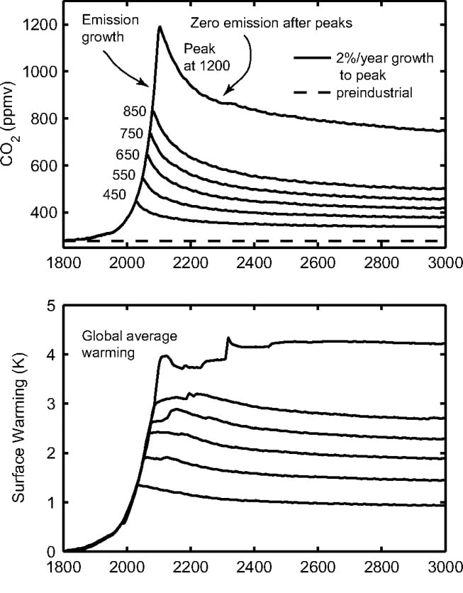
Emissions stop instantly at about twice pre-industrial.

Slide 8
Economy
Emissions
Concentrations
Climatic change
Impacts
Decarbonization
Carbon removal
Sunlight reflection
Adaptation
Decarbonization breaks the link between economy and emissions
Ex: solar, nuclear, wind, carbon capture and storage…
Carbon removal breaks the link between historical emissions and climate change
Ex: enhanced rock weathering, ocean alkalinity, direct air capture…
Sunlight reflection weakens the link between concentrations and climate change
Ex: stratospheric aerosols, marine cloud brightening, cirrus thinning…
Adaptation weakens the link between climate change and harm
Ex: solar air conditioning, climate-resilient agriculture, early warning…

Slide 9
Decarbonization ≠ Carbon Removal (CDR)
Counterpoint: 1 not emitted = 1 ton emitted + 1 ton removed
(only until net zero)
Technology
Decarbonization is (mostly) about suppling energy without CO₂ emissions– Solar, Nuclear, Wind and electrification of transportation.
CDR is (mostly) about manipulating Earth’s biogeochemistry or injecting atmospheric carbon underground.
Counterpoint: All CDR methods use energy, some of the most scalable (DAC and open-ocean-alkalization) use a lot of energy → strong links between Decarbonization and CDR.
Policy
Energy markets have existed for centuries. Decarb can work by regulating these markets.
Fundamentally easier to make folks pay more for something they need than to make them pay for a diffuse public good like CDR.

Slide 10
Carbon Removal (CDR) ≠ Sunlight Reflection Methods (SRM)
Fact: 0.1 C cooling by SRM ≠ 0.1 C cooling by having less CO₂
Counterpoint: 0.1 C SRM ~ 0.1 C by less CO₂ – but only in the short term
Technology
CDR is (mostly) about manipulating Earth’s biogeochemistry or injecting atmospheric carbon underground. It’s would be a large-scale commodity tech involving gigatons/year.
SRM is about injecting just the right amount of special stuff in just the right place. Amounts can be very small, less that a megaton/year.
Cost of some methods so small as to be irrelevant.
Shared tech
Almost none. And energy use of SRM tech looks inconsequential.
Notes:
In the long run its utterly different because the CO2 is still in the air → long run risk of climate change + the bio- and geo- chemical impacts of CO₂.

Slide 11
Carbon Removal (CDR) ≠ Sunlight Reflection Methods (SRM) (2)
Policy
CDR has local risk + costs set against a nearly pure global benefit.
  Policy challenge is how to pay & local environmental impacts.
SRM has globally distributed benefit & costs/risks with almost no local costs/risks.
  Policy challenge is how to decide in a sharply divided world where many countries can deploy and where deployment may affect all.
Counterpoint: CDR & SRM both reduce climate change from historical emissions
Notes:
In the long run its utterly different because the CO2 is still in the air → long run risk of climate change + the bio- and geo- chemical impacts of CO₂.

Slide 12
SRM & CDR ≠ Adaptation
Counterpoint: Both SRM and CDR are like adaption in that they can reduce climate harms from historical emissions.
Some people want to call SRM “extreme adaptation”. Local SRM can reasonably be seen as a adaptative measure – e.g. marine cloud bighting (artificial haze) over great barrier reef.
Technology
Little connection other than Nature-Based Solutions that capture carbon and reduce local risks.
Policy
Adaptation has local costs set against local benefits and risks.
  It’s all local → minimal implications for global policy except for responsibility of emitters to pay for damages.
SRM and CDR both have globally distributed benefit & (for SRM) risks

Slide 13
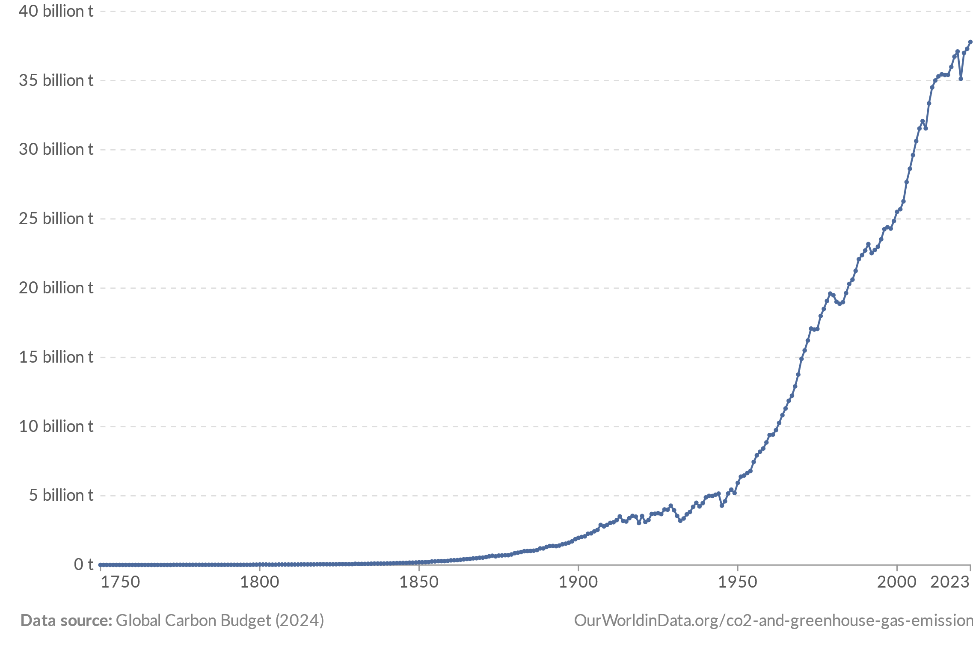
Decarbonization: is it hopeless?
“We are on a highway to climate hell with our foot on the accelerator”
- António Guterres, 2022
Global CO₂ emissions
Notes:
Show of hands. Will emissions be higher in 2030 than they are today???

Slide 14
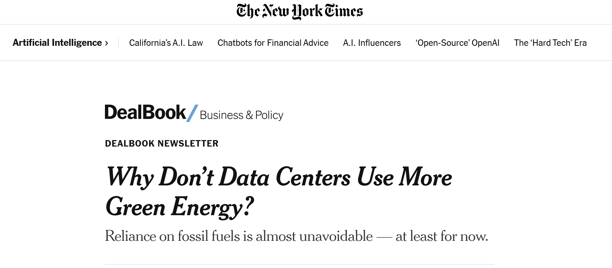

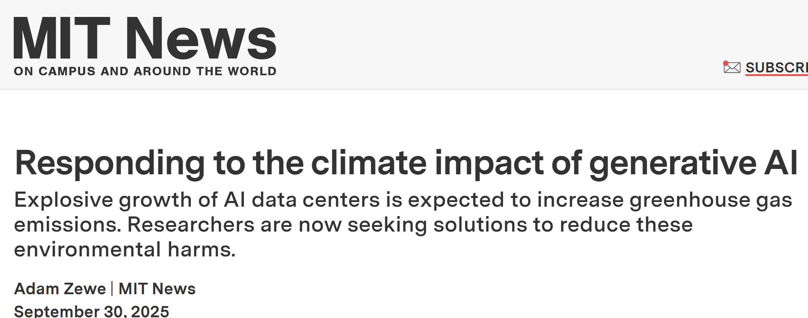
And AI will make it even worse…

Slide 15
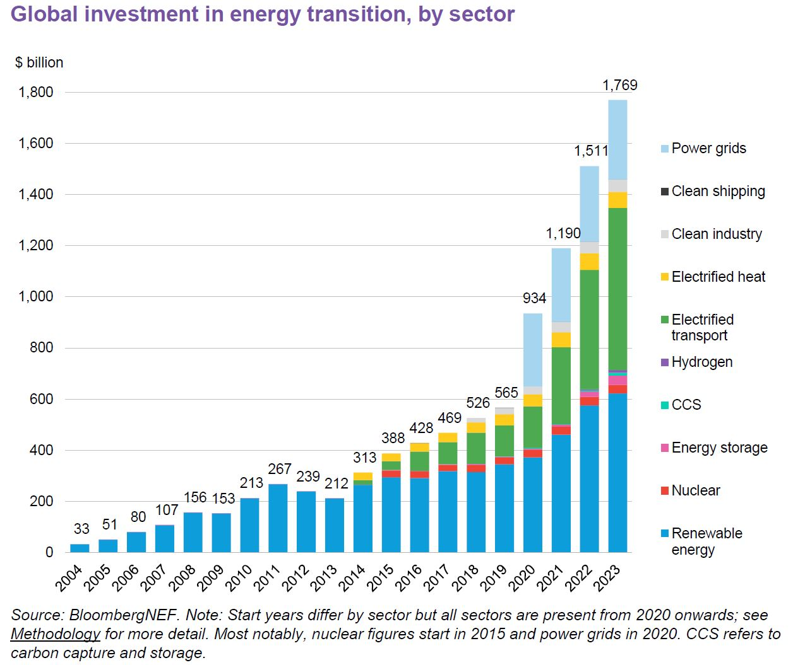
Or maybe not…
About 2% of worlds economy now spend to clean energy technologies
Notes:
data centres are currently responsible for just over 1% of global electricity demand and 0.5% of CO2 emissions, according to IEA data.
https://www.carbonbrief.org/ai-five-charts-that-put-data-centre-energy-use-and-emissions-into-context/

Slide 16
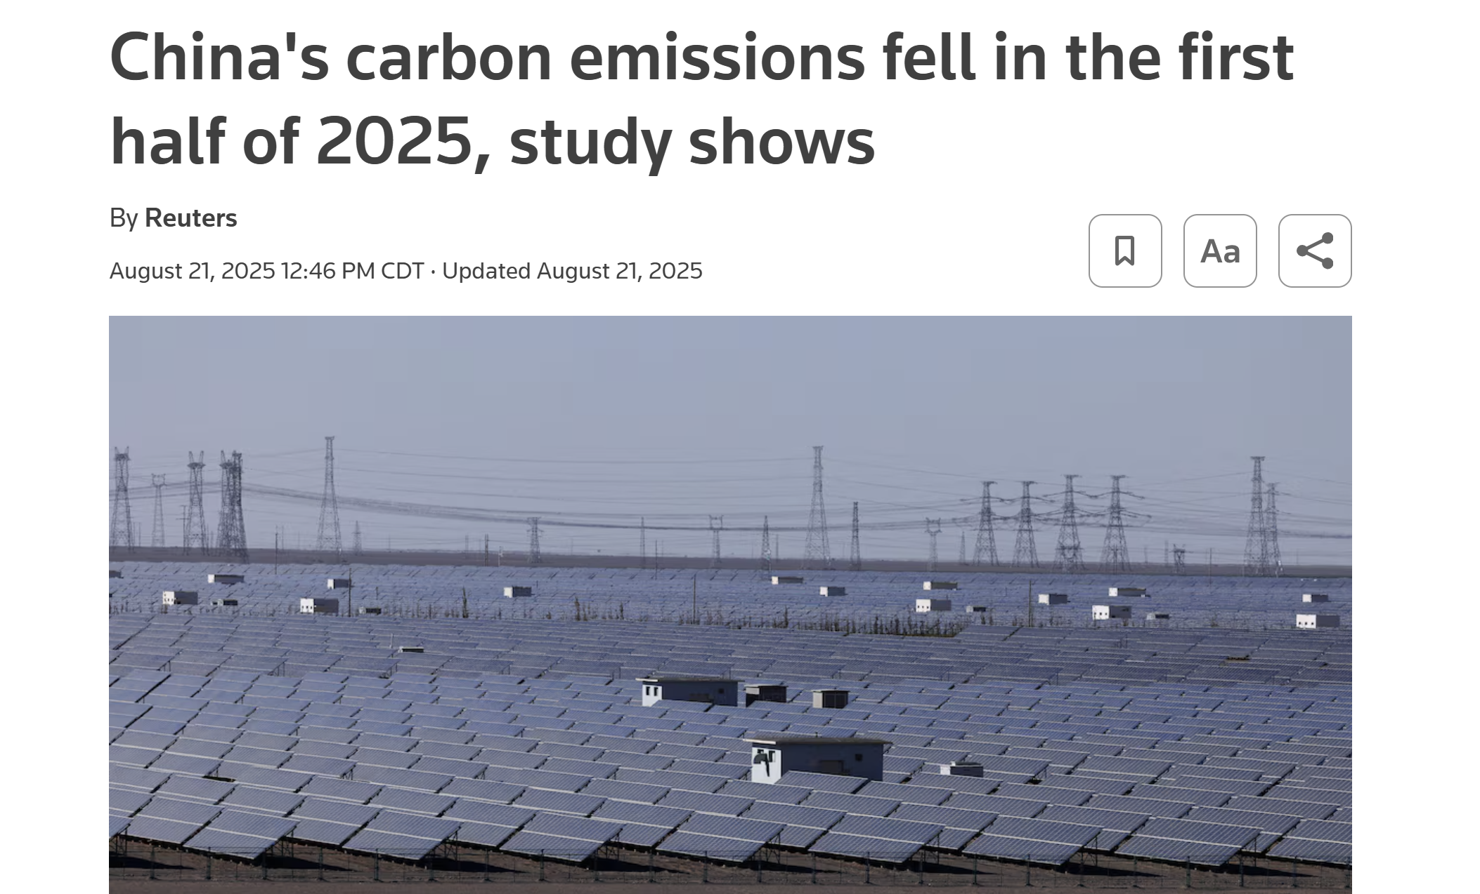
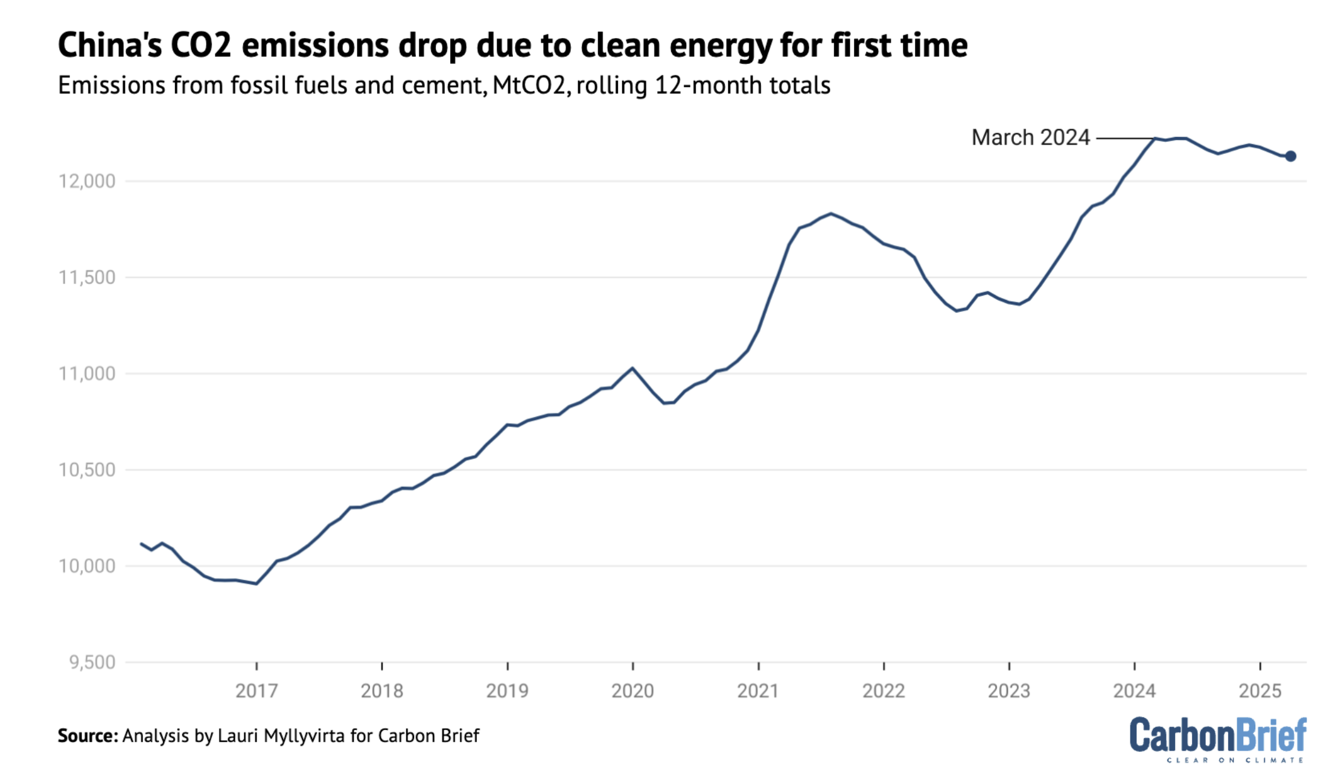
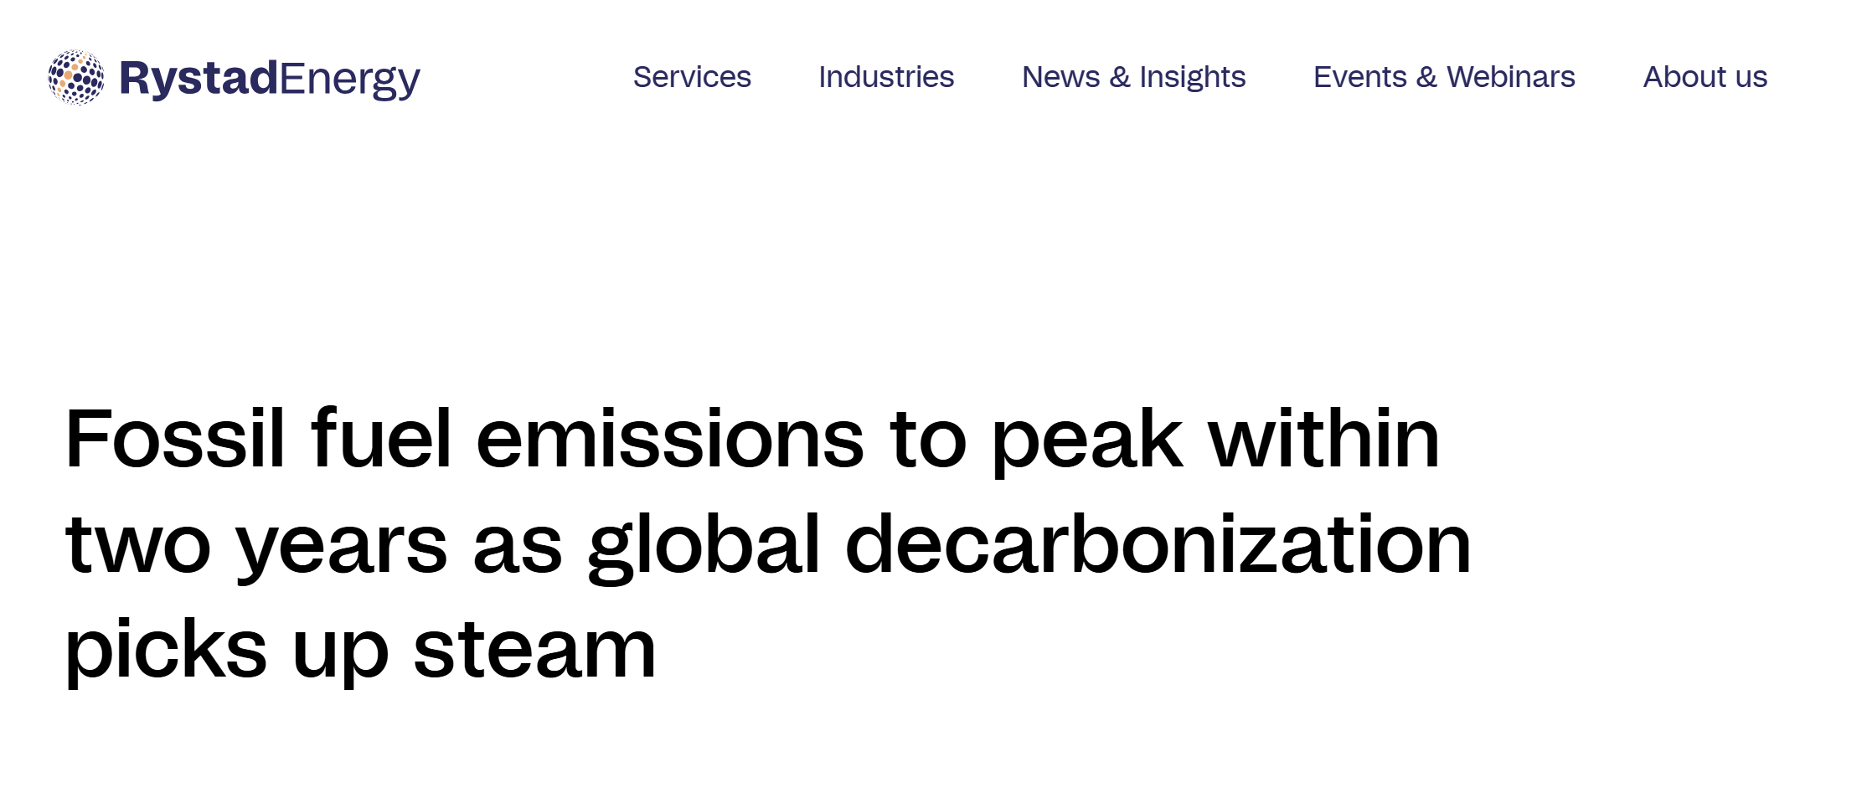
Notes:
https://www.rystadenergy.com/news/fossil-fuel-emissions-to-peak-within-two-years-as-global-decarbonization-picks-up

Slide 17


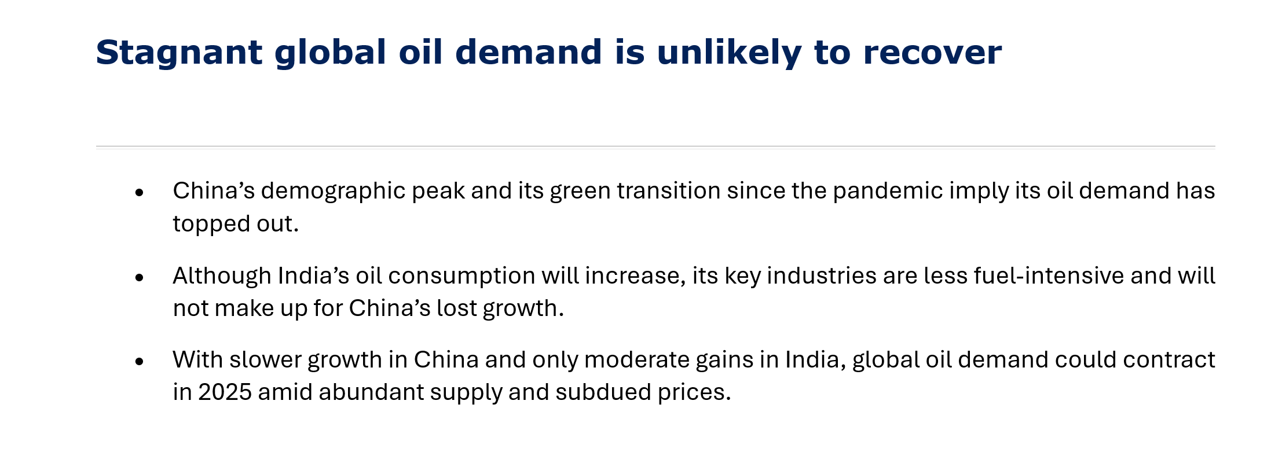

Slide 18
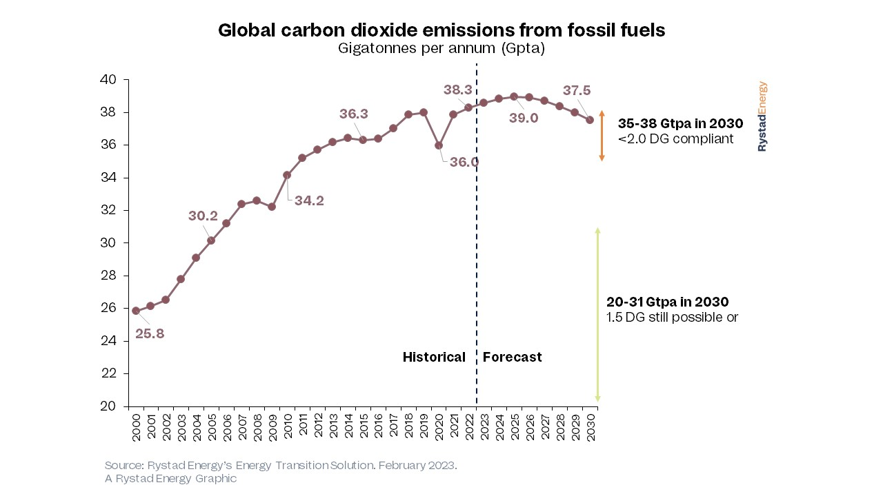
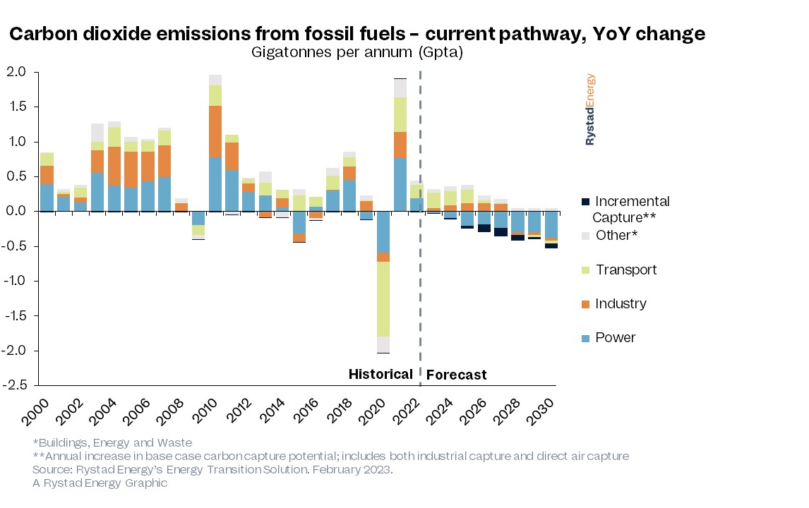
Rystad’s forecast
Notes:
https://www.rystadenergy.com/news/fossil-fuel-emissions-to-peak-within-two-years-as-global-decarbonization-picks-up

Slide 19
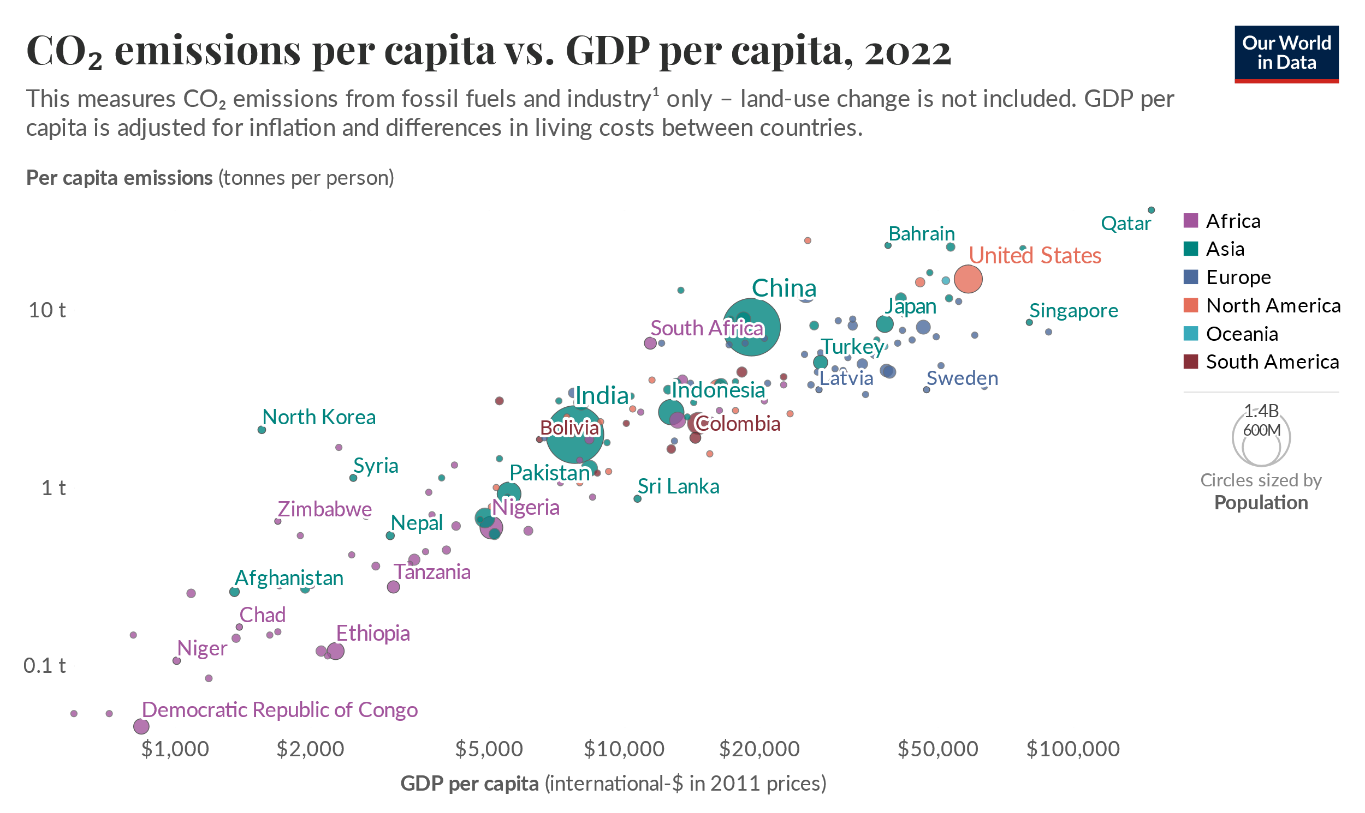
So what?

Slide 20
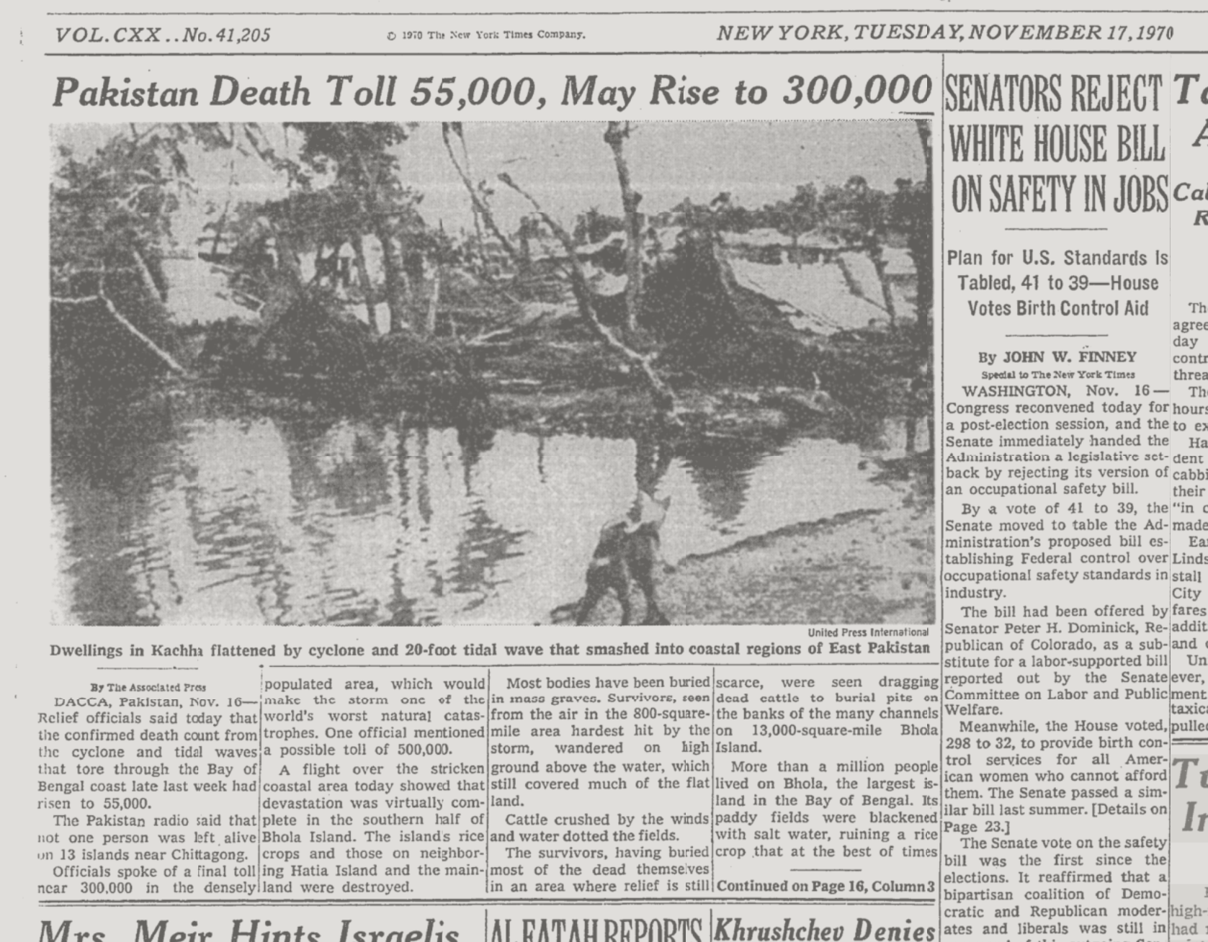
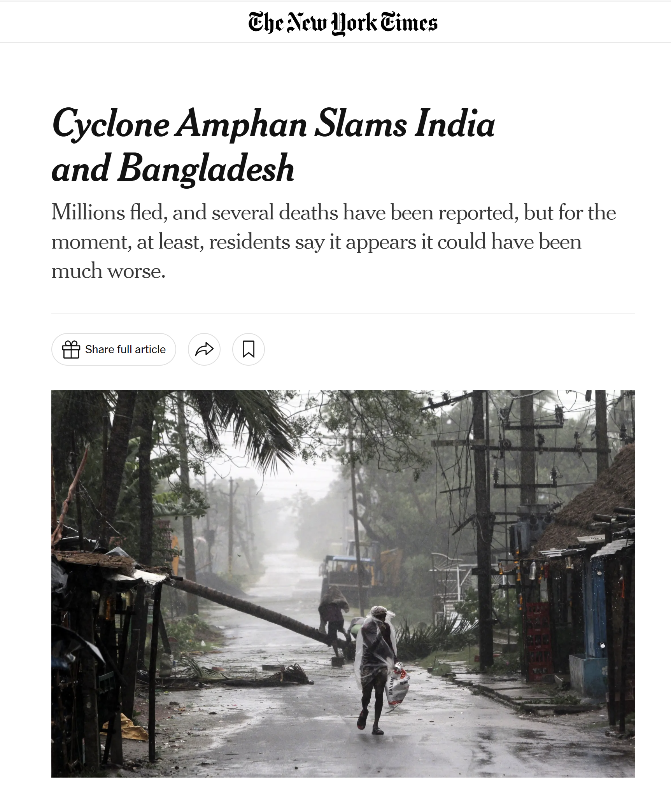
Cyclone Bhola, November 1970
Fatalities: ~0.5 million
Cyclone Amphan, May 2020
Fatalities: ~ 100
Notes:
killed roughly half a million people when it made landfall in the Ganges River delta on the 12th of November 1970 making it was the worst natural disaster since the Chinese floods of 1931. Natural disasters can shake governments: poor management of relief operations by Pakistan triggered a war which led to the formation of Bangladesh in 1971.
Amphan, the strongest cyclone to hit Bangladesh this century struck the same area in May 2020. It’s lodged in my mind, because it hit just four months after I visited costal Bangladesh where I was talking with local farmers and policy makers about storms, climate, and adaptation.
Amphan was no pussy cat, it had higher winds that Bhola although a somewhat smaller storm surge, yet it killed “only” about a hundred people. Accounting for the change in population at risk, Amphan was about ten thousand times less deadly than Bhola. Why? Bangladesh now as over twelve thousand cyclone shelters along with a network of phone based early warning. This is an example of climate adaptation, defined as deliberate adjustments to prevent human suffering made in response to actual or expected climate stimuli.
https://theconversation.com/bangladesh-has-saved-thousands-of-lives-from-a-devastating-cyclone-heres-how-139903

Slide 21
Climate is a 4-dimensional problem
Economy
Emissions
Concentrations
Climatic change
Impacts
Decarbonization
Carbon removal
Sunlight reflection
Adaptation
Notes:
Each has many sub types, much complexity but more-or-less every physical thing that humans can to do to reduce climate risk fits into one, and only one of these.
And, collapsing any two of these into one, removes an essential part of the problem.

Slide 22
What is Climate System Engineering?
Climate Systems Engineering applies insights from systems engineering and climate systems science to study technologies that might reduce the risks of accumulated greenhouse gases.
Systems Engineering
Climate Science
CSE
Notes:
Managing nature…

Slide 23
The Climate Systems Engineering initiative (CSEi)
CSEi applies insights from systems engineering and climate systems science to study technologies that might reduce the risks of accumulated greenhouse gases.
UChicago is hiring CSEi faculty: Applications are welcome from all relevant disciplines including the physical and biological sciences, social sciences, engineering, and humanities. See: https://climateengineering.uchicago.edu/opportunities/
CSEi research scope covers:
  Sunlight reflection methods (SRM)
  Open-systems carbon removal
  Glacial interventions
  Policy, ethics, and governance
CSEi is supported by UChicago, which has dedicated 10 full-time faculty positions and operating funds. CSEi has raised over $36 million in committed donations and research grants, funding 14 professors and research faculty.

Slide 24
 | Speakers | Topics
Oct 4 | Keith | Introductions. Climate in 4 Dimensions. Emissions are peaking. Adaptation. Climate in Context.
Oct 11 | Archer | Carbon cycle and natural geochemical processes as basis to understand carbon removal.
Oct 18 | Shaw | Scientific basis for predicting climate changes in response to emissions of greenhouse gases and aerosol pollution.
Oct 25 | Cael | Carbon removal, including ocean alkalinity enhancement, land-based methods, bioenergy with carbon capture, and direct air capture with storage.
Nov 1 | Keith | Sunlight Reflection Methods (SRM) Part 1: How to Reflect Sunlight, the history of SRM, and why stratospheric sulfur aerosols are most plausible now.
Nov 8 | MacAyeal & Keith | MacAyeal on science of glaciers and interventions to prevent glacial melt. Keith on developing DAC technologies at Carbon Engineering, and lessons for cleantech.
Nov 15 | Shaw & Keith | The climate responses to SRM, potential side effects, and what can be learned from past aerosol pollution, highlighting the limits and uncertainties of experiments.
Nov 22 | Keith & Shaw | The future of climate systems engineering, and climate engineering in context.

